Slide 1
Maltose and Maltotriose Use by Different Saccharomyces Clades
By: Jacob Jaminet
Mentor: Stephen Fong

Slide 2
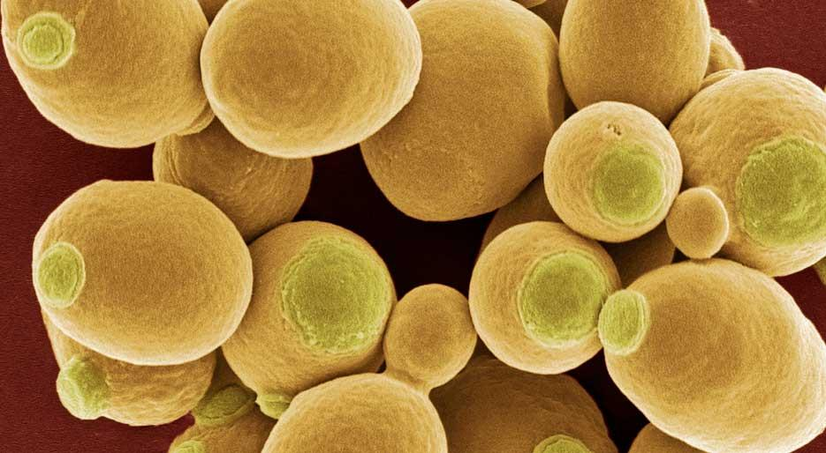
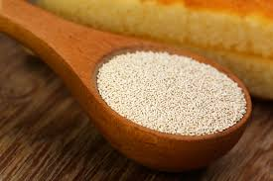
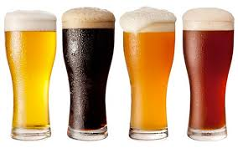
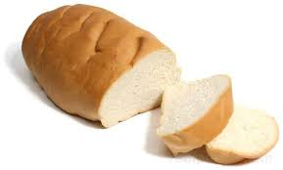
Saccharomyces cerevisiae
Notes:
Saccharomyces cerevisae = baker’s yeast
Been used for millenial for variety of purposes:
Preservation
Bread Making
Brewing

Slide 3
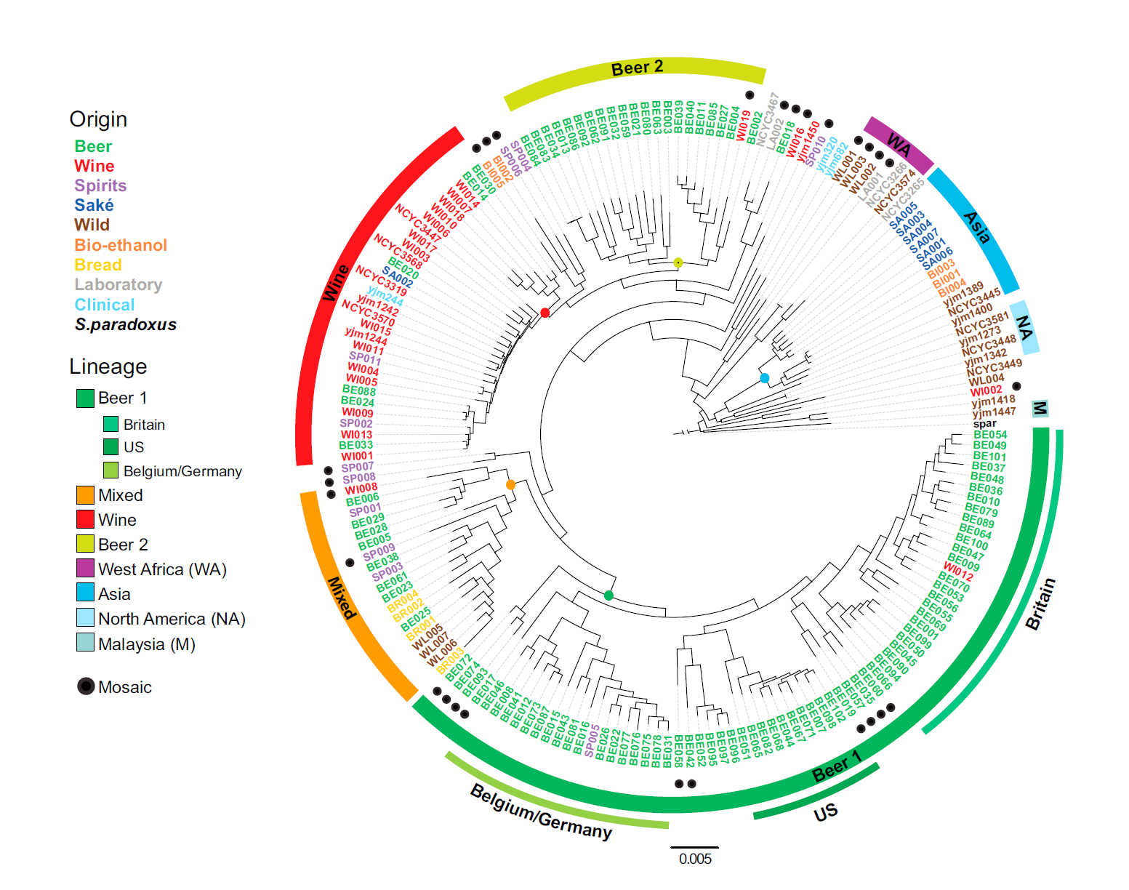
Clades
Diverged by geography and by culinary usage

Slide 4
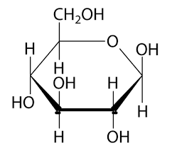
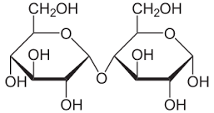
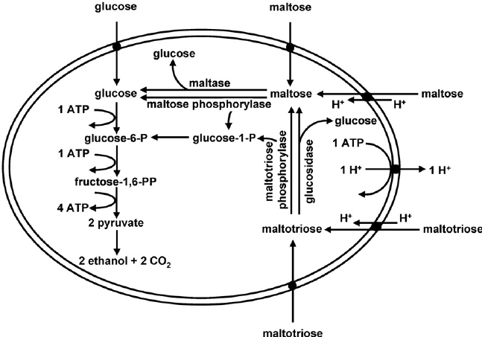
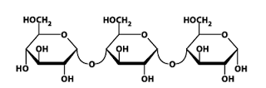
Beer Wort and Sugars
Glucose (~15%)
Maltose (~60%)
Maltotriose (~20%)

Slide 5
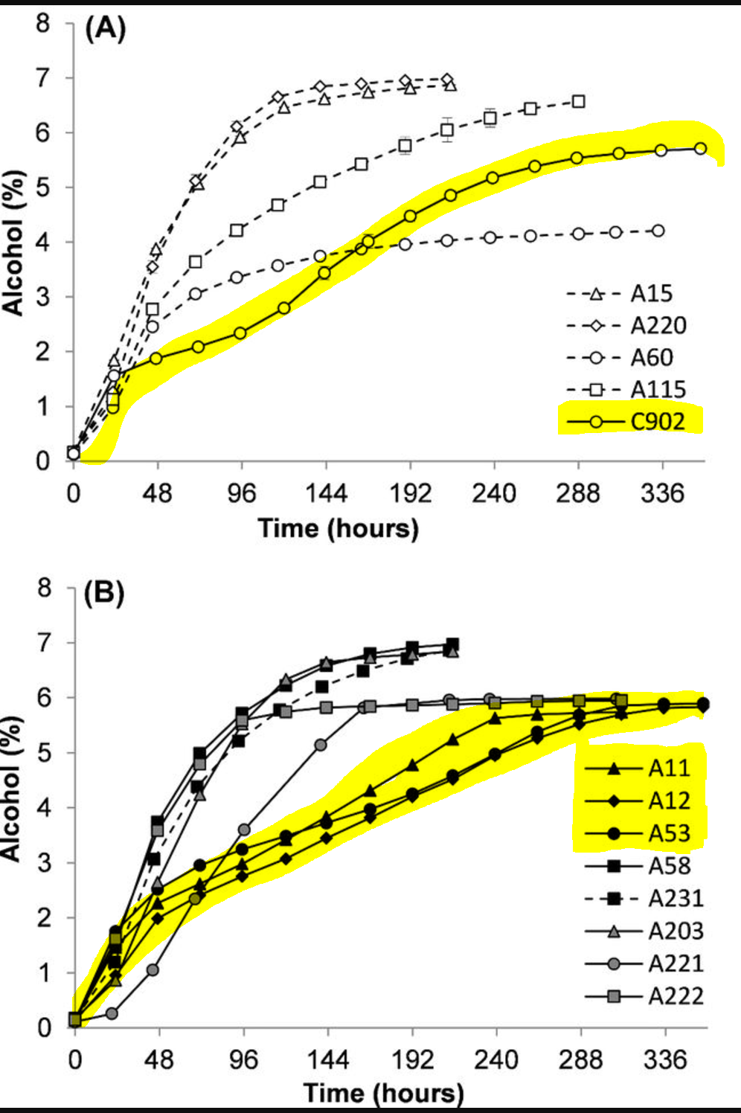
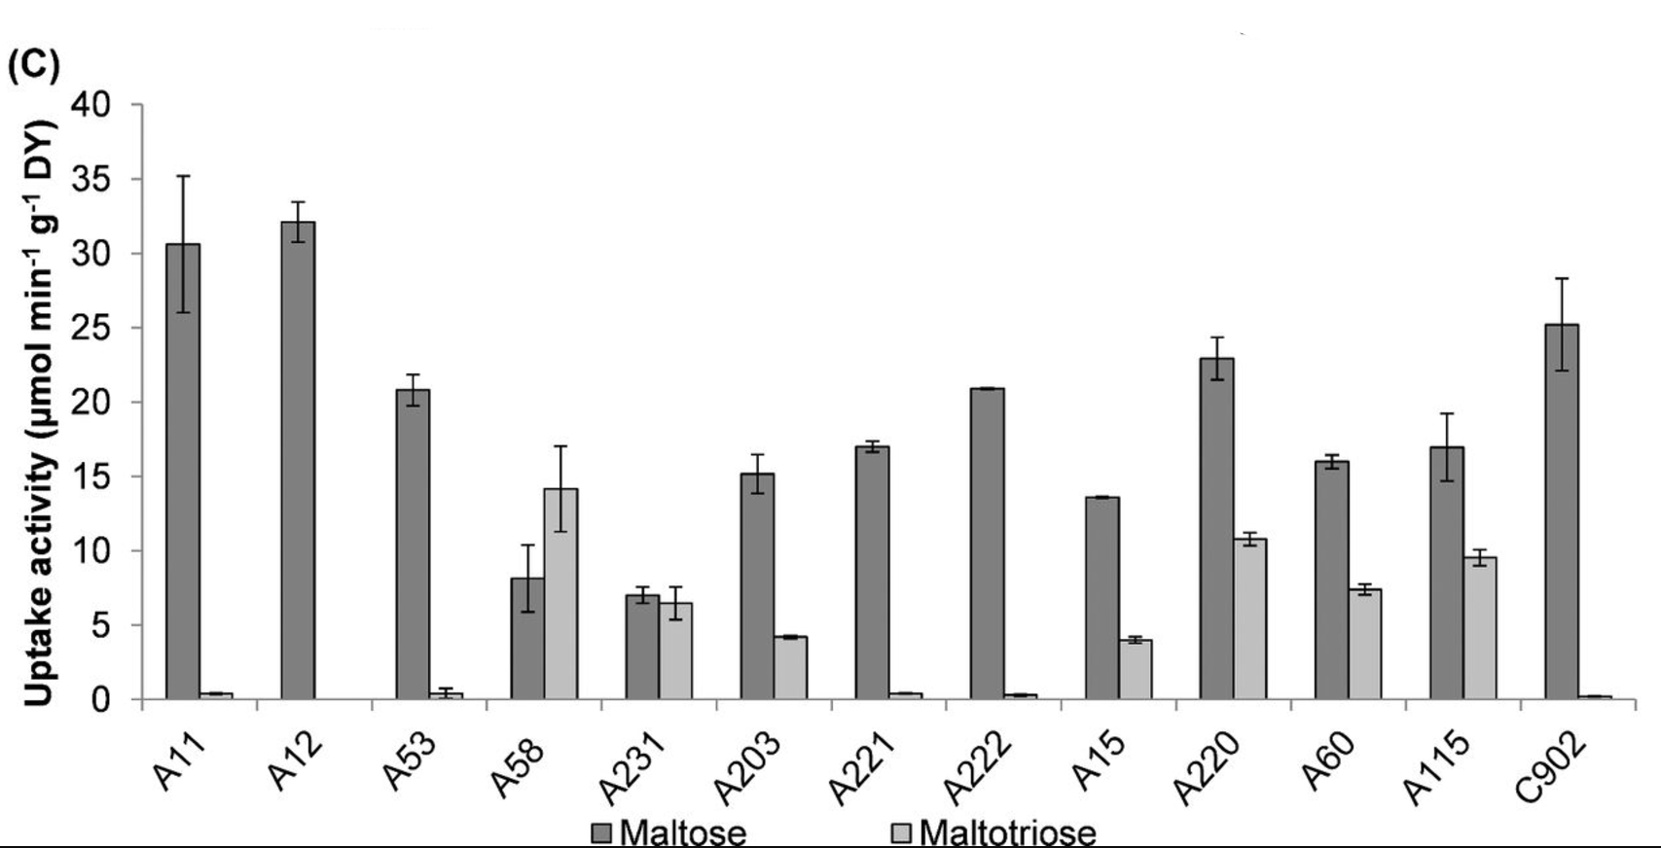
Is uptake the limiting reaction?
Higher activity did not necessarily ensure faster fermentation. In fact, strains with highest maltose uptake activity (Fig. 2C) were relatively slow fermenters (A11, A12, A53 and C902; Fig. 1).

Slide 6
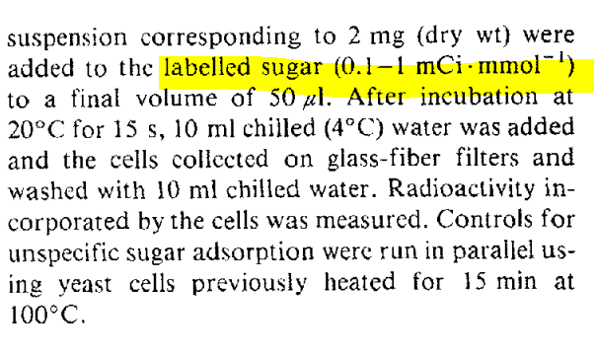
Measuring Uptake
Zero Trans
-Magalahaes et al.
-Alves et al.

Slide 7
Measuring Uptake
Proton Measurement
pH: 6

Slide 8
pH: 6
pH: 7
pH: 6

Slide 9
Re-Run with Proton
If they agree, something else is the rate limiter
If they disagree, one method is not accurate.
pH: 6

Slide 10
Impact
Understand how different clades use sugars
Taste
Efficiency
Glucose (~15%)
Maltose (~60%)
Maltotriose (~20%)

Slide 11
References
Gallone B Steensels J Prahl T Soriaga L Saels V et. al. Cell 2016 vol: 166 (6) pp:1397-1410.e16
Alves S L Herberts R A Hollatz D T Miletti L C de Araujo P S Stambuk B U App and Env Microbio vol: 74 (5) pp: 1494-1501
Magalhães F Vidgren V Ruohonen L Gibson B; Maltose and maltotriose utilisation by group I strains of the hybrid lager yeast Saccharomyces pastorianus. FEMS Yeast Res 2016; 16 (5): fow053. Doi:10.1093/femsyr/fow053

Slide 12
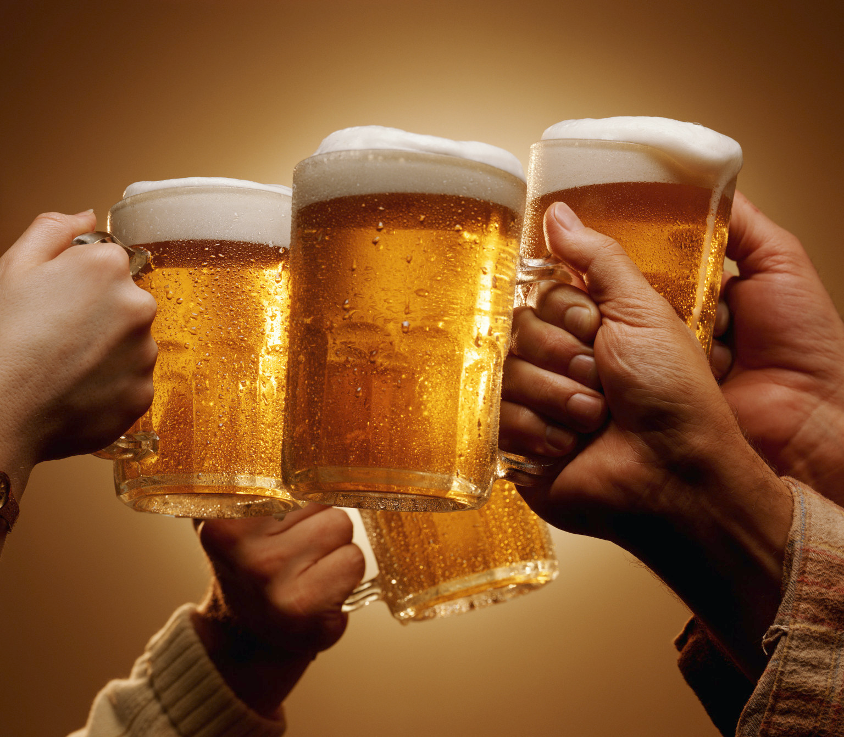
Cheers! / Questions?

