Slide 1
Mutations in MCL-1 PEST Region of Breast Cancer on Binding Affinity to Bak/Bax
Deeksha Jain

Slide 2
Introduction
Cancer is a disease of dysregulation resulting in unregulated growth and division of cells
Apoptosis is the process for mediated cell death of the resulting growth
BCL-2 proteins are key regulators of the apoptotic process
MCL-1 is an anti-apoptotic gene from within that family
Highly studied as human cancers have shown to have MCL-1 amplifications
Past studies indications
MCL-1 targeted drug treatments
Need to understand proper functioning of MCL-1 for targeted treatments and therapies

Slide 3
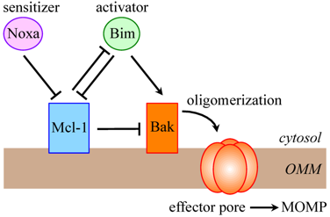
MCL-1 Significance
MCL-1 pathway
Difference between BCL-2 and MCL-1
Proline (P), glutamic acid (E), serine (S), and threonine (T) rich regions → PEST
Importance
Deletion and mutations within the region have been shown to affect anti-apoptotic functioning via mitochondrial localization
Affects apoptosis via ERK/BIM pathway
Question is, does this affect MCL-1’s ability to inhibit Bak/Bax directly?

Slide 4
Experimental Outline
MCL-1 KO, MCL-1 functional cell lines obtained from ATCC
Induce mutation via CRISPR/Cas9
Validate genome editing
Insert mutated gene into cell lines via lipofection
Purification of MCL-1 from cell lines
Biochemical assay for binding affinities

Slide 5
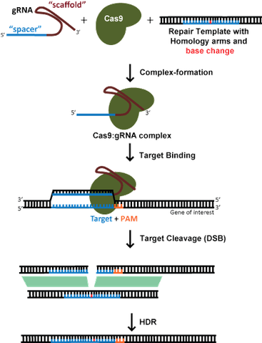
Mutation Introduction via CRISPR/Cas9
Clustered regularly interspaced short palindromic repeats (CRISPR)
CRISPR associated genes (Cas) → helicase and nuclease
Genome editing technology used for site directed mutagenesis for PEST region
Obtained from OriGene
Establish guide RNA + repair template via BLAST
Insert within CRISPR/Cas9 vector via electroporation
Electric field induces voltage across cell membrane → pores

Slide 6
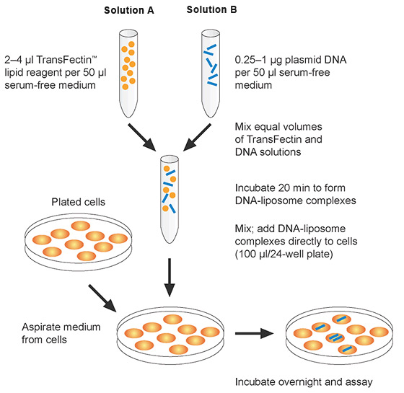
Validation + Lipofection Insertion
PCR, Gel Electrophoresis + Sequencing will confirm mutation
Add 6xhistidine tags via PCR (N-terminus)
Entry vector containing mutated MCL-1 gene needs to be inserted into cell line
Infection done via lipofection
Inject genetic material into cells via liposomes → merge cell membranes
Lipofectamine 2000 kit from Life Technologies
Transfection, change medium 24hrs, incubate 48
Stable tranfectants selected via Geneticin
Verify transgene expression via PCR and gel electrophoresis

Slide 7
Purification + Co-immunoprecipitation
Lyse cells and isolate MCL-1 via polyhistidine tags using QIAGEN Ni-NTA fast start protein purification kit
Bind his-tag bound protein to nickel resin, clear lysates, elute his-tag proteins
Co-immunoprecipitation is a technique of precipitating a protein antigen out of a solution using an antibody that binds to that specific protein. Analyzed via SDS-PAGE

Slide 8
Discussion
All goes well → binding affinity of MCL-1 for Bak/Bax will be decreased given mutations in PEST sequences → increased apoptosis
Other results → binding affinity increased or unaffected by specific mutation
Concerns
Formation of insertion/deletion during CRISPR/Cas9 in off-target locations
HDR v NHEJ
Can check via sequencing for effects in future studies
Hidden epitope ie no Ab recognition or pull through
Findings will help with MCL-1 specific targeting in drugs for targeted therapies
Decrease adverse effects of inhibition

Slide 9
References
Active Motif. Nuclear Complex Co-IP Kit. (n.d.). Retrieved April 2017, from https://www.activemotif.com/catalog/25/nuclear-complex-co-ip-kit
Addgene. CRISPR/Cas9 Guide. Retrieved April 2017, from https://www.addgene.org/crispr/guide/
BioRad. Chemical- and Viral-Based Transfection Methods. (n.d.). Retrieved April 2017, from http://www.bio-rad.com/en-us/applications-technologies/chemical-viral-based-transfection-methods
Demelash, A., Pfannenstiel, L. W., Tannenbaum, C. S., Li, X., Kalady, M. F., Devecchio, J., &
Gastman, B. R. (2015). Structure-Function Analysis of the Mcl-1 Protein Identifies a Novel Senescence-regulating Domain. Journal of Biological Chemistry,290(36), 21962-21975. doi:10.1074/jbc.m115.663898
Grabow, S., Delbridge, A., Aubrey, B., Vandenberg, C., & Strasser, A. (2016). Loss of a Single Mcl-1 Allele Inhibits MYC-Driven Lymphomagenesis by Sensitizing Pro-B Cells to Apoptosis. Cell Reports,14(10), 2337-2347. doi:10.1016/j.celrep.2016.02.039
Germain, M., & Duronio, V. (2007). The N Terminus of the Anti-apoptotic BCL-2 Homologue MCL-1 Regulates Its Localization and Function. Journal of Biological Chemistry,282(44), 32233-32242. doi:10.1074/jbc.m706408200
Mojsa, B., Lassot, I., & Desagher, S. (2014). Mcl-1 Ubiquitination: Unique Regulation of an Essential Survival Protein. Cells,3(2), 418-437. doi:10.3390/cells3020418
Sharma, S., Javadekar, S. M., Pandey, M., Srivastava, M., Kumari, R., & Raghavan, S. C. (2015). Homology and enzymatic requirements of microhomology-dependent alternative end joining. Cell Death and Disease,6(3). doi:10.1038/cddis.2015.58
Thomas, L. W., Lam, C., & Edwards, S. W. (2010). Mcl-1; the molecular regulation of protein function. FEBS Letters,584(14), 2981-2989. doi:10.1016/j.febslet.2010.05.061

Slide 10
Questions

