Slide 1
Measurement of Changes in Force Generation of Cardiomyocytes through the Down Regulation of Vinculin using CRIPR-Cas Gene Editing
Fadi Hijaz
Virginia Commonwealth University
Center for the Study of Biological Complexity

Slide 2
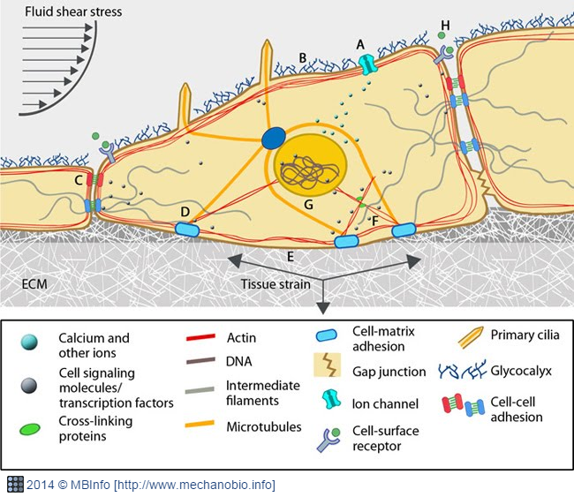
Mechanobiology
Cells are intrinsically mechanosensitive
Experience externally & internally applied forces
Force Dictates…
Development
Gastrulation
Disease

Slide 3
Role of the Cytoskeleton
DOI: 10.1152/ajpheart.00816.2005

Slide 4
A Mutation & the Effect
Dilated Cardiomyopathy (DCM)

Slide 5
Vinculin
https://doi.org/10.1016/j.febslet.2013.02.042

Slide 6
The Experiment!
Provide functional analysis of cardiomyocytes which have had the expression of vinculin mutated through the application of…
CRISPR-Cas9 Gene Editing
Traction force measurement with a microfabricated postarray deflection device (mPAD)

Slide 7
CRISPR-Cas9 to induce a Vinculin knockout
Genomic manipulation requires only :
- the Cas9 protein and
- an engineered small guide RNA (sgRNA) with a PAM sequence upstream of target complementary sequence
Base-pairing between the sgRNA and target DNA causes double-strand breaks due to the endonuclease activity of Cas9
Agrotis et al. (2015)
DOI=10.3389/fgene.2015.00300

Slide 8
mPADs and the Functional Analysis Experiment

Slide 9
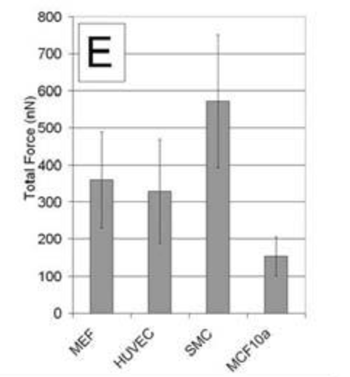
Results we expect to see…
PMCID: PMC1480360

Slide 10
Questions and Comments

