Slide 1
The role of microglia in regulating axon initial segment integrity in health and disease

Slide 2
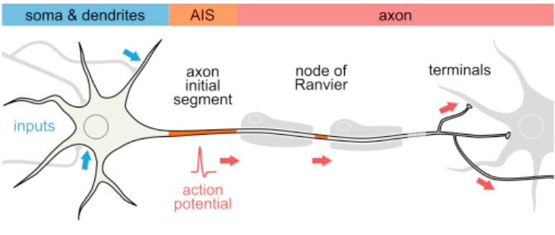
Multiple Sclerosis

Slide 3
The axon initial segment (AIS)
Demyelination vs. AIS
Inflammation

Slide 4
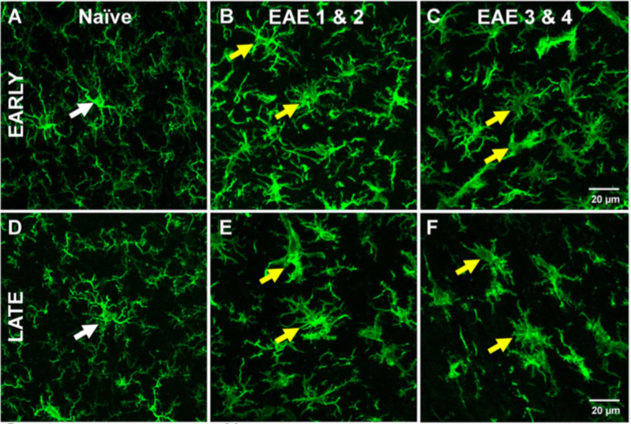
Microglia
Surveying (non-reactive)
Reactive

Slide 5
Microglia vs. AIS
In healthy subject (Baalman et al. 2015)
In EAE//MS (Clark et al. 2016)
In brain injury (TBI)

Slide 6
Focus
Do surveying microglia support the AIS?
Do reactive microglia damage the AIS?

Slide 7
Experiment
Remove microglia
Examine consequence to AIS: length, number, function
Healthy
Surveying microglia may support AIS → no surveying microglia → decrease health AIS?
Brain Injury (TBI)
Microglial activation follows TBI
Remove microglia → no reactive microglia → reduce damage to AIS?

Slide 8
Removal microglia
(Cre)/LoxP ablation
colony stimulating factor 1 receptor (CSF1R)
“floxed” mouse
Cre-ER mouse
confocal microscopy//IBA-1 immunostaining

Slide 9
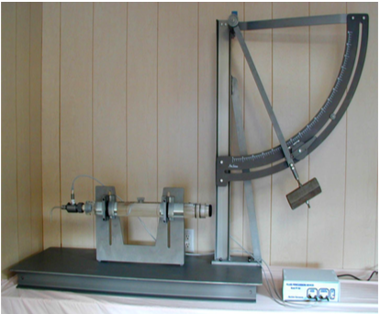
Method TBI
Controlled cortical impact

Slide 10
Groups
8 groups
Microglia knockout and TBI vs. No microglia knockout and TBI
Microglia knockout and no TBI vs. No microglia knockout and no TBI
3 days and 7 days post microglia knockout

Slide 11
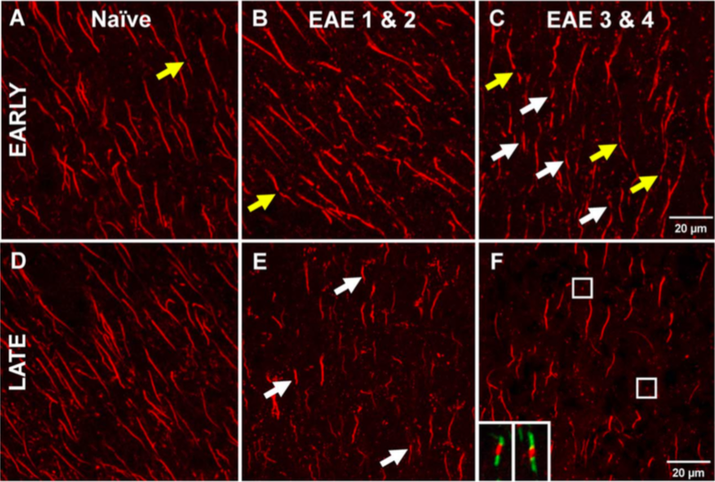
AIS analysis
length and number
Function (EP)

Slide 12
Discussion
Healthy (no TBI) mice
Surveying microglia support AIS
TBI mice
Small population surveying microglia supports
Small population reactive microglia disrupts
Desired result
Remove microglia in health → AIS disruption
Remove microglia in TBI → attenuate AIS disruption

