Slide 1
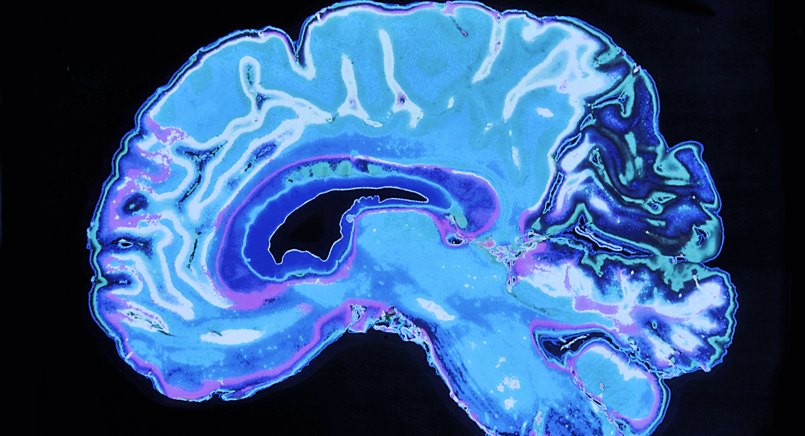
THE PATH TO THE BRAIN
Transendothelial Leukocyte Migration
And Scientific Writing
Sailasya Gundlapudi
BNFO 301

Slide 3
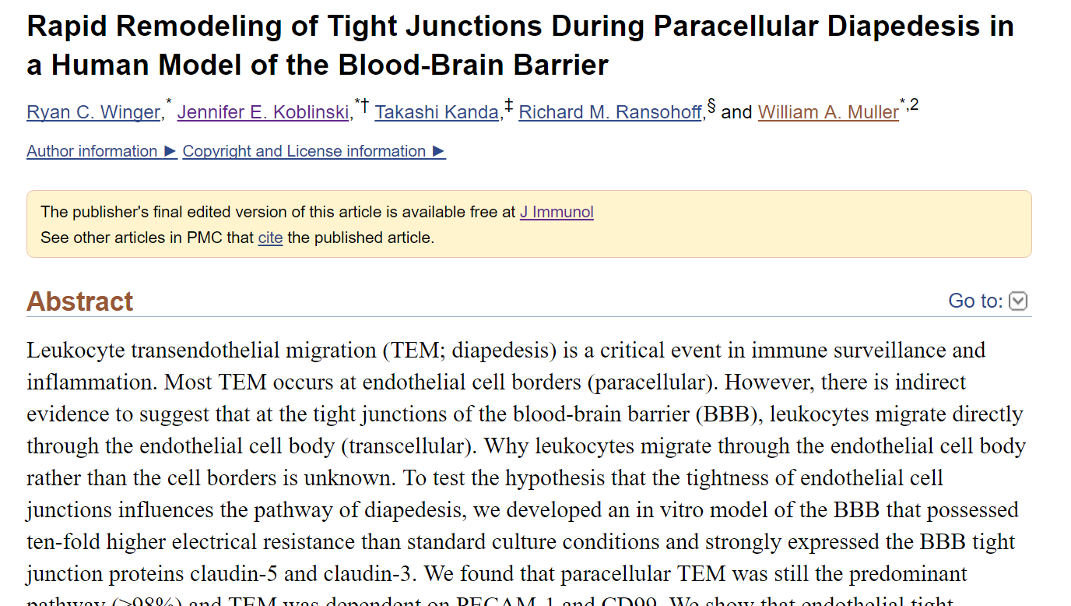
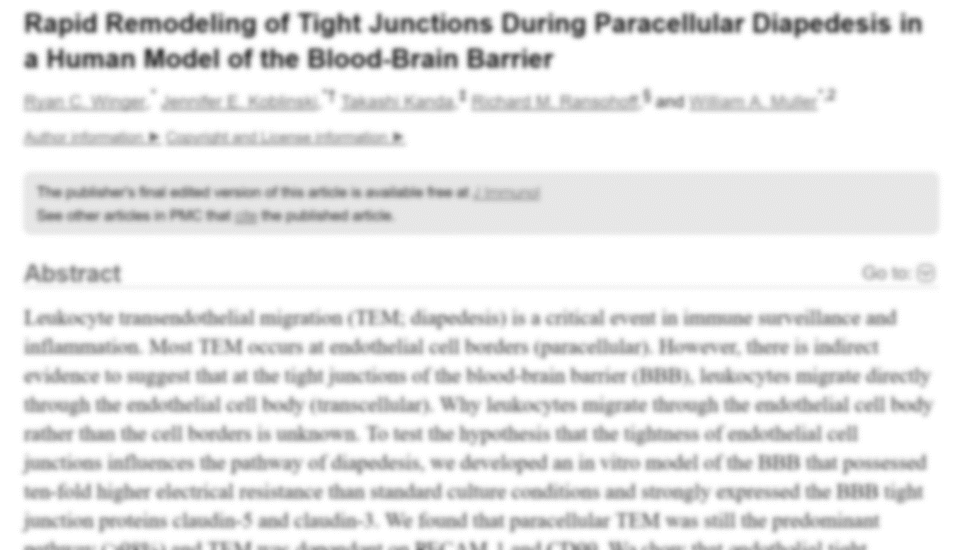
https://lasyagundlapudi.wixsite.com/leukocytemigration

Slide 4
How does anything reach the brain?
Important decisions are made in the brain
Blood Brain Barrier protects the brain
Endothelial cells line the blood brain barrier

Slide 5
The Importance of Leukocytes
White blood cells
Fight infection
Linked to multiple sclerosis, stroke, and other neurological disorders

Slide 6
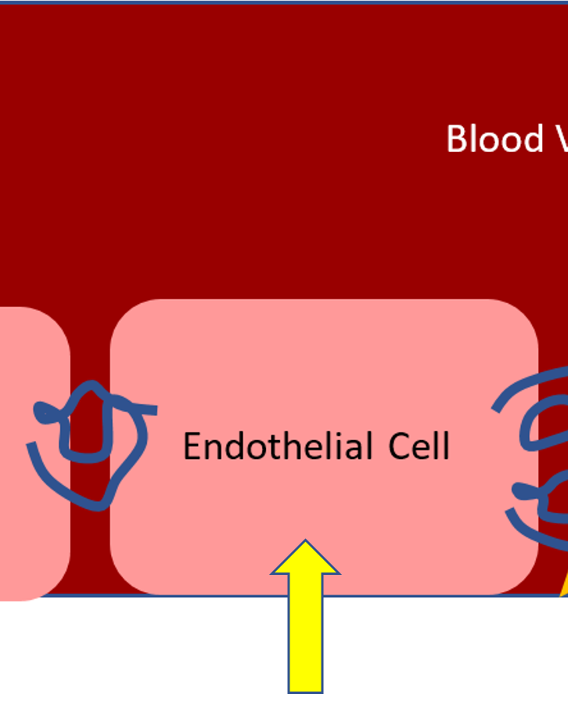
How do Leukocytes cross Endothelial Cells?
Paracellular Migration
Transcellular Migration
The smaller the gap between endothelial cells, the more likely leukocytes would migrate transcellularly.

Slide 7
Making a Model of the Blood Brain Barrier
+ CPT-CAMP + Astrocytes

Slide 8
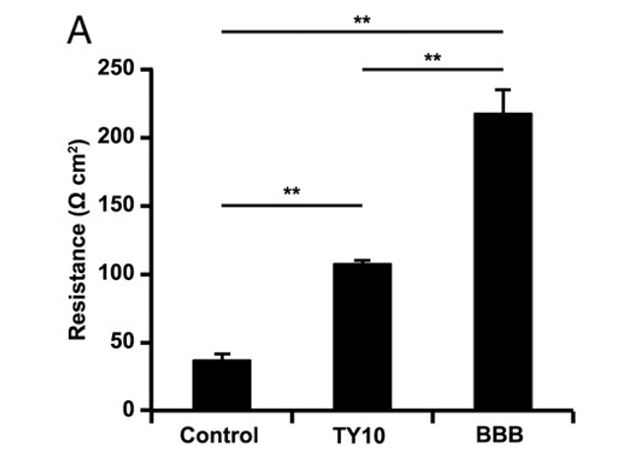
Does the model represent the blood brain barrier?
Flourescein Isothiocynate Dextran Permeability
Trans endothelial electrical resistance (TEER)
Fluorescent polysaccharide
Measured how much permeated the barrier

Slide 9
Paracellular vs. Transcellular Migration
Experiment 1: How many leukocytes migrate through the cell vs. in between the gaps?
Two groups of cell models
Migration for one hour

Slide 10
PECAM-1 and CD99 as signaling molecules
What else influences leukocyte migration?
PECAM-1 and CD99
Signaling molecules
Speculated to encourage leukocyte migration
Separate groups of cell models
One group: anti-PECAM and anti-CD99
Other group: control
Claudin-5 staining

Slide 11
Leukocytes Migrate Paracellularly
In the end, how did leukocytes migrate across the endothelial cells?
>98% migrated paracellularly
But happens to tight junctions during migration?

Slide 12
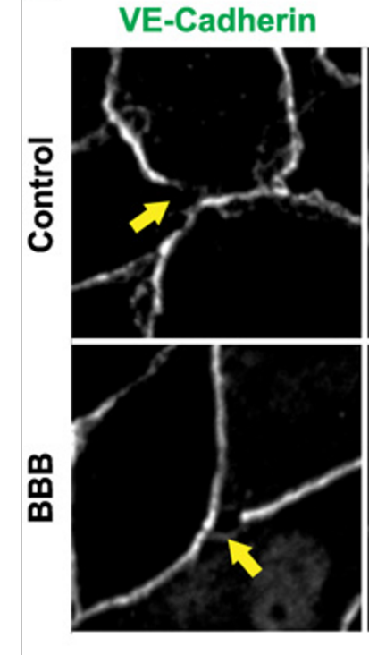
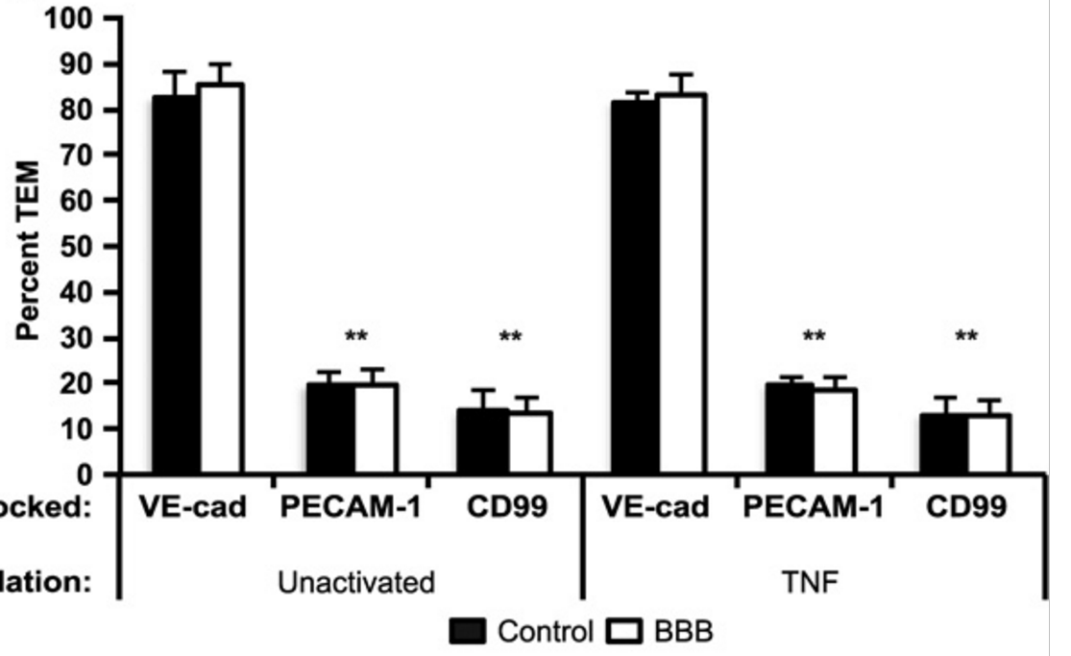
Tight Junctions Reform During TEM

Slide 13
Paracellular Migration is Dominant; Tight Junctions are Plastic
Leukocytes migrate paracellularly even when endothelial cells are tightly packed together
Tight junctions in endothelial cells reform themselves to accommodate incoming molecules
Blocking PECAM-1 and CD99 could drastically reduce trans endothelial leukocyte migration
Pieced together, these results could potentially lead to a method of controlling leukocyte migration to the brain and, eventually, treating the multiple neurological diseases that it causes.

Slide 14
QUESTIONS

