Slide 1
The Role of phospholipase-C β1 in intracellular calcium release in smooth muscle contraction
Neel Gohil

Slide 2
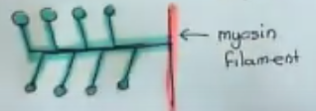
What is smooth muscle contraction (SMC)?
When myosin filaments move towards the dense bodies on their sides resulting in dense bodies coming closer to each other

Slide 3
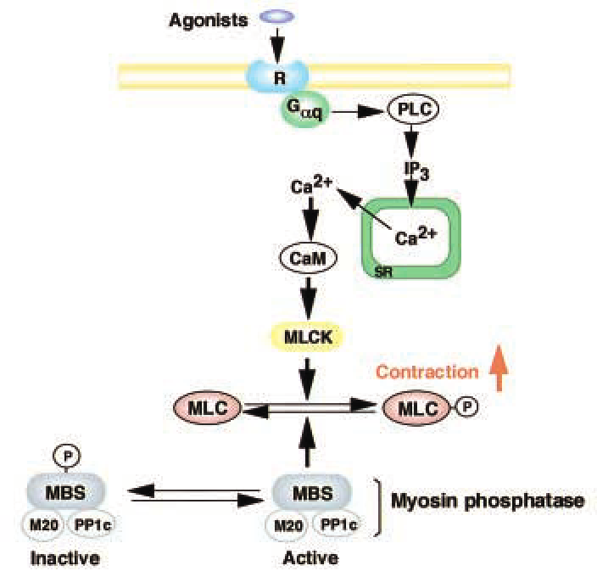
Role of intracellular calcium in SMC?
Rise in intracellular calcium leads to activation of further processes that at the end result in contraction

Slide 4
Role of phospholipase C- β1 (PLC-β1)
Cleave the bond between phosphatidylinositol 4,5-bisphosphate (PIP₂) and lipid bilayer
How does PLC-β1 effect intracellular calcium release?

Slide 5
Gene Knockout cell line
PLC-β1 knockout mice will be obtained from
heterozygous mice
Smooth muscle tissues (myocytes) will be
isolated

Slide 6
Fluo-4 dye

Slide 7
Fluo-4AM dye
The dye is now able to enter the cell due to no ionization

Slide 8
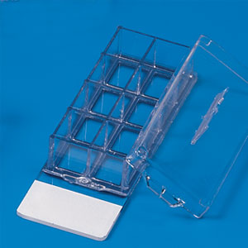
Experiment Procedure
Fluo-4 AM solution will be mixed with a buffer solution
Myocytes will be placed in a chamber slide
Fluo-4 solution will be added to the slide and incubated
Non-specific esterase

Slide 9
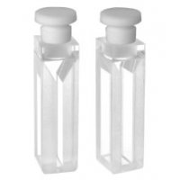
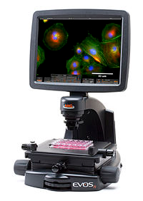
Experiment procedure (micro-fluorometer)
Myocytes will be placed in micro-fluorometer
Laser pointed at 485nm
images analyzed using ImageJ software on an inverted LCD microscope

Slide 10
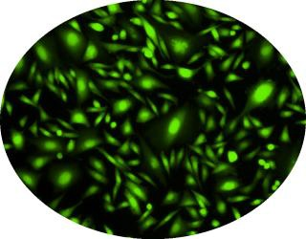
Experiment procedure (F_{min})
Triton X-100 (detergent) will be added to lyse myocytes
BAPTA will be added to bind to calcium
Fluorescence will be imaged using inverted microscope with LCD monitor

Slide 11
Experiment procedure (F_{max})
Calcium in the form of CaCl₂ will be added to the solution
Saturation of BAPTA
Increase in fluorescence

Slide 12
Discussion
It is anticipated that there will be an increase in Ca2+ release in myocytes from wild type mice in response to ACh and that there will be no Ca2+ release in myocytes from PLC-β1 KO mice. This is because there will be no PIP2 hydrolysis, and IP3 release in PLC-β1 KO mice.
Understanding the role of these enzymes will help us understand the regulation of smooth muscle contraction and how to address problems related to lack of or unregulated contraction of the smooth muscle.

Slide 13
Questions?

