Slide 1
Tbx5 Dominant Negative Protein Inhibiting Myocardial Regeneration in Zebrafish
Joshua Fung
BNFO300
5/3/17

Slide 2
Introduction
61,000 people die of cardiovascular disease per year
Possible solution: Heart Regeneration
Zebrafish: one of few organisms that possess this ability
Tbx5: expressed in heart development
Dominant Negative

Slide 3
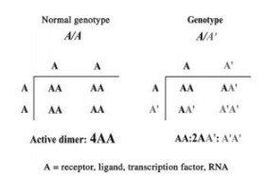
Dominant Negative
mutation that alters protein so it interferes with function of wild-type protein produced by other allele
Figure1. Veitia RA., 2007

Slide 4
Methods
Tbx5 Dominant Negative construction
Transgenic line: Tg(bactin2:loxP-mTagBFP-STOP-loxP-mCherry-2a-EnR-tbx5)

Slide 5
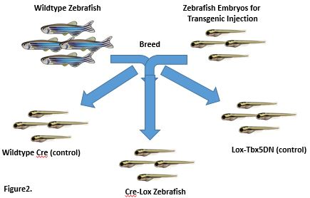
Methods

Slide 6
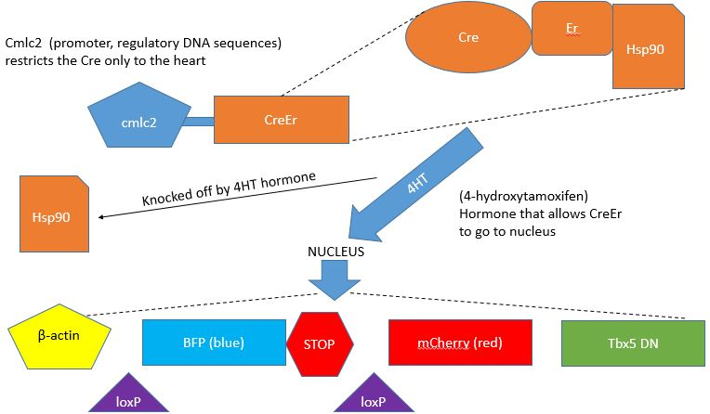
CreLox Recombination

Slide 8
Methods continued
Ventricular resection surgery
Euthanization
Perfusion
Cryosectioning
Acid Fuchsin-Orange G Staining

Slide 9
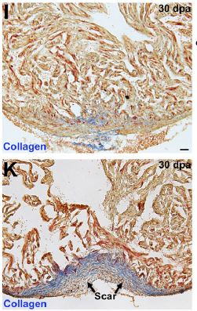
Results
if all goes well, one of two things can happen:
Resected hearts scar or regenerate
- Scarring indicates tbx5DN inhibits regeneration and that tbx5 is necessary
- Successful regeneration indicates that tbx5 is not necessary for heart regeneration
Figure5. Gupta et al, 2013

Slide 10
Synthesis and recap
Expressing tbx5DN vs conditional knockout
If conditional knockout approach was used, which would be the “real” results

