Slide 1
Creating zebrafish models of novel NRAP variants using CRISPR/cas9
Ryan Duong

Slide 2
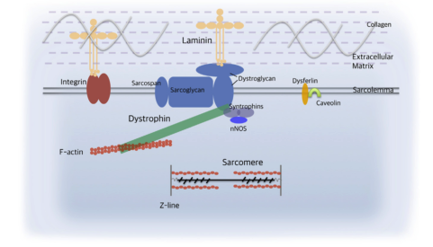
Muscular Dystrophy
Dystroglycanopathies = decreased glycosylation of alpha-dystroglycan
Disease(s) | Associated gene
Walker-Warburg Syndrome And Muscle Eye Brain | B3GLNT2, B4GAT1, DAG1, FKRP, FKTN, GMPPB, ISPD, LARGE, POMGNT1, POMGNT2, POMT1, POMT2, TMEM5
Fukuyama Congenital Muscular Dystrophy | FKTN
Congenital Muscular Dystrophy with or without Cognitive Impairment | POMT1, FKRP, FKTN
Limb Girdle Muscular Dystrophy with or without cognitive Impairment | FKRP, POMT1, FKTN, POMT, POMGNT1, ISPD
Li, et al

Slide 3
Human case study: NRAP gene’s potential involvement in dystroglycanopathy
WT NRAP
LIM domain
Nebulin repeat region
Missense: A1270T
Splice (g>A)

Slide 4
Is there a causative effect between the doubly heterozygous NRAP variants and dystroglycanopathy pathology?
Make an zebrafish model
2. Look for glycosylated alpha dystroglycan
3. If it is decreased, then YES
3. If it is normal, then NO

Slide 5
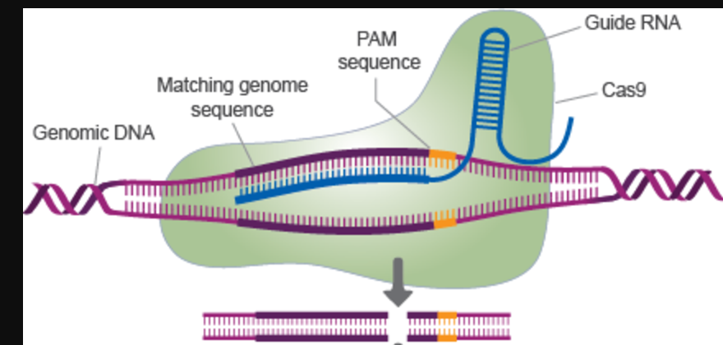
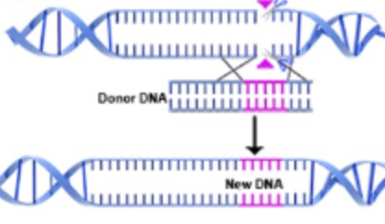
Using CRISPR/cas9 to create zebrafish NRAP mutants
HDR

Slide 6
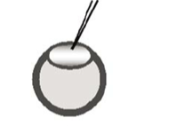
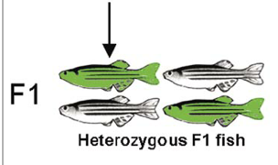
Transfection of CRISPR/cas9 components
gRNA, cas9 mRNA, ssODN

Slide 7
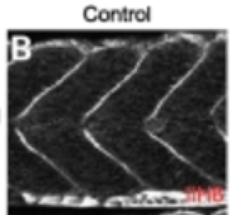
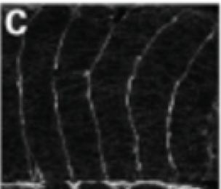
Examining mutant NRAP lines to show NRAP variants’ involvement in pathogenicity
Is there a causative effect between the doubly heterozygous NRAP variants and dystroglycanopathy pathology?
Mutant Zebrafish NRAP lines
splice/WT
Missense/WT
Splice/missense
Disease(s) | Associated gene
Walker-Warburg Syndrome And Muscle Eye Brain | B3GLNT2, B4GAT1, DAG1, FKRP, FKTN, GMPPB, ISPD, LARGE, POMGNT1, POMGNT2, POMT1, POMT2, TMEM5, NRAP???
Fukuyama Congenital Muscular Dystrophy | FKTN
Congenital Muscular Dystrophy with or without Cognitive Impairment | POMT1, FKRP, FKTN
Limb Girdle Muscular Dystrophy with or without cognitive Impairment | FKRP, POMT1, FKTN, POMT, POMGNT1, ISPD

