Slide 1
Does a knockout of NDUFA2 Lead to Parkinson’s Disease?
Ruairidh Barlow

Slide 2
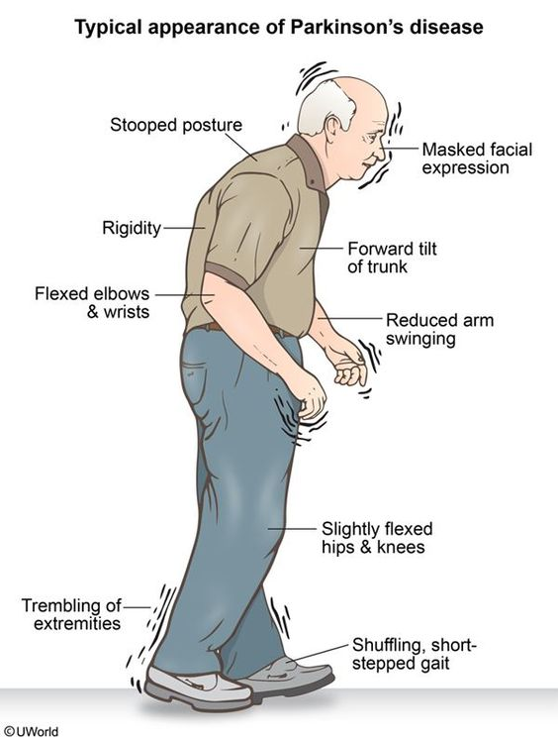
What is Parkinson's Disease?
Age related neurodegenerative disease
Symptoms: tremors, stiffness, and slow movement

Slide 3
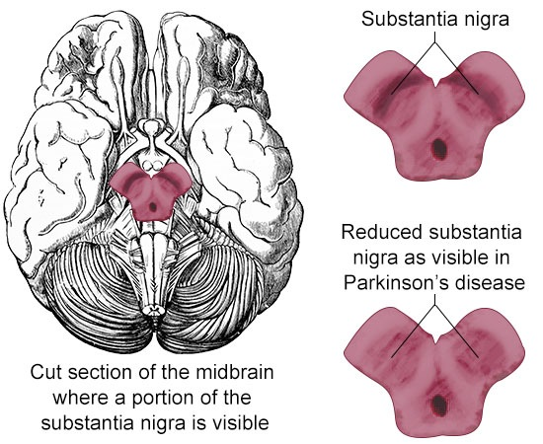
Substantia Nigra Pars Compacta
Death of dopaminergic neurons is a key feature in the pathology of the disease

Slide 4
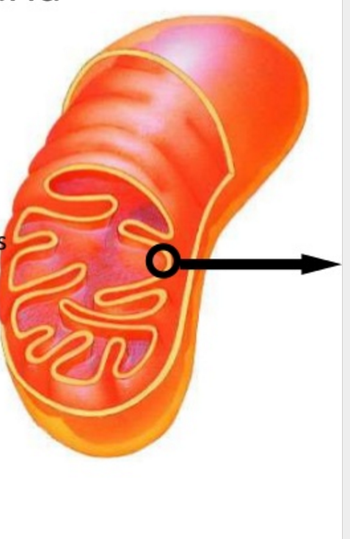
Complex I
NADH: ubiquinone oxidoreductase
Complex I catalyzes the transfer of electrons from NADH to coenzyme Q10
Complex I is made up of 44 protein subunits

Slide 5
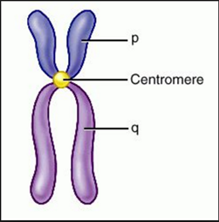
NDUFA2: Protein In Question
NDUFA2 Protein Structure
NADH dehydrogenase [ubiquinone] 1 alpha sub complex subunit 2
Interacts with other subunits of complex I
Plays a role in the assembly of complex I
Chromosome 5

Slide 6
SH-SY5Y Cell Line
Express dopaminergic markers
Have been used to study Parkinson's Disease.
Purchased from “Sigma-Aldrich”
“Neurites extend, reminiscent of dendrites and/or axons.” Kovalevich et al (2013)

Slide 7
CRISPR/Cas9
Clustered regularly interspaced short palindromic repeats (CRISPR)
State of the art gene editing procedure
Derived from E. coli
CRISPR Associated genes (Cas)
Primarily helicase and nuclease
Kit will be purchased from “OriGene”

Slide 8
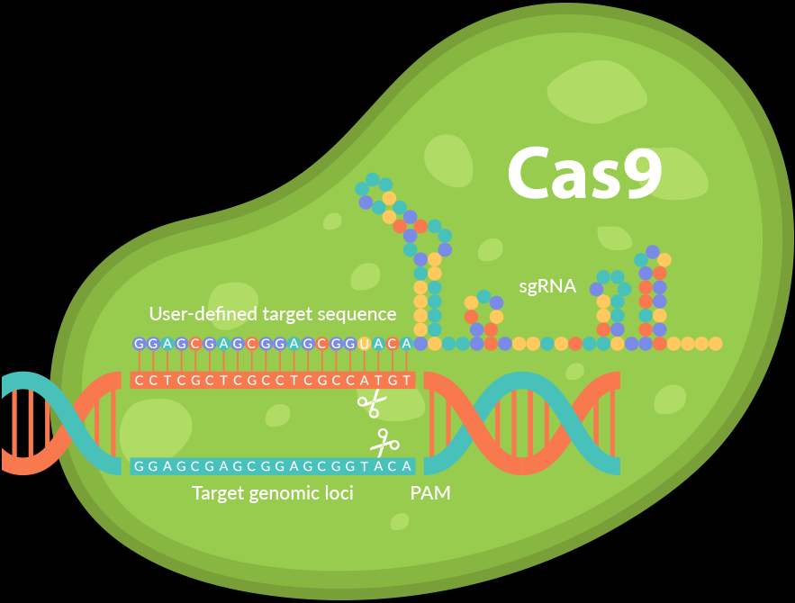
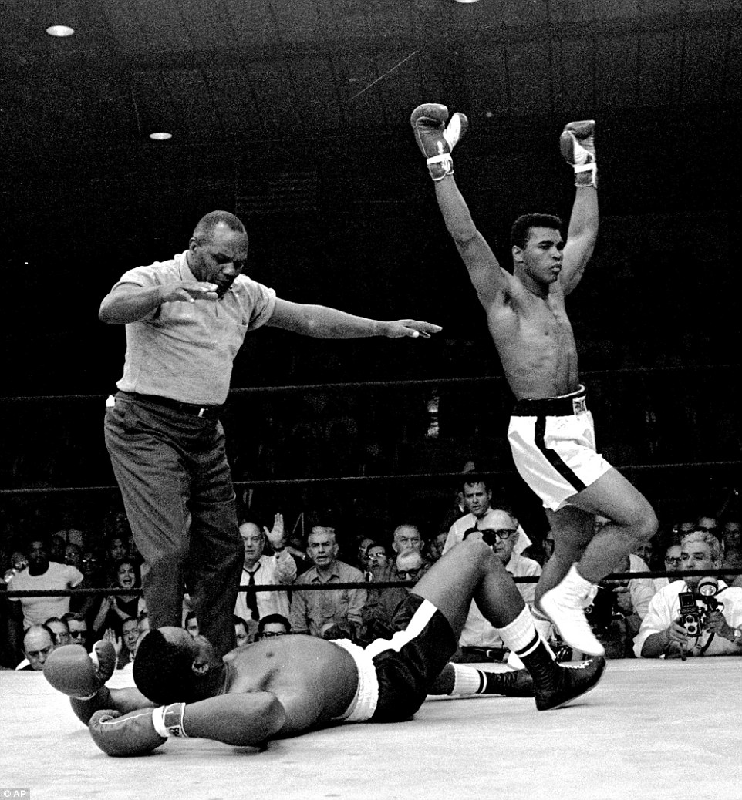
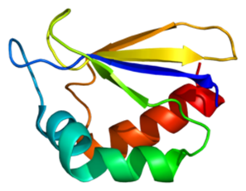
Does A Knockout of NDUFA2 Leads to Parkinson's Disease?
Parkinson’s?
CRISPR
NDUFA2

Slide 9
Knockout Procedure
https://www.atum.bio/eCommerce/cas9/input
gRNA Design (Guiding RNA)
19 – 25 nucleotides long
Adjacent to a 5’-NGG-3’ proto-spacer motif (PAM)
Complement to target sequence
NDUFA2 target sequence “CCAGAGCTTGGGCTGCACAT”

Slide 10
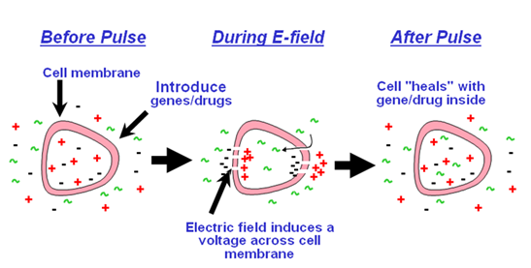
Knockout Procedure
gRNA Design
Insertion of Oligo (gRNA) into a CRISPR/Cas9 Nuclease Vector
Via electroportation

Slide 11
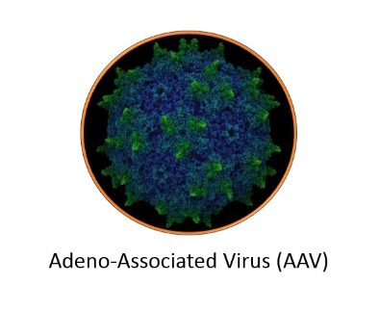
Knockout Procedure
gRNA Design
Insertion of Oligo (gRNA) into a CRISPR/Cas9 NucleaseVector
Infection of SH-SY5Y Cell Line
Adeno-Associated virus
Cas9 Nuclease Vector
SH-SY5Y Petri dish

Slide 12
Isolation of Mitochondria

Slide 13
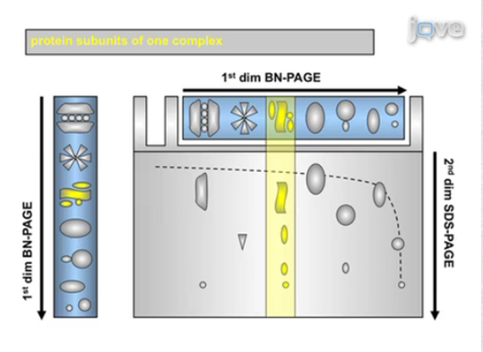
Complex I Assembly and Protein Subunit Detection BN-PAGE
Blue native-polyacrylamide gel electrophoresis (BN-PAGE)
One dimensional: Mitochondrial supercomplexes (Complex I)
Two dimensional: Complex subunits
Was the knock out a success?

Slide 14
Mitochondrial Oxygen Consumption
Seahorse XF24 Extracellular Flux Analyzer (Seahorse Bioscience Inc., USA)
Able to measure O₂ consumption levels without additional dye or markers

Slide 15
Mitochondrial Membrane Potential
Rhodamine 123 dye
Molecule with a positive charge, sensitive to proton gradients
FACScan (BD Biosciences, Bedford, MA, USA)
Measures dye accumulation

Slide 16
Mitochondrial Rate of ATP synthesis
Rate measured with luminometer
Intensity of light is proportional to the concentration of ATP

Slide 17
Discussion
By comparing oxygen consumption levels, membrane potential, and rate of ATP synthesis between the three cell types it can be determined what, if at all, the impact a knockout of NDUFA2 will have on a cell
The results from this experiment will help to further our understanding of NDUFA2’s potential role in Parkinson’s disease. This information will help determine whether Parkinson’s is just the expression of complex I dysfunction in dopaminergic neurons

Slide 18
Questions?

Slide 19
References
de Lau LM, Breteler MM. Epidemiology of Parkinson’s disease. Lancet Neurol 2006;5:525-535.
Tanner, C. M., & Aston, D. A. (2000). Epidemiology of Parkinsonʼs disease and akinetic syndromes. Current Opinion in Neurology, 13(4), 427-430. doi:10.1097/00019052-200008000-00010
Postuma RB, Berg D, Stern M, et al. MDS clinical diagnostic criteria for Parkinson’s disease. Mov Disord 2015;30:1591-1601.
Wirth, C., Brandt, U., Hunte, C., & Zickermann, V. (2016). Structure and function of mitochondrial complex I. Biochimica et Biophysica Acta (BBA) - Bioenergetics, 1857(7), 902-914. doi:10.1016/j.bbabio.2016.02.013
NDUFA2 NADH:ubiquinone oxidoreductase subunit A2 [Homo sapiens (human)] - Gene - NCBI. (n.d.). Retrieved April 15, 2017, from https://www.ncbi.nlm.nih.gov/gene?Db=gene&Cmd=ShowDetailView&TermToSearch=4695
Heo, J. Y., Park, J. H., Kim, S. J., Seo, K. S., Han, J. S., Lee, S. H., . . . Kweon, G. R. (2012). DJ-1 Null Dopaminergic Neuronal Cells Exhibit Defects in Mitochondrial Function and Structure: Involvement of Mitochondrial Complex I Assembly. PLoS ONE, 7(3). doi:10.1371/journal.pone.0032629
(n.d.). Retrieved April 15, 2017, from https://www.atum.bio/eCommerce/cas9/input
NDUFA2 - human gene knockout kit via CRISPR. (n.d.). Retrieved April 29, 2017, from http://www.origene.com/CRISPR-CAS9/KN202715/NDUFA2.knockout
Bao, L., Chen, S., Conrad, K., Keefer, K., Abraham, T., Lee, J. P., . . . Miller, B. A. (2016). Depletion of the Human Ion Channel TRPM2 in Neuroblastoma Demonstrates Its Key Role in Cell Survival through
Proteomics, C. (n.d.). 2D Blue Native. Retrieved April 29, 2017, from http://www.creative-proteomics.com/services/2d-blue-native-sds-page-for-complex-analysis.htm
Fiala, G. J., Schamel, W. W., Blumenthal, B. Blue Native Polyacrylamide Gel Electrophoresis (BN-PAGE) for Analysis of Multiprotein Complexes from Cellular Lysates. J. Vis. Exp. (48), e2164, doi:10.3791/2164 (2011).
University of Virginia School of Medicine. (n.d.). Retrieved April 29, 2017, from https://pharm.virginia.edu/facilities/seahorse-xf24-extracellular-flux-analyzer/
Vives‐Bauza, C., Yang, L., & Manfredi, G. (2007). Assay of Mitochondrial ATP Synthesis in Animal Cells and Tissues. Mitochondria, 2nd Edition Methods in Cell Biology, 155-171. doi:10.1016/s0091-679x(06)80007-5
Hodge, G. K., & Butcher, L. L. (1980). Pars compacta of the substantia nigra modulates motor activity but is not involved importantly in regulating food and water intake. Naunyn-Schmiedeberg's Archives of Pharmacology, 313(1), 51-67. doi:10.1007/bf005058

