Slide 1
Understanding Different Molecular Mechanisms Involved in Schizophrenia
Amanda Atrash

Slide 2
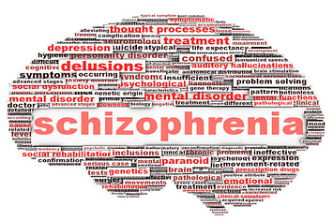

Slide 3
Disrupted-In-Schizophrenia-1 (DISC1)
Protein
Acts as a scaffold
20XX | 20XX | 20XX | 20XX

Slide 4
Nuclear Distribution Element-like 1 (NDEL1)
Protein
Involved in neuroplasticity
Relationship with DISC1
20XX | 20XX | 20XX | 20XX

Slide 5
Does knockout of one protein affect the function of the other?
How does knockout of NDEL1 lead to changes in plasticity and dendrite formation in the brain?
Notes:
Disruption of DISC1 via knockout of NDEL1 stunts spine formation in the hippocampus region of mice

Slide 6
Are proteins binded together?

Slide 7
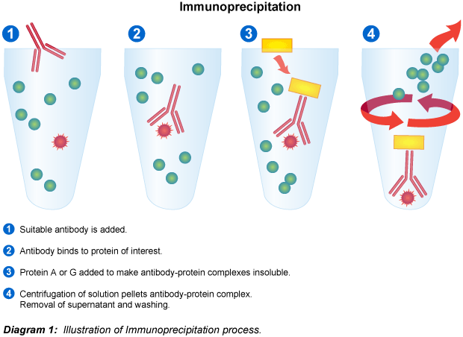
Process of Immunoprecipitation, https://goo.gl/images/R0BoLG

Slide 8
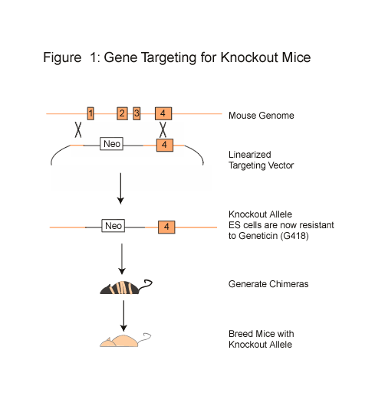
Knockout NDEL1

Slide 9
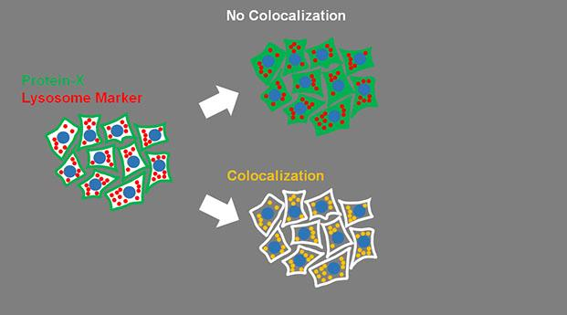
Are proteins in right place?
Notes:
Focused on hippocampus region, colocalization

Slide 10
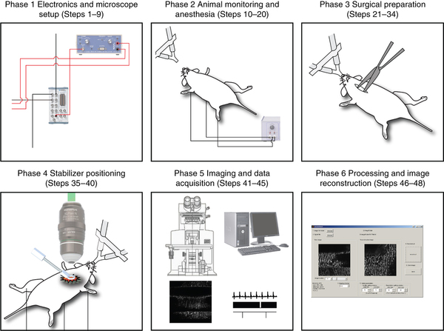
Confocal Imaging
Vinegoni et al. (2015)

Slide 11
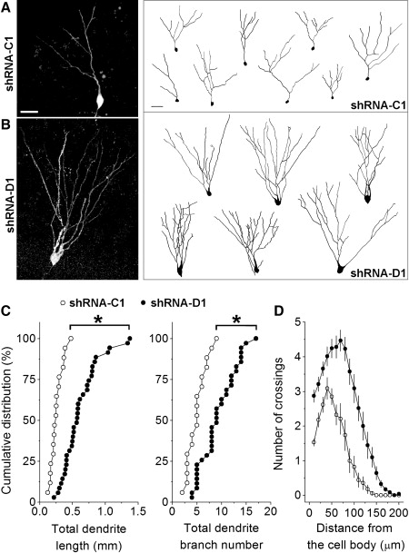
Golden et al. (2013), results

Slide 12
Spine Formation → Schizophrenia Drug Treatment

Slide 13
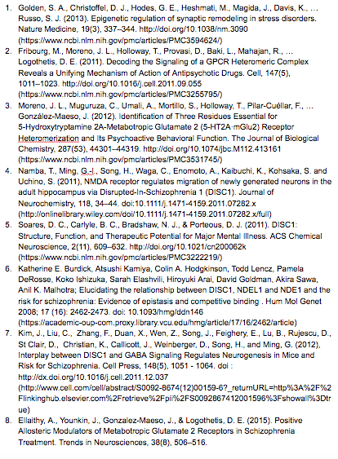
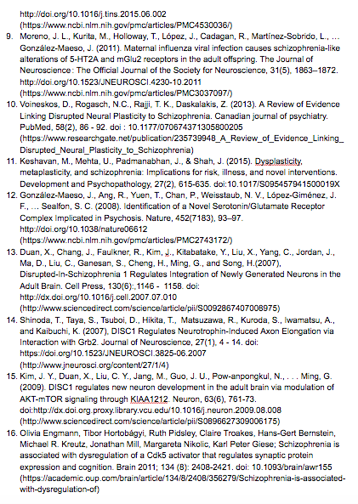
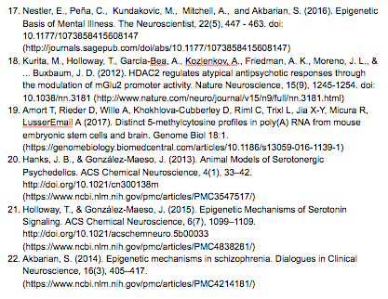
References

