Slide 1
Higher Affinity Heptapeptides Against Influenza Hemagglutinin-Sialic Acid Identification for Treating Flu Virus Disease
Ahmed ”e” Al Qaffas

Slide 2
People at risk of any pandemic
Vaccine is not enough
Current anti-Flu drugs inadequacy
Would Peptide therapy provide
a better solution?

Slide 3
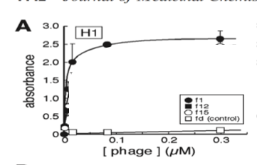
found them!
Mimicking sialic acid function.
Easily synthesized.
Their binding can be predicted with Dock simulation.
They are target specific.
Figure1) shows a competitive assay to measure the binding of heptapeptide f1 to HA of H1N1 influenza virus.

Slide 4
Predicting and validating the binding of these peptides provide a better solution to pandemics outburst of influenza disease.
Easy to Test
Time efficient
Structural based prediction

Slide 5
His-tag
Human
Anti-flu antibodies
substrate
Heptapeptide chain
Well
Step 1
Step 3
Step 5
Washing the well
Step 2
Step 4
influenza strain X
Goat’s
Anti-Human
Antibodies

Slide 6
Similar Results
Docking visual Prediction of Peptide-HA binding site.

