Slide 1
Lysis of shiga toxin-producing Escherichia coli by delivery of Crispr/Cas9 cascade coding cosmid targeting Stx 1 and Stx 2 genes via lambda phage delivery system
Amanda Rutledge

Slide 2
How E. coli become Shiga toxin-producing
Shiga toxin-encoding phage
(such as 933W)
Escherichia coli
Notes:
Become shiga toxin producing when undergo lysogenesis with shiga toxin encoding phage

Slide 3
How E. coli become Shiga toxin-producing
Shiga toxin-encoding phage
(such as 933W)
Escherichia coli

Slide 4
How E. coli become Shiga toxin-producing
Escherichia coli

Slide 5
What We’ll Need…
Modified Lambda Phage (CY1591)
kanamycin resistance gene inside cos site
Plasmid pUC18
functioning cos site
shiga-toxin targeting Crispr/Cas
Tet promoters
Plasmid pACYC184
Tet repressor protein gene
E. Coli Y1088 strain
hsdM+

Slide 6
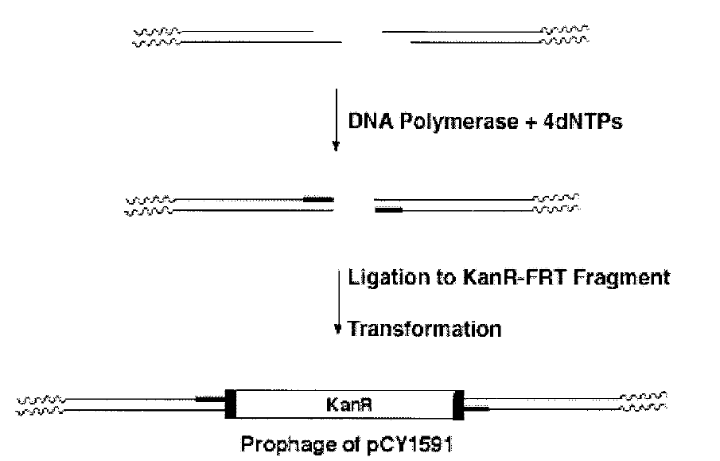
Modified Lambda Phage (Cronan 2003)
Cronan JE. Cosmid-Based System for Transient Expression and Absolute Off-to-On Transcriptional Control of Escherichia coli Genes. Journal of Bacteriology. 2003;185(22):6522-6529. doi:10.1128/JB.185.22.6522-6529.2003.

Slide 7
Plasmid pUC18
pUC18
Tet P
cas3
Tet P
casA-E
Repeat
S1
Repeat
S2
Repeat
pUC18
Cos site

Slide 8
Plasmid pACYC184
Hind III
Tet repressor
AvaI
Hind III
AvaI

Slide 9
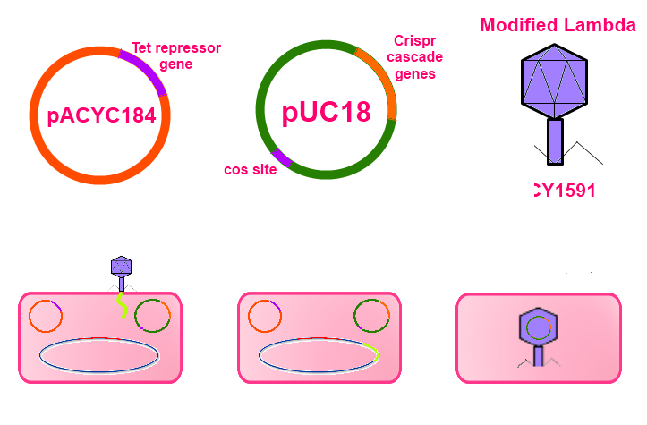

Slide 10
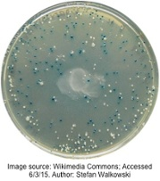
Testing for proper packaging of cosmid

Slide 11
What can these phage do?
Crispr/Cas9

Slide 12
Questions?

