Slide 1
In Bacteroides fragilis, which genes give the tumoricidal effect in Colorectal cancer?
Suquoia Mosby
Mentor: Dr. maria rivera

Slide 2
Background
Colorectal cancer is the third most common cancer diagnosed in both men and women in the US
When comparing healthy gut microbiomes to the gut microbiomes of CRC patients, the CRC patients tended to have altered gut microbiomes¹
The main type of alteration noted is a drop in gut microbiota diversity.
A drop in diversity may lead to dysbiosis
Dysbiosis are differences in microbiome diversity that are associated with disease

Slide 3
Influence of gut microbiome in CRC: Zackular et. al 2013
Groups of germ-free mice underwent fecal transplant
Feces from healthy mice
Feces from tumor-bearing mice
Induced tumors in mice
Healthy community was distinguished from the dysbiotic community by the number of tumors
Species identified from the healthy community:
Bacteroides, Odoribacter, Turicibacter

Slide 4
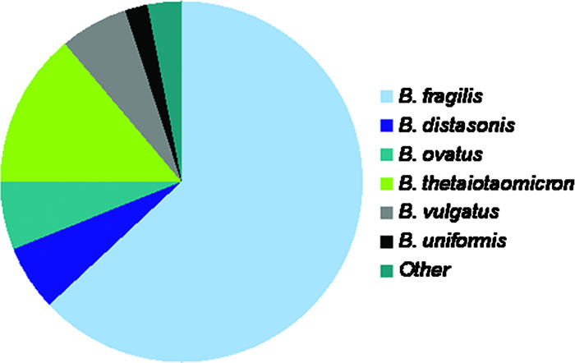
Bacteroides species commonly found in the gut microbiome

Slide 5
Components of the gut microbiome influencing tumor size: Vetizou et. al 2015
Testing the effect of specific bacteria as probiotics on tumor size
Fed germ-free mice broad-spectrum antibiotics and injected a carcinogen
Found that mice that were given B. fragilis as a probiotic had tumors that were significantly smaller

Slide 6
Experimental question
Of the gene products in Bacteroides fragilis, which ones give the tumoricidal effect in colorectal cancer?

Slide 7
Comparative genomics of Bacteroidetes: Xu et al. 2007
Performed a comparative genomic analysis of 8 Bacteroidetes species
1416 protein-coding genes common to all Bacteroidetes species
B. fragilis has 4625 total protein-coding genes
B. fragilis has ~3209 protein-coding genes that are not shared with other Bacteroidetes
Protein-coding genes that might be involves in the tumoricidal effect

Slide 8
Experiment
Using sequence of B. fragilis provided by Xu et al. 2007
Take each protein gene sequence B. fragilis (3209 not shared)
Input into PRIMER program to design forward and reverse primers for each gene sequence
Polymerase Chain Reaction to isolate each one of those genes
Clone the PCR product into an expression vector
Expression vector with the gene of interest is transformed into E. coli.
A culture of E. coli expressing the gene of interest will be administered by oral feeding to mice.
Promote tumor growth by injecting carcinogen
Notes:
BNFO- get the sequences of protein genes so we can design primers for PCR

Slide 9
To measure whether the protein has desired tumoricidal effect
Similar to Vetizou et. al 2015-- have two groups of germ-free mice and feed them the E. coli culture
Control culture: plasmid, no insert
Experimental culture: plasmid with target gene
Inject carcinogen
Harvest intestines after 73 days and count the number of tumors

Slide 10
Experiment we want to focus on: Polymerase Chain Reaction (PCR)
What is it
Why is it important for answering the question

Slide 11
Expression vector
Target genes implanted into pLink
Notes:
Target gene goes into pLink area
PT7 promoter site
F1 ori allows for single-stranded production
LacI Lac inducer gene

Slide 12
Implant expression vector
E. coli BL (DE3)
Notes:
Why this E. coli?

Slide 13
Expression of target gene
Send E. coli signal to undergo replication by introducing Isopropyl-beta-D-1-thalagalactopyroside (IPTG)
Displaces Lac repressor by inducing a conformational change
Initiates transcription and translation
We get our protein expressed by our E. coli culture

Slide 14
The lac operon. Top: Repressed, Bottom: Active.
1: RNA Polymerase, 2: Repressor, 3: Promoter, 4: Operator, 5: Lactose, 6: lacZ, 7: lacY, 8: lacA.

Slide 15
Expected results
Repeat this 3200 times more
Determine which construct decreases the number of tumors

Slide 16
Q&A
Acknowledgements

