Slide 1
Understanding the role of the PACE/Furin site and Apoptosis in terms of Factor 8 production in regards to Hemophilia A Therapy
Herleen Mokha
BNFO 300 Spring 2016
Notes:
intro

Slide 2
How can scientists cure patients of Hemophilia?
Notes:
How can scientists cure patients of hemophilia?
Now, obviously, this is not my proposal question, that would be much too difficult to answer in the course of one semester. But I did want to take a look at the bigger picture. In essence, my proposal will help with the process of choosing what form of treatment will be the most useful when it comes to treating patients of hemophilia.

Slide 3
Hemophilia A is a X-linked genetic disease that affects 1 in 5000 individuals characterized by a delayed or incomplete ability to successfully clot a blood vessel that has sustained a lesion.
Notes:
Hemophilia A is an X-linked genetic disease of the blood that affects 1 in 5000 individuals. The disease is characterized by the inability for a blood vessel to form a clot once it has sustained a lesion. This inability is due to a missing coagulation factor called Factor 8, which is one of 13 coagulation factors needed in the blood.

Slide 4
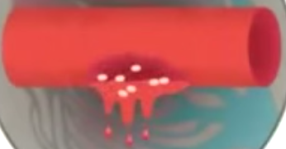
What’s so important about all these coagulation factors?
Notes:
So what exactly is a coagulation factor? Imagine if you will, a set of dominos, each domino must knock the subsequent one down in order for the cascade of dominos to be effectively completed. If one domino is missing or shortened, the cascade of dominos will be halted. In the same way, every coagulation factor must perform an action in order so that a clot may form. Factor 8 is the focus of a majority of studies because out of the 13 factors, factor 8 deficiency is the most common.

Slide 5
Why is Factor 8 the most deficient?
Notes:
Factor 8 is most deficient because when it is getting formulated within a cell, It must pass through many regulatory steps before it can be secreted into the bloodstream and perform its duty. Often times these regulatory steps end up simply holding factor 8 within a cell, never to allow it to release!
Strong holds by chaperone proteins such as BiP
Protein misfolding
Low expression of Factor 8 mRNA

Slide 6
Apoptosis
A combination of these obstacles collectively result in poor expression of Factor 8 in hemophilia A patients, and increased chance of apoptosis (Lenting).
Notes:
A combination of these obstacles collectively result in poor expression of cofactor protein F8 in hemophilia A patients, and increased chance of apoptosis (Lenting).
If too much Factor 8 remains within the cell, apoptosis of the cell may occur, never allowing the cell to perform any factor 8 production ever again… or any function for that matter.

Slide 7
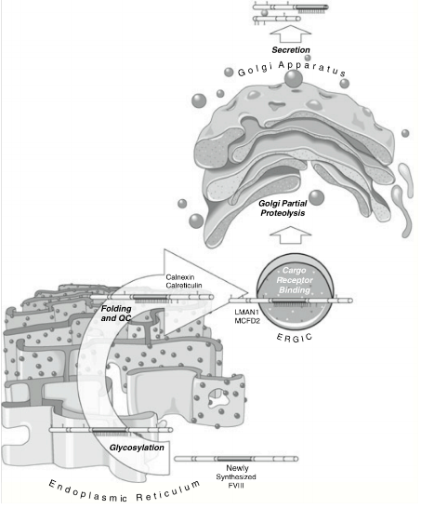
Notes:
This figure is designed to help clarify what was just discussed. Don’t get too caught up in the vocabulary, just watch my finger.
As you can see here, newly synthesized F8 is a long chain. The dark grey part of the chain is referrred to as the B domain. As it passes through the ER, all those regulatory processes that make F8 get stuck occur. For example, a fraction of F8 will get stuck by binding to BiP, or immunoglobin binding protein.
The fraction of F8 that does move past all this will travel through the Golgi. The last step of passing through the Golgi involves cleaving at the aformentioned B domain through use of the Golgi’s PACE/Furin site.

Slide 8
What work has been done thus far?
Deletion of the B Domain
Mutation of A1 Domain
Introduction of F8 variants
Varying something other than F8 itself
Notes:
So, what work has been done thus far to help with low secretion of F8?
Deletion of the B domain of F8 was done in hopes of seeing more secretion, changes in the A1 domain were made in order to cause decreased attraction b/t F8 and BiP, Many variants of Factor 8 were produced.
However, one recent study actually involved creating a variant of something that interacts with F8, not F8 itself. It was the PACE/Furin site.

Slide 9
2014: deletion of 4 Amino Acids in the PACE/Furin site
Notes:
In 2014, 4 amino acids of the PACE/Furin site in the Golgi Body of canine models were deleted.
The results were A 3-fold increase in F8 secretion occurred!
However, although this increase was preferential, something that was not looked into during this study was the apoptotic effects the deletion of the PACE/Furin site had on apoptotic levels of cells. Would apoptotic levels decrease due to lack of PACE/Furin in the Golgi? Or would they remain the same b/c of the possibility that F8 still remained within the ER?

Slide 10
Can the deletion of the PACE/Furin site subsequently aid in lowering the amount of apoptosis within a cell?

Slide 11
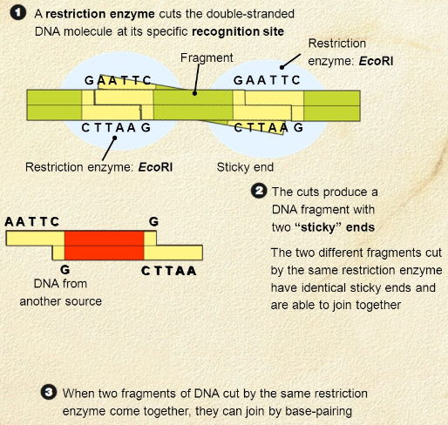
The Experiment: Construct Cloning
PACE/Furin site at residues 1645-1648 must be deleted
Notes:
There are 2 main parts to this experiment, the first is the creation of a construct, which means creating an endothelial cell which does not contain the PACE/Furin site at residues 1645-1648 through the use of restriction enzyme mapping
What will happen is that an enzyme will be able to open up the gene of interest and generate an overhang. If you look at step 1 of this figure you can see that a restriction enzyme is able to cut a DNA strand in such a way that one strand is cut longer than the other. This allows for better re-annealing of the base pairs, which is exactly what will need to occur following the removal of the genes that code for the PACE/Furin Site.

Slide 12
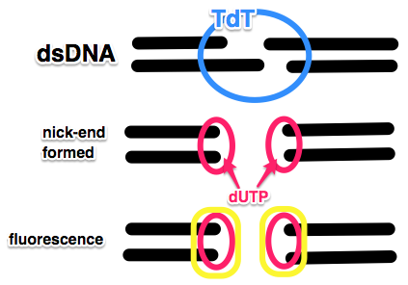
The Experiment: TUNEL
Terminal deoxynucleotidyl transferase dUTP Nick-End Labeling assay
Notes:
Now, we can conduct comparative analysis of levels of apoptosis between canine endothelial cells that are wild type cells with normal functioning PACE/Furin vs. cells that are constructed following deletion of the PACE/Furin site. This is done using TUNEL, or Terminal deoxynucleotidyl transferase dUTP Nick-end Labeling assay.
Essentially, the process is all in the name, which I will break down for you all.
A defining aspect of apoptosis within a cell is breakage of dsDNA
Tdt, or terminal deoxynucleotidyl transferase, will bind to broken sections of dsDNA and nick the ends through cleavage of overhangs.
dUTP can bind to these blunt ends now.
A staining solution is able to stain dUTP, causing fluorescence of breaks within DNA.
Now, we can compare normal cells to cells that have apoptosis occurring, because those ones will be stained.

Slide 13
Results
Can the deletion of the PACE/Furin site subsequently aid in lowering the amount of apoptosis within a cell?
If it is true that lacking PACE/Furin allows for F8 release, then it is expected that a decrease in apoptosis as a result
Both an increase in secretion of F8 and a confirmed decrease in apoptosis will be efficacious in the world of Hemophilia A therapy
Notes:
Let’s look back to our original question. Can the deletion of the PACE/Furin site subsequently lower the amount of apoptosis within a cell?
if it is true that lacking PACE/Furin allows for F8 release, then it is expected that a decrease in apoptosis as a result.
Any questions?
An example of a result different from the original intention is that although release of F8 is increased due to lack of PACE/Furin, the cofactors being released may not have gone through proper regulation due to the deletion of the PACE/Furin site, resulting in secretion of many F8 proteins that will play no real role in coagulation seeing as they may not be viable, functioning proteins
Other notes:
ELISA is enzyme-linked immunosorbent assay. It is used to measure the amount of protein product.
Flow cytometry is a method used to count the number of cells in a solution using a laser beam

