Slide 1
How do Neonicotinoids bind to the alpha subunit of the nicotinic acetylcholine receptor in Apis mellifera?
Robert Kalish

Slide 2
Why does it matter?

Slide 3
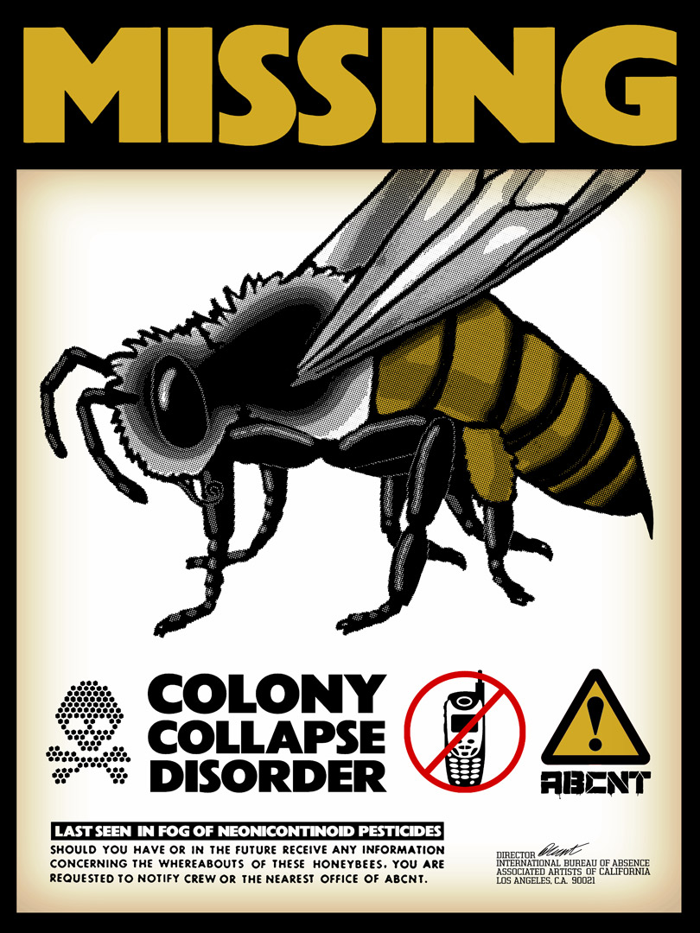
Neonicotinoid Pesticides
Although banned in the EU, neonicotinoids are still used on 95% of US corn crops(Gauthier et al.)

Slide 4
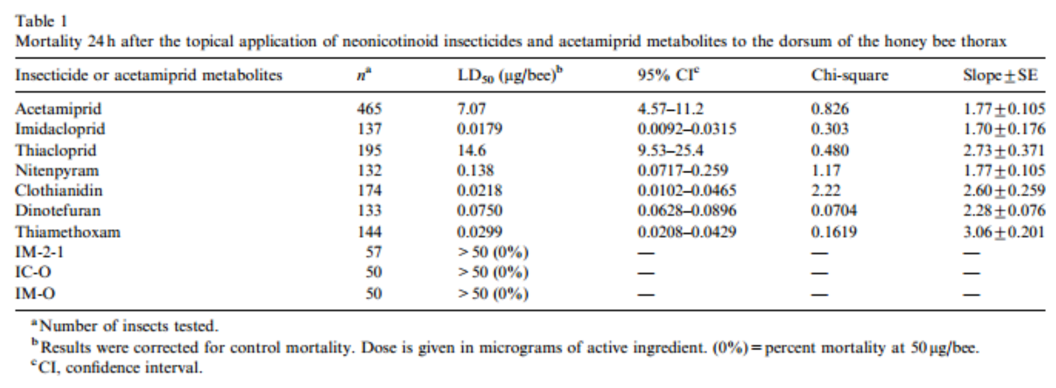
Neonicotinoid toxicity
Iwasa, Takao, Naoki Motoyama, John T. Ambrose, and R.michael Roe. "Mechanism for the Differential Toxicity of Neonicotinoid Insecticides in the Honey Bee, Apis Mellifera." Crop Protection 23.5 (2004): 371-78.Elsevier. Web. http://www.farmlandbirds.net/sites/default/files/Iwasa2004.pdf

Slide 5
Chemical Structures

Slide 6
Binding Sites of the alpha subunit

Slide 7
Binding to the Nitro Group
Figure 2. The structure of the agonist binding domain of AChBP from the mollusk Lymnaea stagnalis when bonded with Imidacloprid. The figure was generated based on the PDB file 2ZJU in RSCB-Ligand Explorer. Q55 and C187 of AChBP, which are colored green, correspond to Q79 and G189, respectively, of the chicken α7 subunit (Shimomura et al., 2002).

Slide 8
Binding to Imidazole Ring
Figure 3. The structure of the agonist binding domain of AChBP from the mollusk Lymnaea stagnalis when bound to Imidacloprid. The figure was generated based on the PDB file 2ZJU in RSCB-Ligand Explorer. Y192 and Y185 (of YXCC) are major structures in determining loop C binding site, W143 is a catalyst for Loop B binding.

Slide 9
Binding Sites of the alpha subunit

Slide 10
Primers
Apis Mellifera nAChR subunit a7 (genbank: NM_001011621) in the pMT3 vector will be used as a template.
Mutant | Forward Strand (C) | Reverse Strand (B)
N212E | 5’-TATTACGAGTGCTGCCCAGAACCG-3’ | 3’-CGGTTCTGGGCAGCACTCGTAATA-5’
K77Q | 5’-ATCTCTGGTTACAATTGGAATGG-3’ | 3’-CCATTCCAATTGTAACCAGAGAT-5’
Edge Primers | 5’-ATGAGACGTTGGACTCTCATGGC-3’ (A) | 3’-TATTTCCTTTGTATTCCTTTTCTC-5’ (D)
15 copies of each wild-type and mutant receptor must be combined with beta subunits and injected into separate Oocytes so that they can undergo 3 trials of exposure to each of the 5 agonists.

Slide 11
Voltage Clamp ElectroPhysiology
Na⁺ and Ca²⁺ rush in once channels are opened
After the cell is exposed to agonist, positive ions enter the cell through the now open channels. To maintain a constant negative voltage negative ions must be run through the series circuit.
Oocyte
-100mV
Receptors
Electrodes
Maintains constant voltage of
-100mV. Reads current required to maintain the voltage as output.
Geneclamp 500

