Slide 1
Epigenetic Affects of the Krüppel-Like Transcription Factor 1 on DNA Methylation
By Steven Jermstad

Slide 2
How are red blood cells made?
(Koury et al 2015)

Slide 3
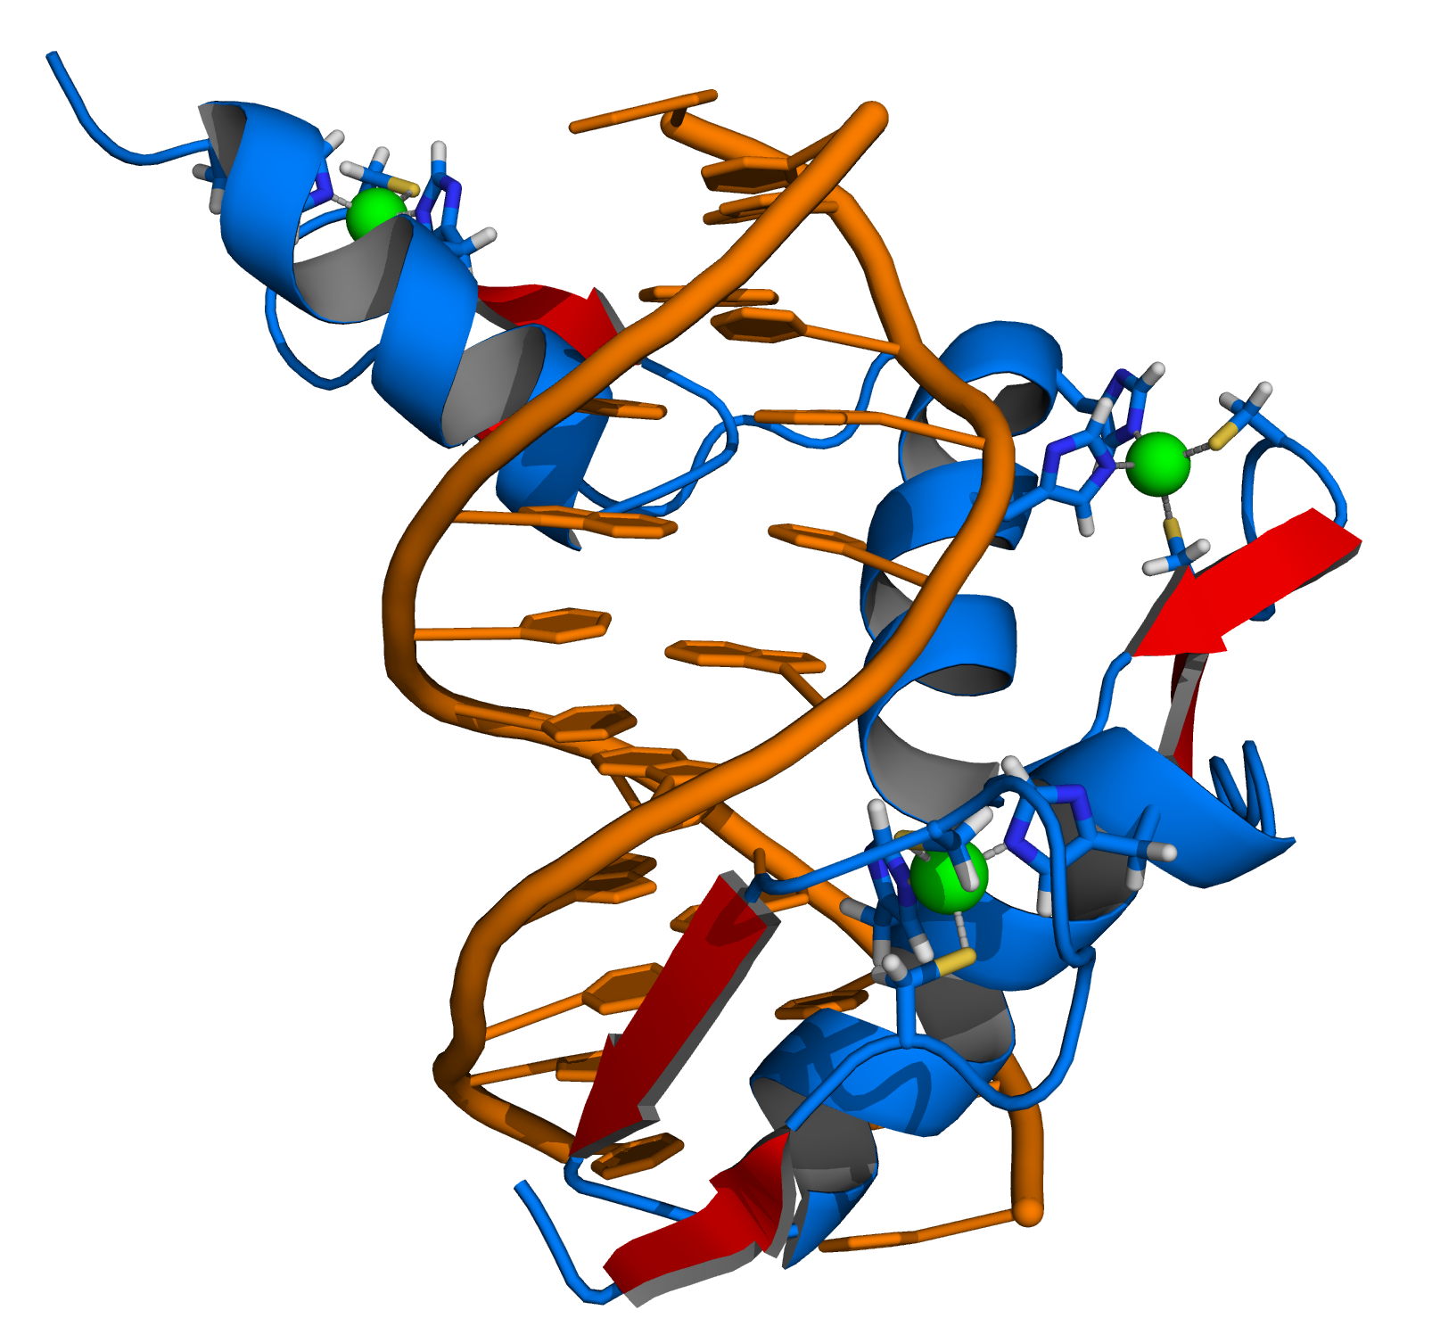
What is KLF1
KLF1 is a zinc fingered transcription factor
From : https://en.wikipedia.org/wiki/Zinc_finger

Slide 4
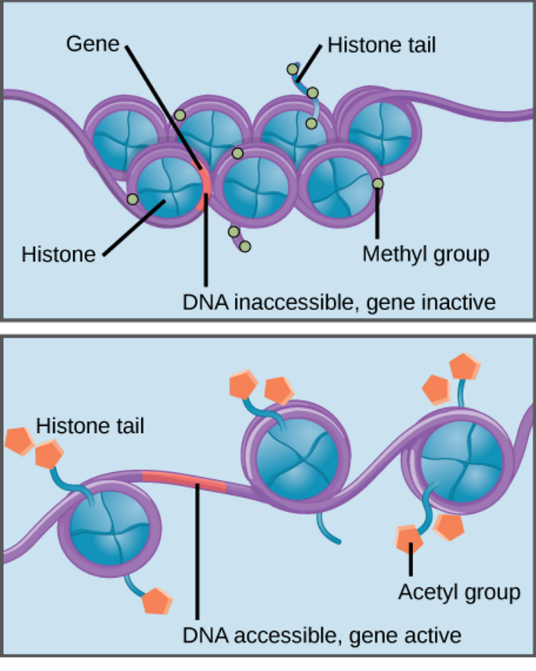
What is KLF1?
KLF1: a Zinc finger transcription protein
KLF1 required for histone modification near β-globin gene
From: https://courses.candelalearning.com/biologymajors/chapter/chapter16-gene-expression/

Slide 5
What is KLF1?
KLF1: a Zinc finger transcription protein
KLF1 required for histone modification near β-globin gene
While we know how KLF1 affects histones in the genome, little is know about how it affects DNA methylation
What genes could it affect through methylation?
Main question: What genes, if any does KLF1 affect through DNA methylation?

Slide 6
Knocking out the Gene
First cells with the KLF1 gene knocked out must be obtained
These cells will come from embryonic mice

Slide 7
Making the Knock Out Mice
Mice heterozygous with the KLF1 KO phenotype already exist
They can be purchased from “Jackson Research Labs”
https://www.flickr.com/photos/cameliatwu/3942602723/
http://paperv.com/story/2415/gene-targeted-mouse-model-tool-creator-creative-animodel/

Slide 8
MeDIP-chip
Methylated DNA immunoprecipitation
Genome-wide analysis
Preformed on mice liver cells

Slide 9
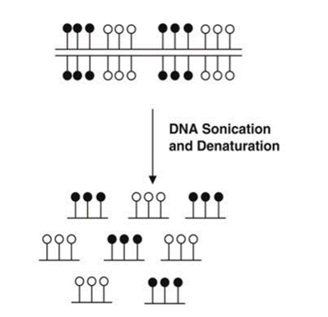
MeDIP-chip
First step is to shared the DNA by sonication
Then Denatured by heat

Slide 10
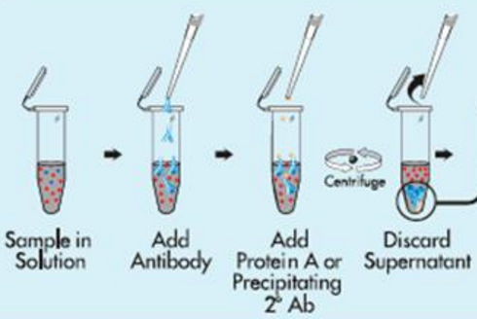
MeDIP-chip
Next the strands are methylated DNA are separated and labeled by anti-bodies that are specified for the directed against 5-methylcy-tidine
The anti-body tagged DNA is separated by centrifugation
From :https://www.studyblue.com/notes/note/n/ch-16-control-of-gene-expression/deck/4811347

Slide 11
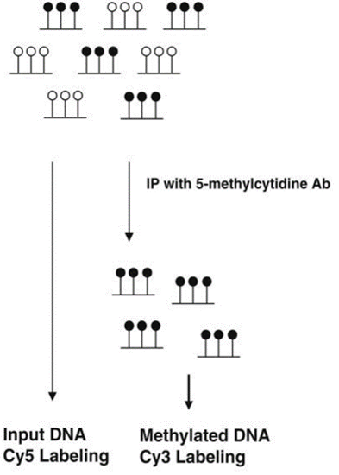
MeDIP-chip
The separated DNA is now purified (by digestion with proteinase K) and tagged with florescent dyes

Slide 12
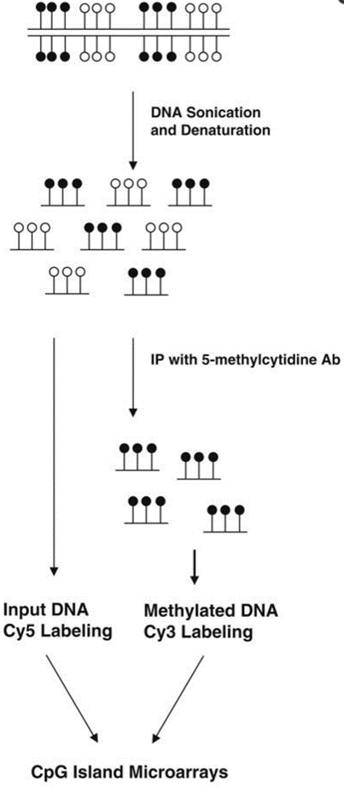
CpG Island Microarray
The propose of tagging the methylated and input DNA is to prepare them for analysis by a CpG Island Microarray
(Weng et al, 2009)

Slide 13
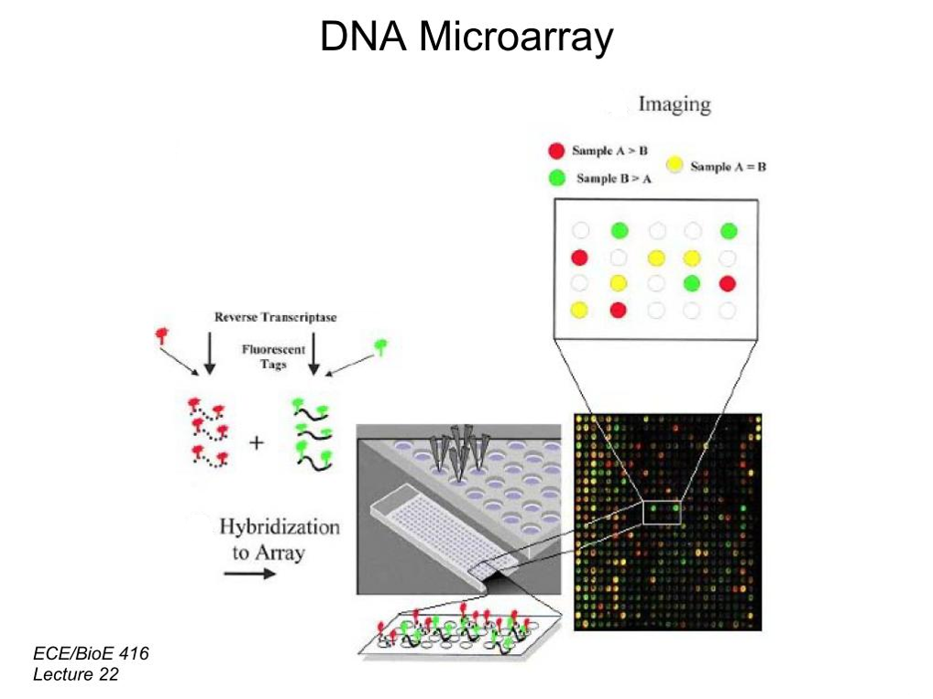
CpG Island Microarray
The labeled DNA Strands are hybridized to the microarray slide
Which contains complementary CpG region probes
MeDIP-chip

Slide 14
Discussion
By comparing the red, green, and yellow spots on the microarray we can determine how, if at all, KLF1 affects DNA methylation, as well as what regions of DNA are affected
The information gained from this experiment will further our under standing of KLF1’s role in epigenetics, which in turn can help expand our understanding of the development of red blood cells in the embryo

Slide 15
Questions?

Slide 16
References
Alhashem, Y. N., D. S. Vinjamur, M. Basu, U. Klingmuller, K. M. L. Gaensler, and J. A. Lloyd. "Transcription Factors KLF1 and KLF2 Positively Regulate Embryonic and Fetal -Globin Genes through Direct Promoter Binding." Journal of Biological Chemistry 286.28 (2011): 24819-4827. http://www.jbc.org/content/286/28/24819.long
Andrew Perkins, Xiangmin Xu, Douglas R. Higgs, George P.Patrinos, Lionel Arnaud, James J. Bieker, Sjaak Philipsen. "Krüppeling" erythropoiesis: an unexpected broad spectrum of human red blood cell disorders due to KLF1 variants unveiled by genomic sequencing. Blood Jan 2016, DOI: 10.1182/blood-2016-01-694331 http://www.bloodjournal.org/content/early/2016/02/22/blood-2016-01-694331.long?sso-checked=true
Tallack, M. R., Magor, G. W., Dartigues, B., Sun, L., Huang, S., Fittock, J. M., … Perkins, A. C. (2012). Novel roles for KLF1 in erythropoiesis revealed by mRNA-seq. Genome Research, 22(12), 2385–2398. http://doi.org/10.1101/gr.135707.111
Weng, Y.-I., Huang, T. H.-M., & Yan, P. S. (2009). Methylated DNA Immunoprecipitation and Microarray-Based Analysis: Detection of DNA Methylation in Breast Cancer Cell Lines. Methods in Molecular Biology (Clifton, N.J.), 590, 165–176. http://doi.org/10.1007/978-1-60327-378-7_10
Weinmann, A. S. "Isolating Human Transcription Factor Targets by Coupling Chromatin Immunoprecipitation and CpG Island Microarray Analysis." Genes & Development 16.2 (2002): 235-44. Web. http://www.ncbi.nlm.nih.gov/pubmed/11799066?dopt=Abstract
Koury, Mark J., and Volker H. Haase. "Anaemia in Kidney Disease: Harnessing Hypoxia Responses for Therapy." Nat Rev Nephrol Nature Reviews Nephrology 11.7 (2015): 394-410. http://www.nature.com/nrneph/journal/v11/n7/full/nrneph.2015.82.html

