Slide 1
PTK7 protein domains involvement in PCP regulation of axon pathfinding of CoPA neurons in Zebrafish.
Spring 2016 BNFO 300
Damien Islek:

Slide 2

The Human Brain: What makes us tick?
Understanding how the human nervous system makes connections during development is crucial to understanding the way the brain works and how we perceive external stimuli.
http://www.inmonova.com/blog/development-of-human-brain-from-stem-cells/

Slide 3
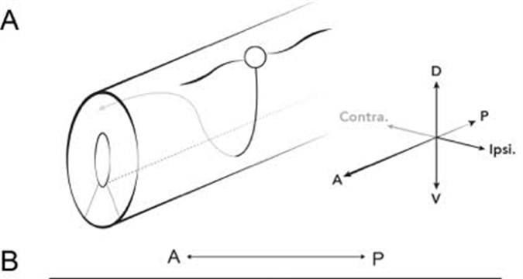
Zebrafish primary commissural ascending neurons (CoPA)
  CoPA neuron in zebrafish
  Wild Type 100% of CoPA axons travel anterior after crossing the midline.
  Axon migration is dependent on Wnt mediated PCP pathway (Hayes et al 2013).

Slide 4
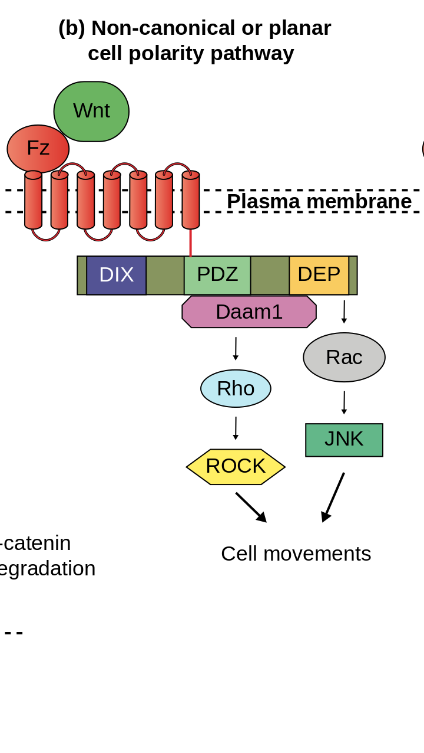
Wnt mediated Planar Cell Polarity Pathway: Core Proteins
Main action in this pathway is Wnt binding to Frizzled.
In Lu et al. PTK-7 was found to be a novel regulator of this pathway in mice.
Hayes et al reported in 2013 that mutant ptk7 zebrafish expressed similar defects as PCP core protein (Fz/Vang) gene mutants.

Slide 5
Experimental Question
Which domain of PTK7 is involved in regulating the PCP pathway which mediates CoPA neuron axon pathfinding in zebrafish?

Slide 6
My Experiment: PTK7 Rescue
What domains of PTK7 are important for regulating the direction of axon growth in zebrafish CoPA neurons.
Start with zebrafish mutant TBX16. Express GFP in
Copa neurons
Use Zinc-Finger Nucelase technology to knockout PTK7 gene from TBX16 zebrafish
Bread zebrafish generation of ptk7 mutant zebrafish
Observe direction of axon migration of neurons which express GFP and M-Cherry
Microinject plasmid and mRNA of Tol2 transposon
Grow zebrafish
Kawakami 2007

Slide 7
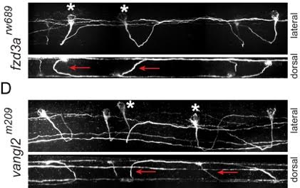
What are we looking for?
In mutant PCP zebrafish axons randomly travel anterior or posterior (50/50 Anterior/Posterior)
If Rescue is successful, theoretically, all CoPA neurons which display Red and Green will have axons which travel anterior.
If this function can be rescued without a certain domain, then that domain must not be required for regulation of this pathway for correct axon migration.
A
P

Slide 8
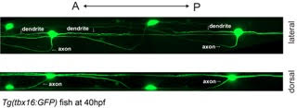
Experimental Groups:
TBX16 Zebrafish:
Express Green Fluorescent Protein in CoPA Neurons.
PTK7 Full Length
Ptk7ΔICD
Ptk7EgfrTM
Ptk7ΔECD

Slide 9
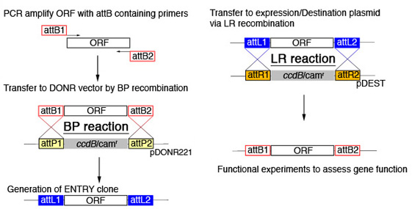
Plasmid Construction: Gateway Cloning
Step 1: PCR amplify cDNA of ptk7 with attB containing primers.
Step 2: Transfer cDNA into entry vector through recombination
  BP Clonase
Isolate the entry vector
Transfer cDNA to destination vector through recombination
  LR Clonase
Isolate the destination vector
cDNA PTK7
“ “
“ “
“ “

Slide 10
Plasmids:
Full Length PTK7
Deleted
Intracellular
Domain
Deleted
Extracellular
Domain
Substituted
Trans-membrane
Domain
Ptk7 cDNA-M Cherry
Tol2
HSP-70
pA
Tol2
Ptk7ΔICD-
M Cherry
Tol2
HSP-70
pA
Tol2
Tol2
HSP-70
Ptk7ΔECD –
M Cherry
pA
Tol2
Tol2
HSP-70
Ptk7EgfrTM –
M Cherry
pA
Tol2

Slide 11
Prediction:
Ptk7 mutant
Ptk7 mutant
+
hsp70: ptk7^{FL}-mCherry

Slide 12
Questions and Comments

