Slide 1
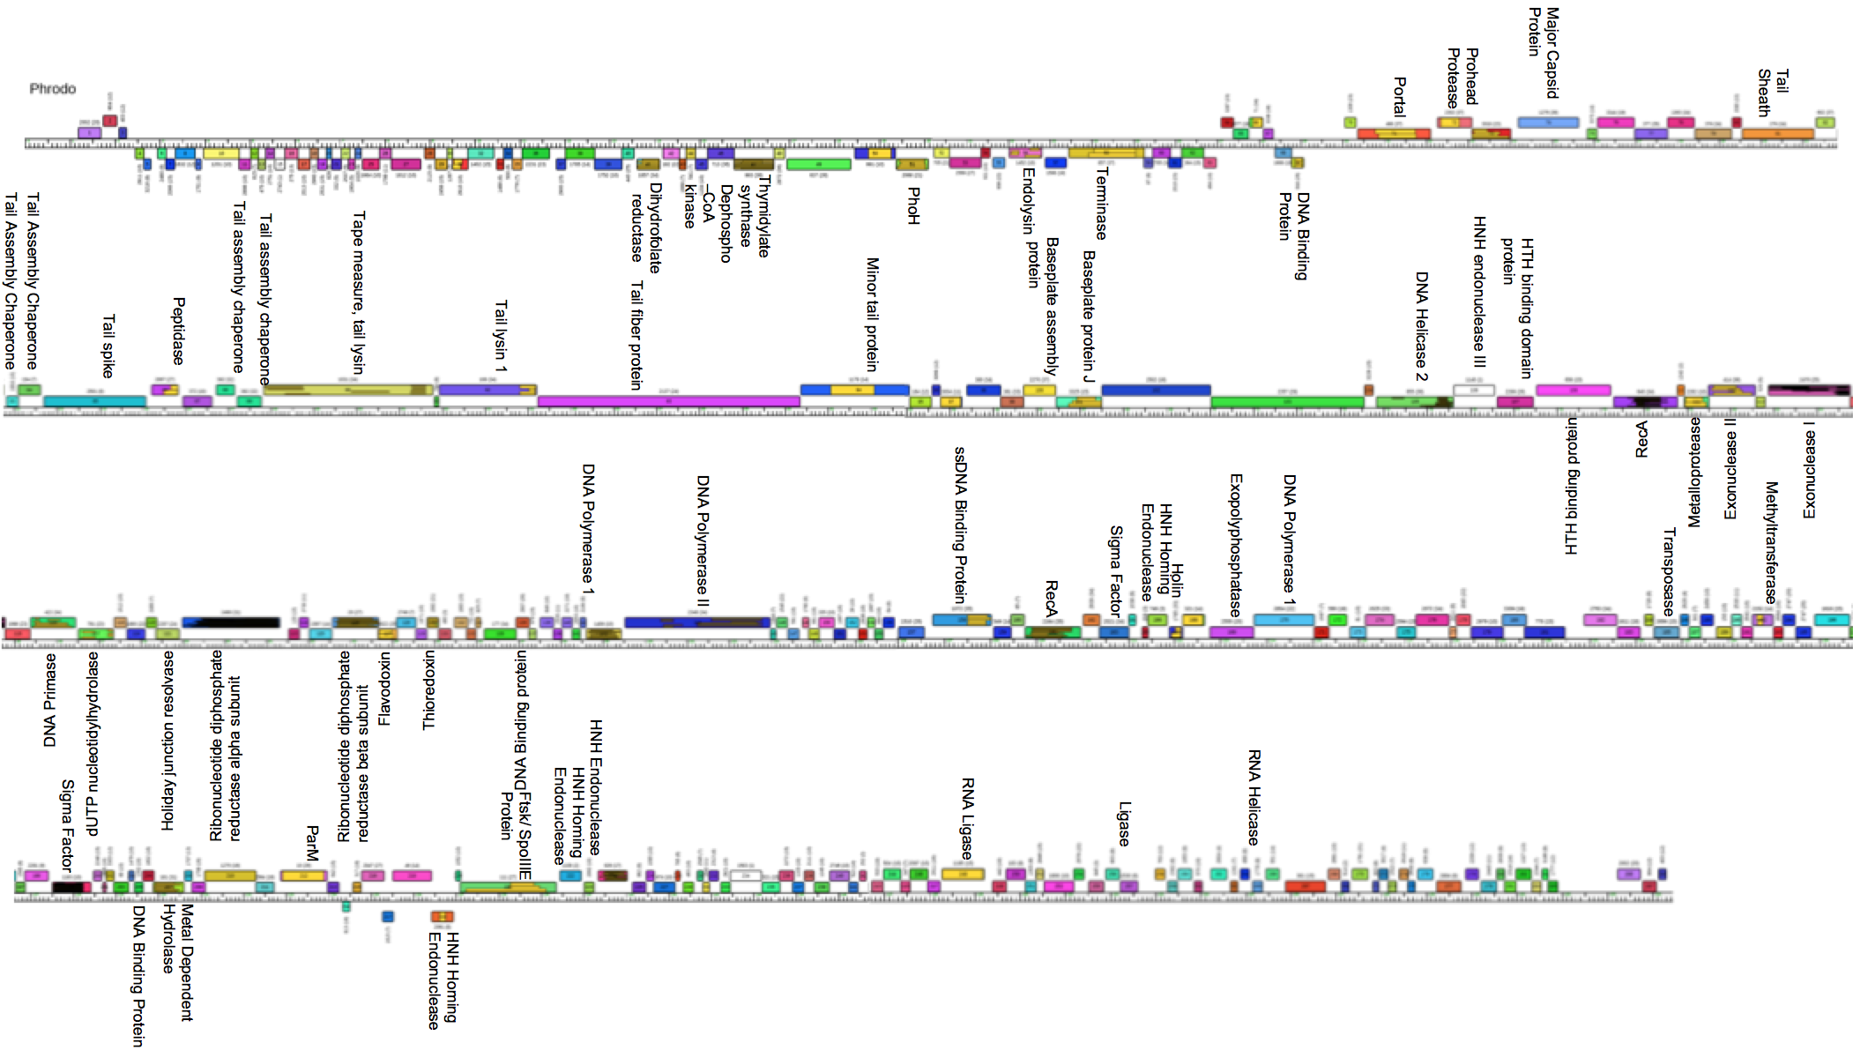
IDENTIFICATION OF HIGHLY CONSERVED BACILLUS ORFS OF UNKNOWN FUNCTION

Slide 2
We propose to investigate the function of unknown proteins by establishing overexpression assays with an entry and expression vector system to screen for phenotypes so that we can identify proteins for further functional analysis.

Slide 3
What is a bacteriophage (Phage)
A bacterial virus
Phrodo is a myoviridae Bacillus phage with a double stranded DNA genome and a contractile tail
We chose Phrodo because its DNA and genetic information is readily available and a vast majority of our genes of interest are found within it’s genome

Slide 4
What are bacillus bacteria? Why do we care?
Rod shaped sporulating gram-positive bacteria
Bacillus genus consists of the ATC family (B. anthracis, B. thuringiensis, B. cereus)
Bacillus bacteria are naturally resistant to antibiotics
Provides an excellent model for studying viruses and their host
Phage Therapy as an alternative to antibiotics

Slide 5
Model Study for studying phage protein function: Wagemans et al.
Identified 26 uncharacterized proteins from phage Pseudomonas aeruginosa PAO1 to overexpress from the early infection stage
Used shuttle vector system, pUC18-mini-Tn7T-Lac, which is E. coli and P. aeruginosa compatible, and vector pTNS2
Results in a single ORF integrated into the host genome
6 of them (protein 7, 8, 14, 15, 18, and 30) were found to have a phenotypic impact on host bacteria

Slide 6
Preliminary Data
Goal: Identify highly conserved proteins using dot plot and Splits tree

Slide 7
SplitsTree
Purpose: group genomes by protein content similarity to examine the relationships between clusters and the proteins shared across all genomes
Tree with the top 55 most highly conserved genes absent
Tree with the top 55 most highly conserved genes present

Slide 8
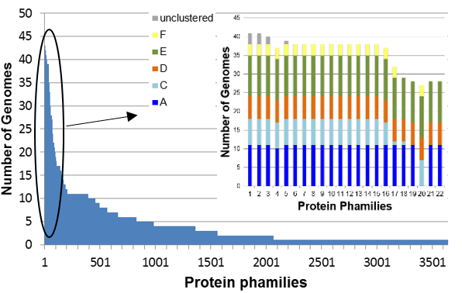
Highly conserved unknown genes
Table to the left shows the frequency of genomes in each pham
Image to the right shows which cluster each of the top 22 highly conserved proteins of unknown function belongs to
Cluster E contains the most unknown proteins

Slide 9
Control and Unknown ORFs to overexpress

Slide 10
Methods
PCR, BP clonase, E. coli transformation, mini prep, LR clonase, Bacillus transformation and overexpression with IPTG

Slide 12
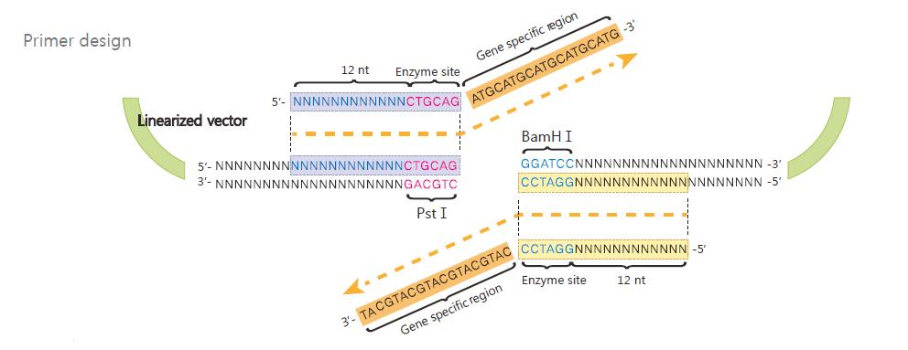
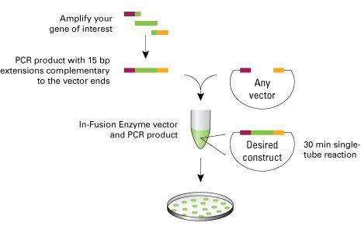
Primer design and two-step PCR
Bacillus phages have a naturally low GC content
Step One: 12 nucleotide attB1 and 2 sites are attached to each end of the primers
Step Two: 12 nucleotide attB1and 2 adapter primer sites are added
DNA will be amplified using LongAmp Taq DNA polymerase

Slide 13
BP and LR clonase reactions
Mimics phage host reactions
Naturally phage DNA has attP sites and host has attB sites and the resulting attL and attR sites are a product of these sites being combined

Slide 14
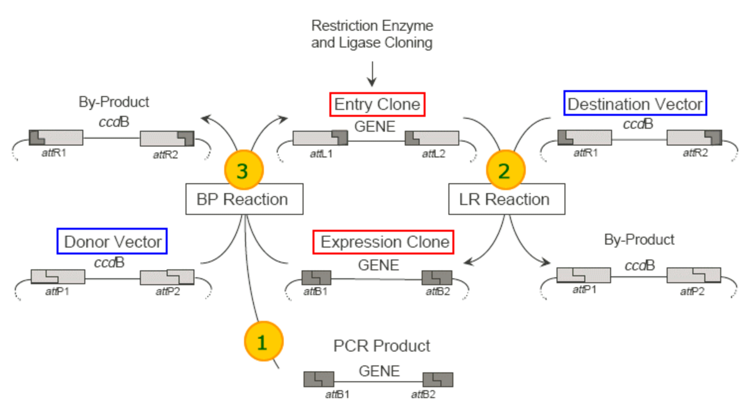

Slide 15
Discussion
Expression vector system and Expected results

Slide 16
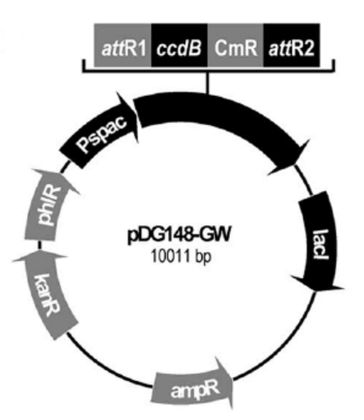
Entry and Expression Vectors
pDONR / ZEO entry vector for E. coli contains T2 and T1 promoters
pDG148 GW expression vector for E. coli and Bacillusc ontains the Pspac promoter
Gene transcription is controlled by the concentration of IPTG

Slide 17
Expected Overexpression Results
Cell death, inhibited cell growth or abnormal cell division
Gp 7: Could not properly divide after one correct division, cells are elongated with two nuclei
Gp 8: Cells begin division correctly but stop mid division, attached daughter cells that burst several hours later
Gp 14 and 18: have a long filamentous phenotype
Gp 15 and 30: affect cells by inhibiting their growth

