Slide 1
The Role Of Desmoplakin During Epidermal Development
Author: Morgan Van Driest
Mentor: Dr. Amanda Dickinson

Slide 2
Project Overview
Background: What is a desmosome? Why does it matter? What am I interested in?
Project aim: To determine how the loss of function of desmoplakin affects embryonic epidermal development
Previous knowledge
Experiment
Expected Outcome
Discussion

Slide 3
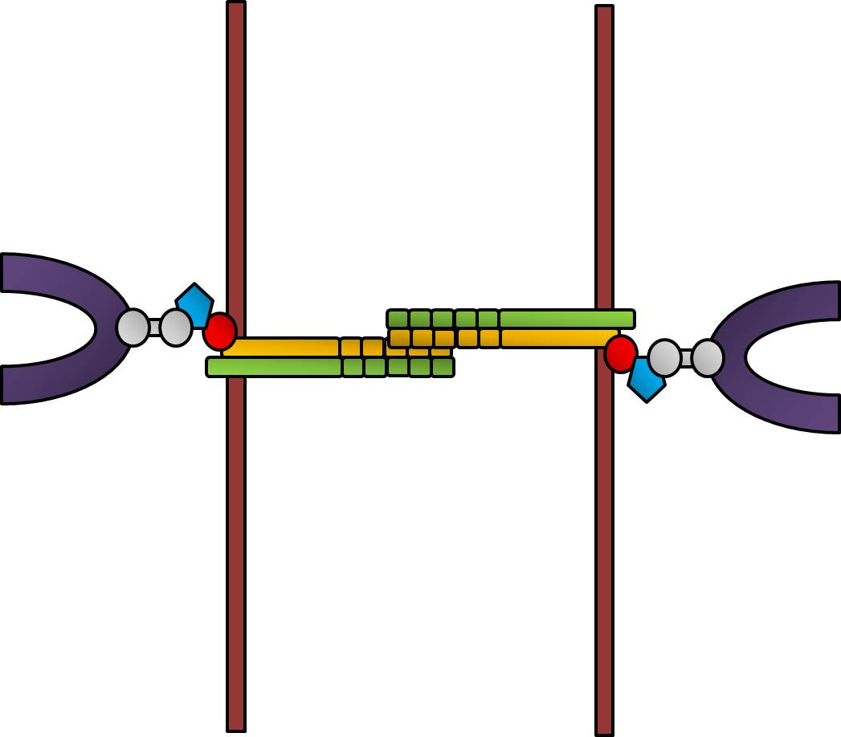
Background: What is a desmosome?
IC
EC
IC
A cell-to-cell junction
Serves to maintain structural integrity of cells in the skin
Consists of three main proteins-desmocollin, desmoglein, and desmoplakin
Calcium binding region
Cell membrane
Desmosome-intermediate filament complex
Image by: Navaneetha Krishnan Bharathan (2016)

Slide 4
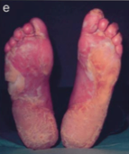
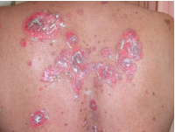
Background: Why does it matter?
Without proper function of the desmosome and its protein componenets, the skin can become blistered, abnormally calloused and vulnerable to infection and disease (Whittock, 2012 et al).
Images by Whittock et al (2012) & http://www.dermnetnz.org/immune/pemphigus-vulgaris.html

Slide 5
Background: What am I interested in?
Of the three major proteins that make up the desmosome, I am interested in desmoplakin.
IC
EC
IC
Calcium binding region
Cell membrane
Desmoplakin contains 3 critical protein domains: The plakin domain, the rod domain, and the tail domain. The tail region of desmoplakin is particularly important because it directly associates itself with keratin.
Image by: Navaneetha Krishnan Bharathan (2016)

Slide 6
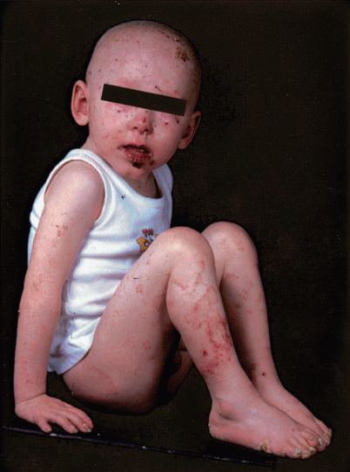
Previous knowledge about the role of desmoplakin in desmosomal disease:
Improper desmoplakin function has been associated with an early onset of skin fragility and blistering on areas of the body that receive the most mechanical stress (Whittock et all, 2002).
What isn’t known however, is how the improper function of desmoplakin affects the developing human embryo.
Images by: McGrath (2005) and http://www.reproduction-online.org/content/145/3/R65/F1.large.jpg

Slide 7
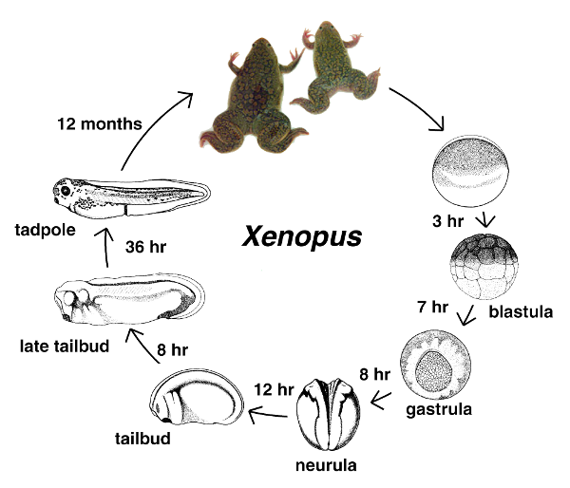
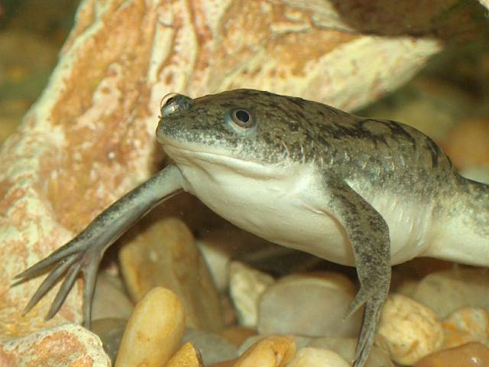
How can desmoplakin be studied during epidermal development?
Through the use of Xenopus laevis (African clawed frog)
It is an innovative and tractable system, with free-living embryos
Its epidermal development is very similar to the epidermal development in mammals.
Advantages include easy embryonic manipulation, cost efficiency and easy access to desmosomal gene annotations (Bowes et al, 2010).
Image by: Xenbase.org

Slide 8
Project Aim:
To determine how a deletion in the desmoplakin tail domain affects its affinity to bind with keratin in the developing epidermis of Xenopus embryos.

Slide 9
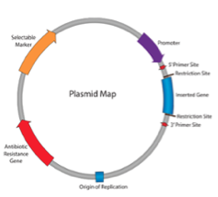
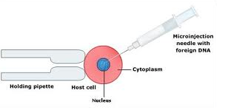
Experimental Design:
Obtain a mutant construct of the desmoplakin gene (missing the tail region).
Subclone mutant gene into a plasmid vector
Insert vector into Xenopus embryos at the one cell stage via microinjection.
Image by: http://www.biotecharticles.com/Biotech-Research-Article/Genetic-Transformation-Using-Microinjection-2993.html
A schematic of a plasmid vector. The mutant desmoplakin gene is inserted into the plasmid, and replicated upon insertion into the host cell. Taken from (Morgan & Juchheim, 2014).

Slide 10
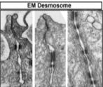
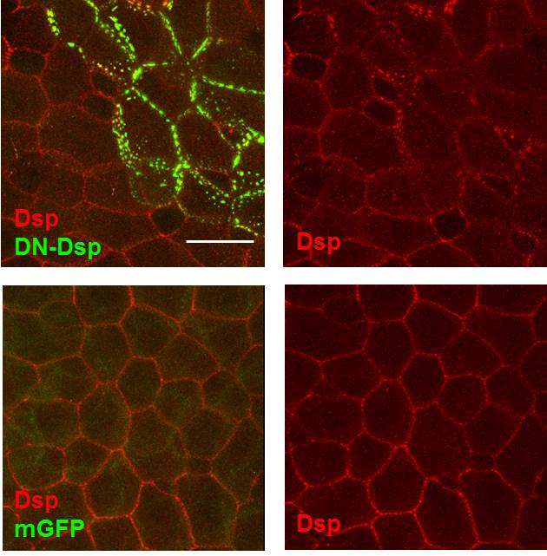
Experimental Design
Once mutant gene is introduced to the nucleus of the embryo, allow for cell growth and replication.
Stain developing cells with tubulin antibodies
Visualize cell differentiation using electron microscopy.
Photographic representations of the desmosome and desmoplakin using EM and tubulin antibody staining. Taken from Dickinson Lab, 2016

Slide 11
Expected Outcome:
Deletion of the tail region of desmoplakin should have a devastating affect on cell adhesion and differentiation.
It is thought that if desmoplakin lacks the tail region, it will no longer be able to attach to keratin
Embryos should exhibit signs of fragility and distortion
Images by: Image by: Navaneetha Krishnan Bharathan (2016)

Slide 12
Discussion:
The knowledge gained from this experiment could potentially be valuable in understanding how loss of desmoplakin function affects epithelial cell differentiation
With the information from this study, further investigation of how various desmoplakin related diseases can be treated/prevented would be useful to enhancing the quality of life for affected individuals.

Slide 13
Questions?

Slide 14
References
Bowes, J.B., Snyder, K.A., Segerdell, E., Jarabek, C.J., Azam, K., Zorn, A.M., and
Vize, P.D., (2010), Xenbase: gene expression and improved integration, Nucleic Acids Research, Volume 38 (suppl) 1, pp. D607-D612, doi:10.1093/nar/gkp953.
http://www.dermnetnz.org/immune/pemphigus-vulgaris.html
http://www.reproduction-online.org/content/145/3/R65/F1.large.jpg
McGrath, J. A. (2005), Inherited disorders of desmosomes. Australasian Journal of Dermatology, 46: 221–229. doi: 10.1111/j.1440-0960.2005.00188.x
Morgan, K., & Juchheim, M. (2014). Plasmids 101: The promoter region - let's go! Retrieved 5/1, 2016, Retrieved
from http://blog.addgene.org/plasmids-101-the-promoter region
Navaneetha Krishnan Bharathan, Virginia Commonwealth University, Department of Human and Molecular Genetics. Dickinson Lab (2016)
Whittock, Neil V.Morley, Susan M. et al. Compound Heterozygosity for Non-Sense and Mis-Sense Mutations in Desmoplakin Underlies Skin Fragility/Woolly Hair Syndrome Journal of Investigative Dermatology, Volume 118 , Issue 2 , 232 – 238
Xenbase.org

