Slide 1
Vaginal TM7: host bacteria, and the mechanisms needed to absorb amino acids.
Patricia Turpin

Slide 2
Bacterial Vaginosis
Lindau, S., (2008), Vaginal Self-Swab Specimen Collection in a Home-Based Survey of Older Women: Methods and Applications. Journal of Gerontology, 106-118.
Gram stained vaginal smear with Bacterial Vaginosis
Datcu, R., (2014), Characterization of the vaginal microflora in health and disease, Danish Medical Journal.

Slide 3
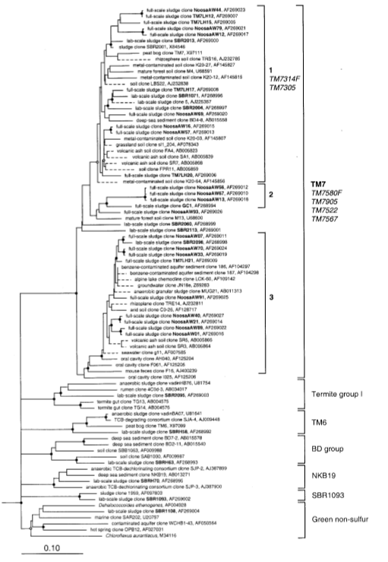
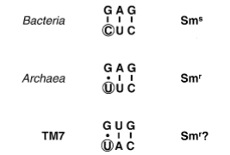

TM7
Hugenholtz, P., et al, (2000) Investigation of Candidate Division TM7, a Recently Recognized
Major Lineage of the Domain Bacteria with No Known Pure-Culture Representatives.
Applied and Environmental Microbiology, 67, 411-419.
May not be able to synthesize amino acids.

Slide 4
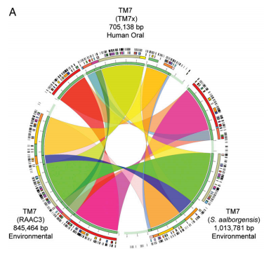
Oral TM7
Actinomyces odontolyticus
He, X., et al (2015) Cultivation of a human-associated TM7 phylotype reveals a reduced genome and epibiotic parasitic lifestyle. PNAS, 112, 244-249.

Slide 5
Question
The purpose of this experiment is to determine what mechanisms TM7 needs in order to absorb the amino acids that it cannot naturally produce.

Slide 6
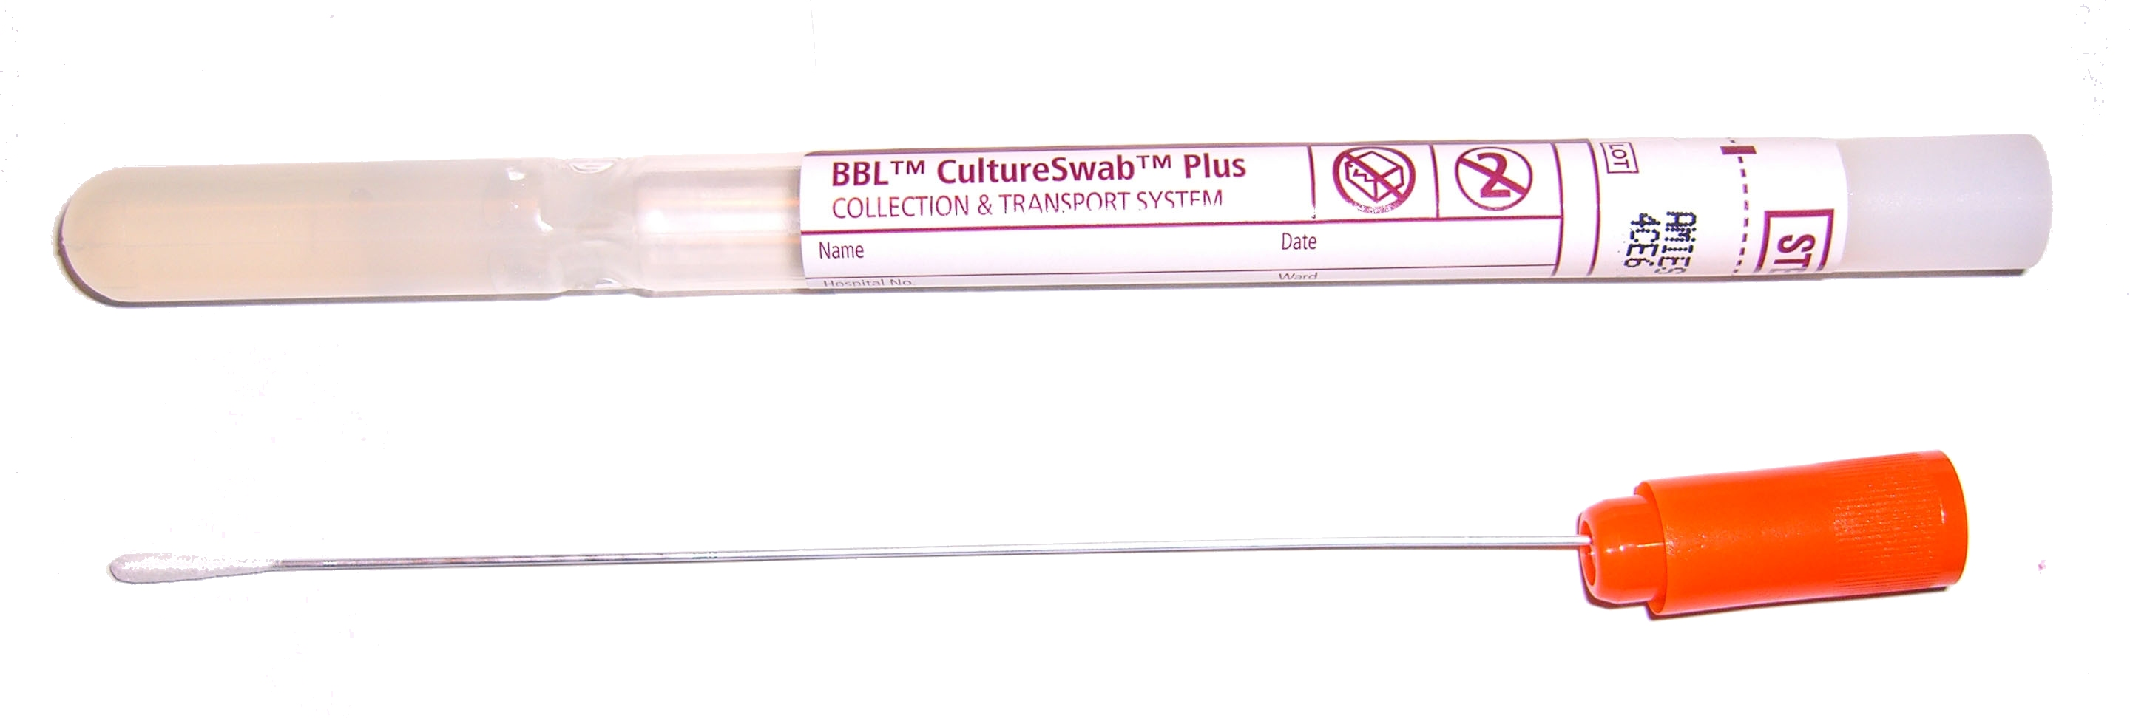

Part 1: Correlation
Actual vs. Expected
Higher the ratio, higher probability to be host.

Slide 7

Part 2: Genetic comparison
The Basic Local Alignment Search Tool (BLAST)

Slide 8
Questions or comments

