Slide 1
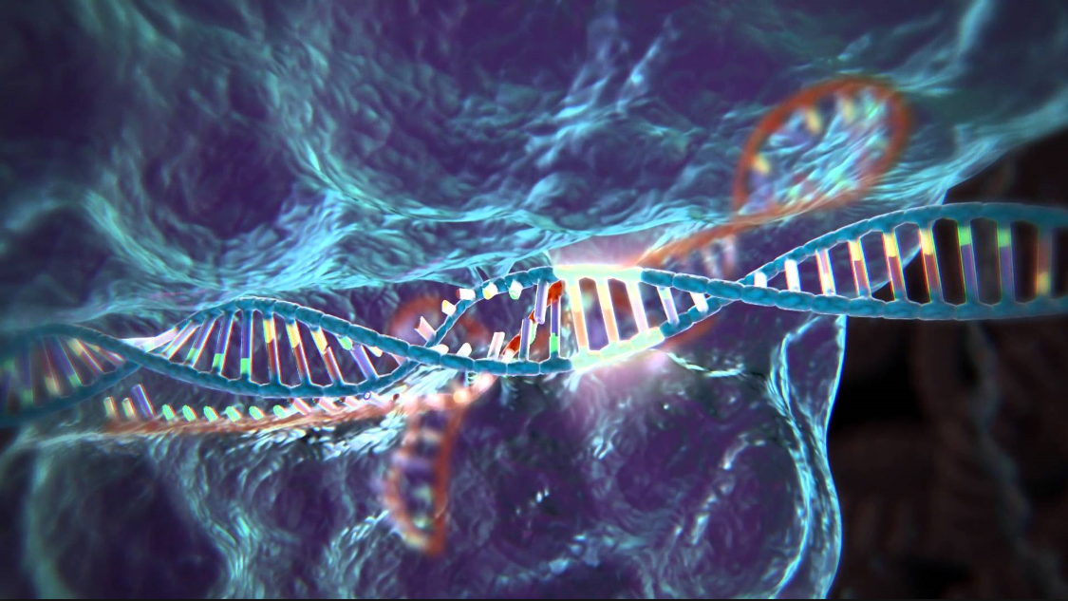
CRISPR/Cas9 as a tool for creation of p53 knock-outs in human glioma cells:
a research proposal by gus thomas

Slide 2
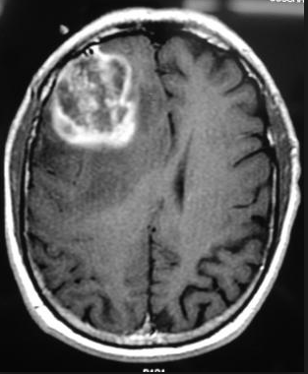
Overview and Introduction:
Glioblastoma Multiforme:
Aggressive brain cancer
Very poor prognosis
Often includes mutated/defective p53 gene

Slide 3
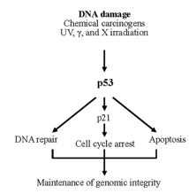
Overview and Introduction:
p53 Gene:
Protein product first step in a cascade of intracellular interactions
Mutant p53 promotes angiogenesis
p21 gene and associated protein prevents tumors

Slide 4
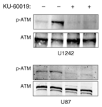
Biddlestone-Thorpe et al. (2013)
Human glioma cell - mp53 versus wtp53:
Gene responsible for p53 easily radiosensitized in mp53
Use of a kinase inhibitor on ATM
Expression of mp53: no physiological effects

Slide 5
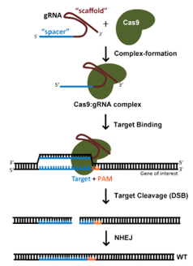
Overview of CRISPR/Cas9
gRNA + Cas9 protein = endonuclease with high specificity
Target determined by gRNA oligonucleotide sequence
Delivery of endonuclease to nucleus of target cell → DNA complement is excised → NHEJ → KO cell line created
Risks:
Off-target effects and/or failure

Slide 6
Experiment: CRISPR/Cas9 Design & Expression:
BLAST used to identify unique p53 sequences
Identification of best gRNA/Cas9 complexes
Three trials for best 5 complex candidates:
No transfection
1µg of endonuclease vectors
3µg of endonuclease vectors

Slide 7
Experiment: Determination of Off-Target Effects:
All cell lines incubated
High-throughput DNA sequencing to determine genotypic differences/off-target effects
Western Blot protein analysis

Slide 8
Expected Results:
Hoping for >1 case with full knockout, few off-target effects
I tentatively conclude that, by looking for protein products of ATM, that radiosensitization can be achieved only alongside mp53
This opens the door for additional research into p53; how might p53 be manipulated to make tumor cells more radiosensitive?
Implications for the future of radiotherapy + genetic therapy

Slide 9
References:
Articles:
L. Biddlestone-Thorpe, M. Sajjad, E. Rosenberg, J.M. Beckta, N.C.K. Valerie, M. Tokarz, B.R. Adams, A.F. Wagner, A. Khalil, D. Gilfor, S.E. Golding, S. Deb, D.G. Temesi, A. Lau, M.J. O’Connor, K.S. Choe, L.F. Parada, S.K. Lim, N.D. Mukhopadhyay, and K. Valerie. ATM Kinase Inhibition Preferentially Sensitizes p53-Mutant Glioma to Ionizing Radiation. 2013. Clinical Cancer Research. 19(12): 3189-3200.
Zhen, S., Ling, H., Takahasi, Y., Narita, S., Yun-Hui, L., and Yan, L. 2014. In Vitro and in Vivo Growth Suppression of Human Papillomavirus 16-Positive Cervical Cancer Cells by CRISPR/Cas9. Biochemical and Biophysical Research Communications. 450(4): 1422-1426.
Golding S.E., E. Rosenberg, N., Valerie, I. Hussaini, M. Frigerio, X.F. Cockcroft, et al. 2009. Improved ATM kinase inhibitor KU-60019 radiosensitizes glioma cells, compromises insulin, AKT and ERK prosurvival signaling, and inhibits migration and invasion. Mol Cancer Therapy. 8:2894–902.
Doench, J.G., Hartentian, E., Graham, D.B., Tothova, Z., Hegde, M., Smith, I., Sullender, M., Ebert, B.L., Xavier, R.J., and Root, D.E. 2014. Rational Design of Highly Active gRNAs for CRISPR-Cas9-Mediated Gene Inactivation. 2014. Nature Biotechnology. 32(12): 1262-1267. http://www.nature.com/nbt/journal/v32/n12/full/nbt.3026.html
Images:
https://www.google.com/search?q=crispr+cas9&source=lnms&tbm=isch&sa=X&ved=0ahUKEwj0jqu9o8HMAhXFVz4KHeD2DLYQ_AUICSgD&biw=1920&bih=1003#imgrc=czdWDDU_aEl5TM%3A
http://emedicine.medscape.com/article/1156220-overview
CRISPR/Cas9 Guide: addgene – the nonprofit plasmid repository. (https://www.addgene.org/crispr/guide/; Accessed April 2016).

