Slide 1
Measurement of the expression of the ALOX15 gene in wounds undergoing negative pressure wound therapy
Nate Stearrett
(presentation format shamelessly stolen from Jeff Elhai)

Slide 2
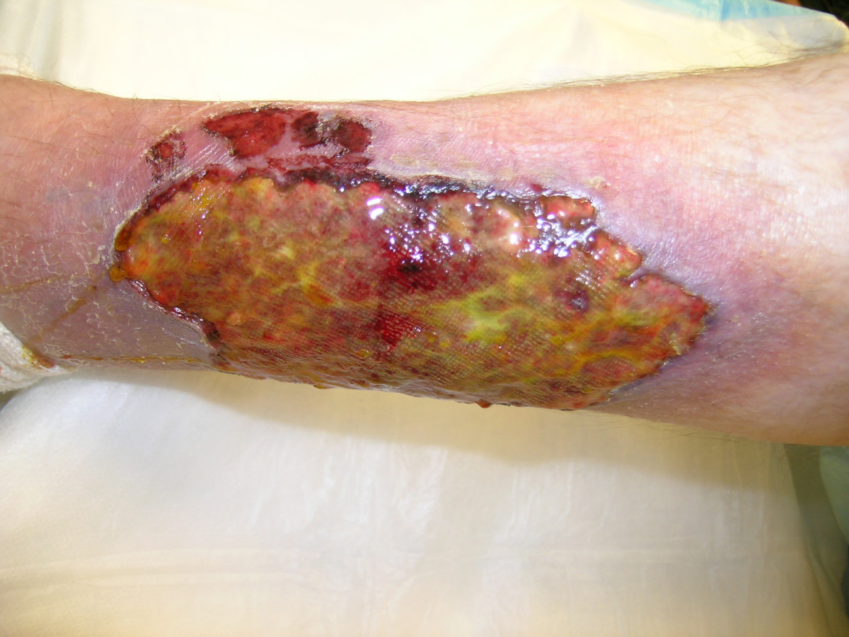
Chronic Wounds
http://wjes.biomedcentral.com/articles/10.1186/1749-7922-2-10

Slide 3
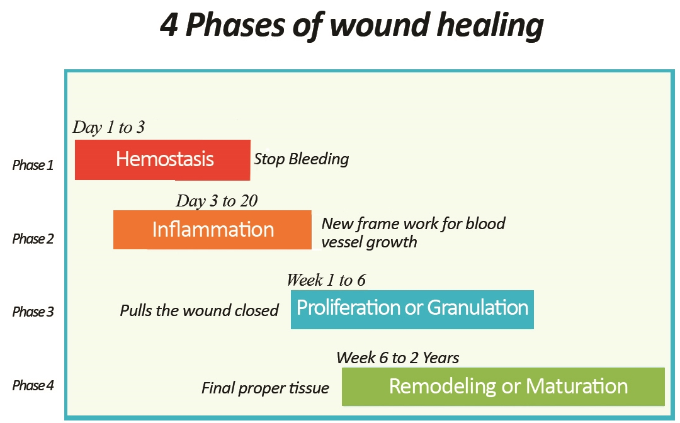
Phases of Wound Healing
https://healthbenefitsfor.wordpress.com/2015/11/09/what-is-the-process-of-wound-healing/

Slide 4
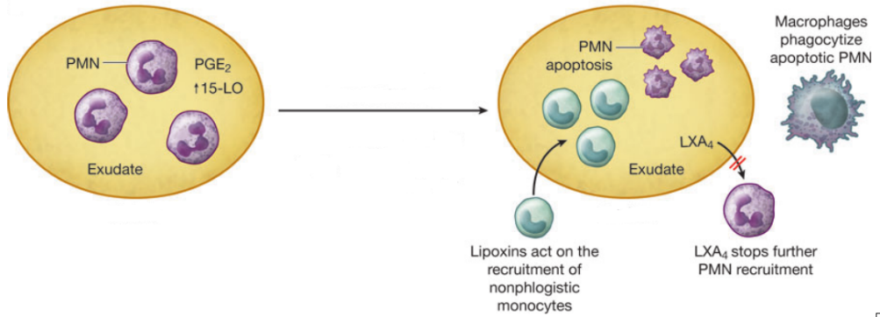
Lipoxin Role in Resolution
Glass, G., Murphy, G., Esmaeili, A., Lai, L., & Nanchahal, J. (2014). Systematic review of molecular mechanism of action of negative‐pressure wound therapy. British Journal of Surgery, 101(13), 1627-1636.

Slide 5
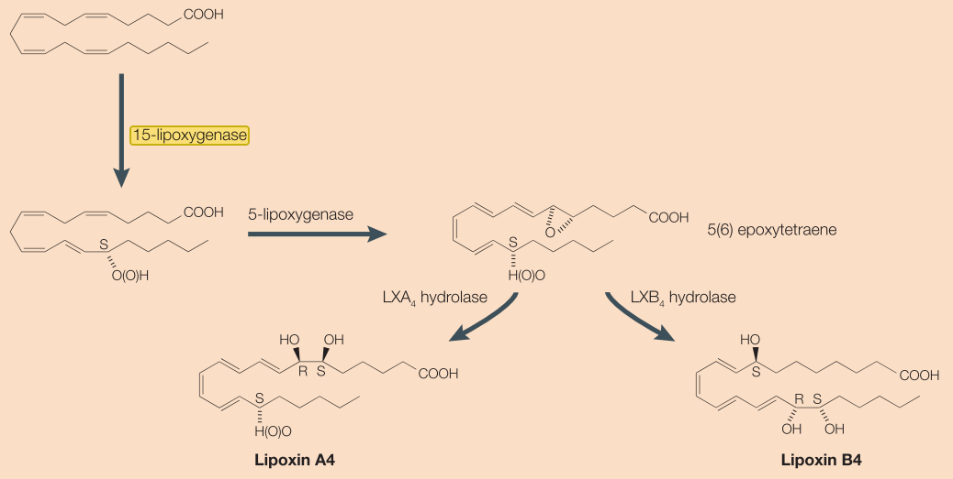
Lipoxin Biosynthesis via 15-LO
Gilroy, D., Lawrence, T., Perretti, M., & Rossi, A. (2004). Inflammatory Resolution: New Opportunities for Drug Discovery.Nature Reviews: Drug Discovery, 3(5), 401-416.

Slide 6
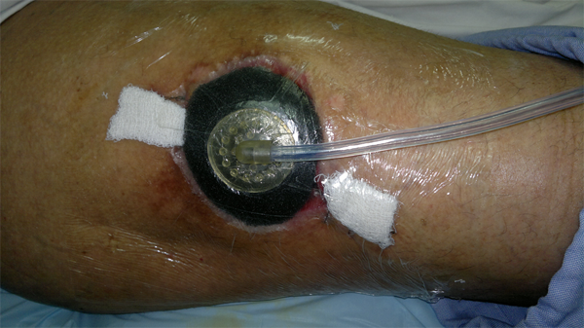
Negative Pressure Wound Therapy
http://www.npwtindia.com/npwt%20hands%20on%20applications.html

Slide 7
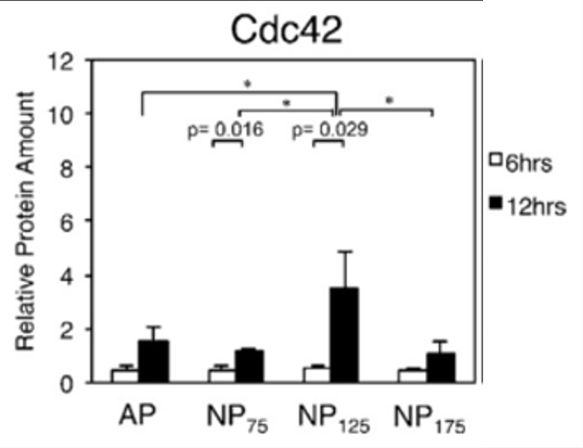
Effect on Gene Expression
Hsu, C. (2013). Negative pressure accelerated monolayer keratinocyte healing involves Cdc42 mediated cell podia formation. Journal of Dermatological Science, 70(3), 196-203.

Slide 8
Hypothesis
The purpose of this experiment is to discover whether NPWT effects the gene expression of ALOX15, whose protein product controls biosynthesis of the lipoxins directly involved in wound resolution.

Slide 9
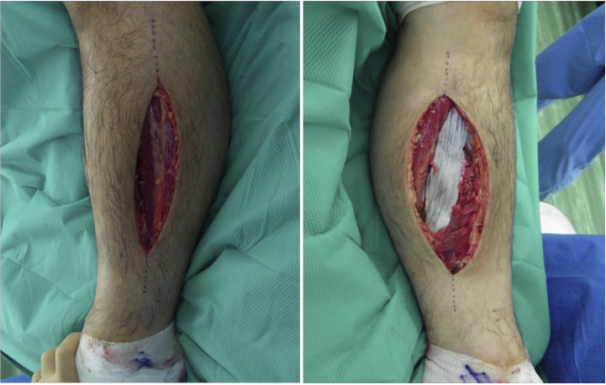
Sampling
Zenke, Inokuchi, Okada, Ooae, Matsui, & Sakai. (2014). Useful technique using negative pressure wound therapy on postoperative lower leg open wounds with compartment syndrome. Injury Extra, 45(9), 83-87.

Slide 10
Cell Lysis and RNA Isolation
Qiagen

Slide 11
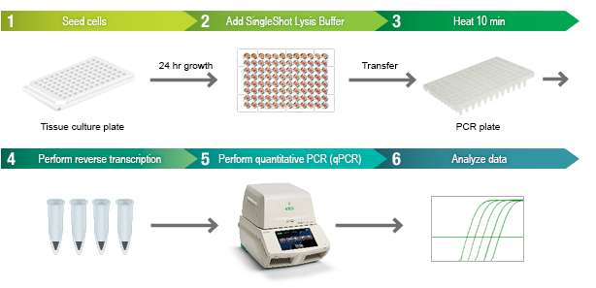
qPCR Amplifies Transcripts
http://www.bio-rad.com/en-us/product/cell-lysis-rt-qpcr-kits

Slide 12
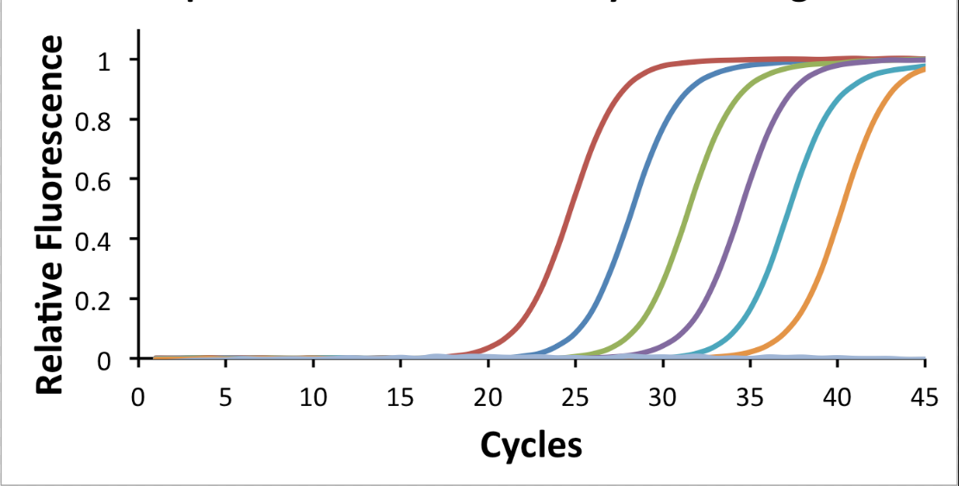
Quantifying Gene Expression
http://www.mypols.de/qpcr-probe-2x-master-mix/

Slide 13
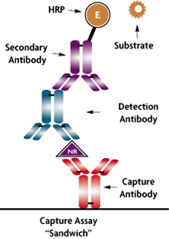
Quantifying Protein Levels
https://www.activemotif.com/catalog/249/nr-sandwich-ar-elisa

Slide 14
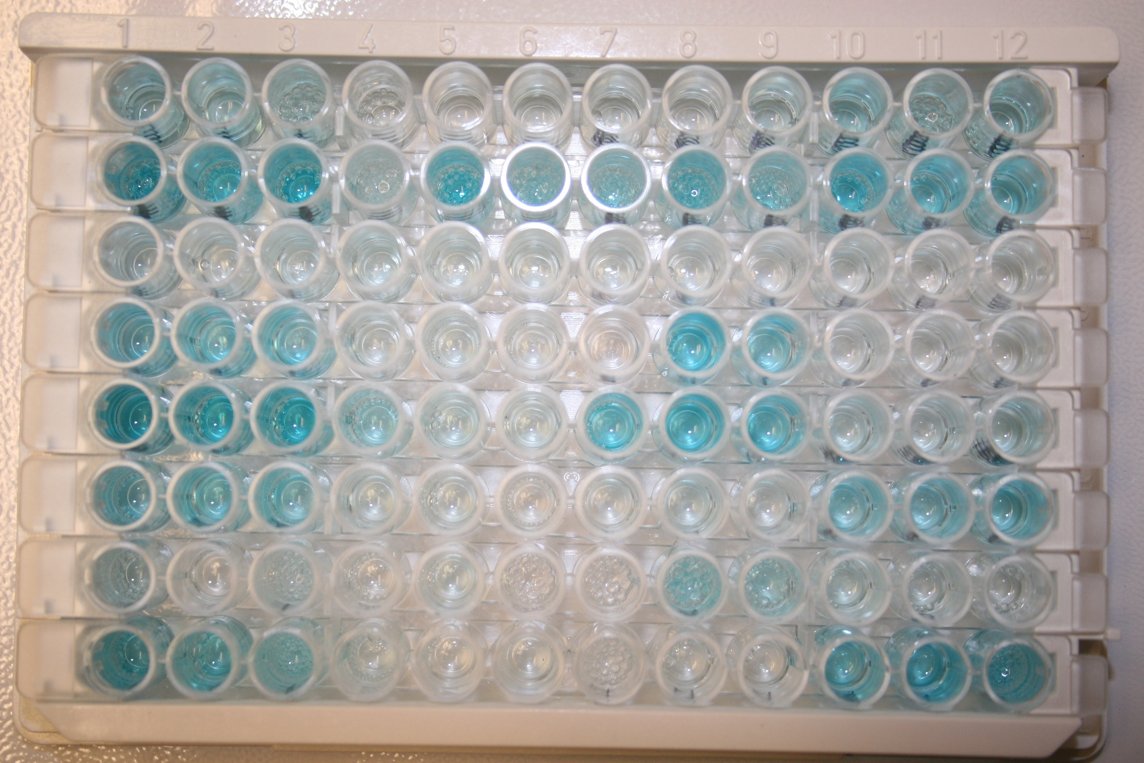
Color Change Indicates Presence
http://vetsci.co.uk/2011/01/07/diagnostic-tests-used-for-viruses/

Slide 15
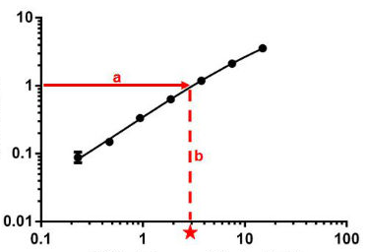
Quantifying Protein Levels
Optical Density (450nm)
Concentration (ng/mL)
http://www.abcam.com/protocols/calculating-and-evaluating-elisa-data

Slide 16
Ideal Results
If NPT does effect gene expression of ALOX15, there should be elevated mRNA transcript and protein levels observed.

Slide 17
Why We Care
http://www.onegoodthingbyjillee.com/2016/03/home-remedies-to-heal-scars-naturally.html

