Slide 1
Lysis of shiga toxin-producing Escherichia coli by delivery of Crispr/Cas9 cascade coding cosmid targeting Stx 1 and Stx 2 genes via lambda phage delivery system
Amanda Rutledge

Slide 2
What’s the worry?
Notes:
Shiga toxin e coli found in meat and dairy. You eat infected meat and dairy. You get sick. No way of actually treating.

Slide 3
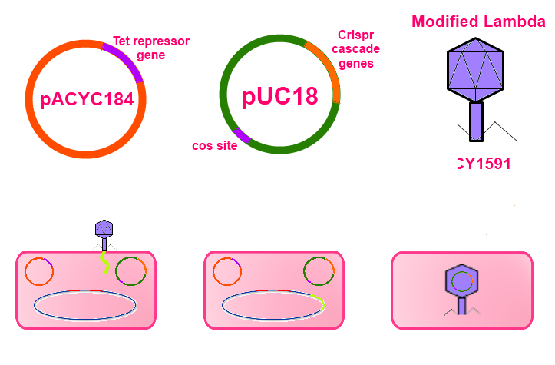
Preview of proposed experiment
C
Notes:
I will describe the construction of tetR containing plasmid, Crispr containing cosmid, and use of modified lambda to package cosmid.

Slide 4
How E. coli become Shiga toxin-producing
Shiga toxin-encoding phage
(such as 933W)
Escherichia coli
Notes:
Become shiga toxin producing when undergo lysogenesis with shiga toxin encoding phage

Slide 5
How E. coli become Shiga toxin-producing
Shiga toxin-encoding phage
(such as 933W)
Escherichia coli

Slide 6
How E. coli become Shiga toxin-producing
Escherichia coli

Slide 7
Construction of pACYC184
Tet Repressor
Gene
HindIII
pACYC184
AvaI
pACYC184

Slide 8
Construction of pUC18 cosmid
Crispr cascade genes
pUC18
lacZα gene
Cos site
pUC18

Slide 9
Modified Lambda
Kanamycin resistance gene
Split cos site

Slide 11
Crispr/Cas9

Slide 12
Questions?

