Slide 1
Deep Venous Thrombosis and FV leiden mutation during overweight pregnancy
Notes:
The topic I chose was studying DVT in pregnancy.

Slide 2
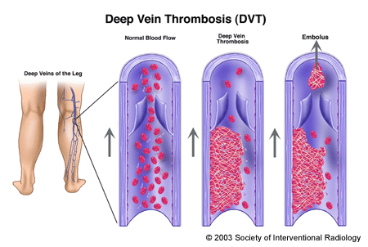
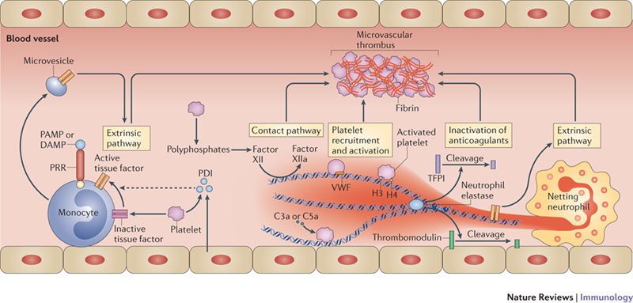
Background
Formation of embolus
Coagulation Cascade
Notes:
Deep Vein Thrombosis or DVT is a condition which causes blood clots or a thrombus to form in multiple places deep within veins. According to the CDC, venous thromboembolism occur in around 2 in every thousand people in the United states each year. This number is even higher in pregnant women, and why it’s thought to be so is to limit bleeding during birth. Vessels are more fragile and can induce clotting and initiate the coagulation cascade much easier. On the left you can see how clotting will look like and how parts can become loose and travel towards the heart, which can cause pulmonary issues, even death.
On the right, is the coagulation cascade shown within the vessel. There’s an extrinsic and intrinsic pathway that meet up towards the end with the activation of Factor 5 which is the start of the creation of a fibrin mesh that will plug the damage.

Slide 3
Big question
What are the effects of an overweight pregnancy in women with FV leiden mutation, on the production levels of Factor V in accordance to Deep Venous Thrombosis
Notes:
So my question is… Why I chose overweight pregnancy was due to the

Slide 4
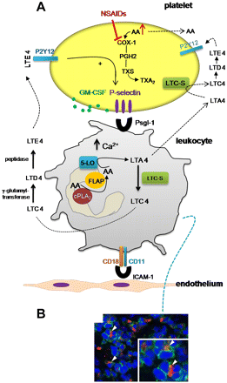
Why Factor V?
Factor V leiden is a mutation of FV and increases chance of hypercoagulability. Also blocks anti-coagulant proteins (aPC).
incomplete penetrance
Origin from liver / platelets
80% in plasma 20% platelets
Factor used right before prothrombin activator which initiates fibrin production from activated thrombin and fibrinogen
Fibrin is what makes initiates the mesh to form and plug a wound
Is there an excess of signaling for FV, thus platelets?
Notes:
Factor 5 leiden is a mutation of the F5 gene, and increases hypercoagulability. How this happens is due to its inability to recognize anticoagulants such as activated Protein C

Slide 5
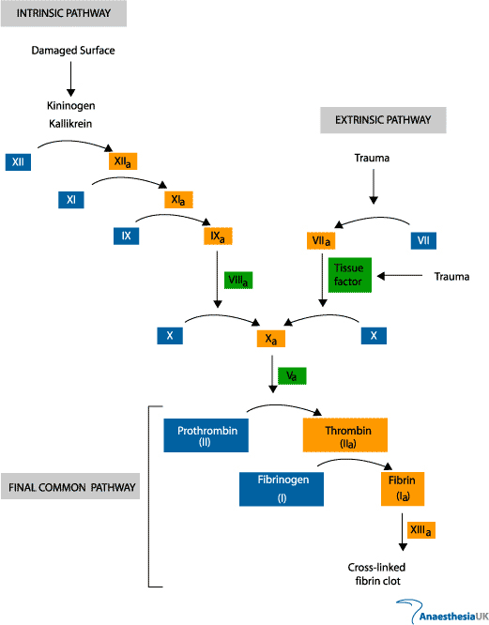
Coagulation cascade

Slide 6
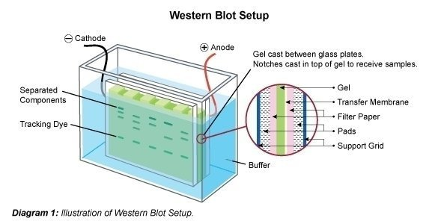
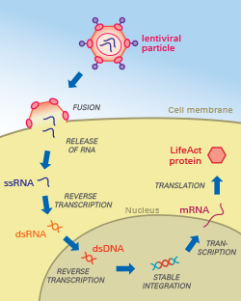
Experiment
- Test standard mouse model C57Bl6
Induce increased weight (high fat diet) / DVT (lentiviral vectors)
Extract liver cells to record rate of megakaryocyte/ FV levels by treating with thrombopoietin before and after pregnancy
Record with Western blot (FV protein)
Record DVT by inferior vena cava
Notes:
The standard black mouse would be used due to its ability to show expression of genes rapidly, and reproduce fast as well.
To induce an increased weight, a high cholesterol diet will be given from when they can start eating.
To induce deep vein thrombosis, a lentiviral construct will be used to induce expression of Factor V Leiden (the mutated normal human FV) . How this will work, is the construct will be used to transduce the the mutated gene into the bone marrow cells, and these will produce a mutated FV.
To measure FV levels, liver cells will be extracted and treated with thrombopoietin to induce platelet growth through megakaryocyte growth. Factor 10 and calcium will be used to activate this factor.
A western blot will be used to measure these levels.
Severity of DVT by looking at the inferior vena cava

Slide 7
Results
What will be compared are the factor 5 levels within DVT/non DVT mice and severity of DVT as well as fat content
If there is a correlation with FV mutation, DVT, and pregnancy, hypothetical assumption can be made about pregnancy’s effects.
Notes:
What I’m proposing is that if there is more than 1 risk factor (being overweight) for pregnant women with the trait for FV leiden, DVT is more likely to form and be more severe.

Slide 8
Questions

