Slide 1
Measuring the Effect of Silencing the APP gene and Stimulating the CaMKII Pathway on Synaptic Plasticity in Alzheimer’s Disease
Harshita Nangunuri

Slide 2
APP Gene
Amyloid precursor protein
B-amyloid peptide
Affects synaptic plasticity
Forms senile plaques (SPs) in AD patients

Slide 3
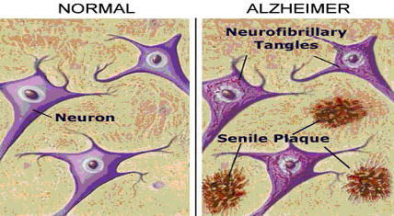
Alzheimer’s Disease
Hallmark Symptoms
Senile Plaques (SPs)
B-amyloid peptide
Neurofibrillary Tangles (NFTs)
Tau protein
http://www.spice-of-life.com/columns/thesis/Figure%2011%20-%20Neuronfibrillary.jpg

Slide 4
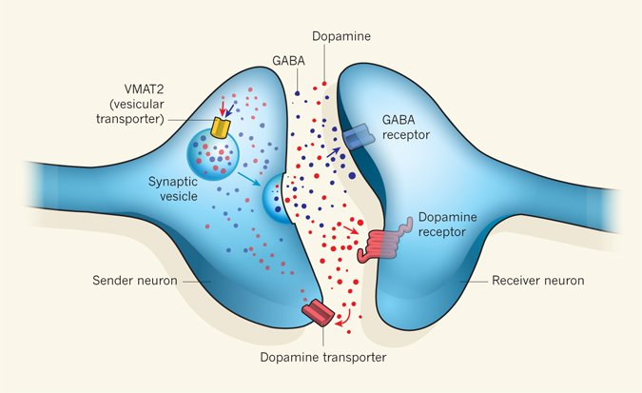
Previous Research
Problems with APP Gene Knockout
http://www.nature.com/nature/journal/v490/n7419/fig_tab/490178a_F1.html

Slide 5
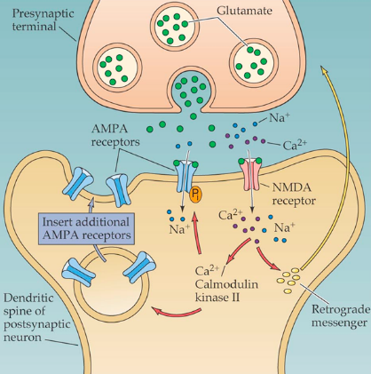
CaMKII Pathway
https://qph.is.quoracdn.net/main-qimg-12969c313f9ce29abe65a2f8241279a2?convert_to_webp=true
Notes:
One method to overcome this problem is by increasing the amount of intracellular Calcium in these cells
Ca+ increases the ability of presynaptic cells to release vesicles
Norepinephrine + a-adrenergic receptor

Slide 6
Central Question
The purpose of this experiment is to determine a method in which the ability of presynaptic neurons to secrete presynaptic vesicles containing neurotransmitters is not compromised when the APP gene is knocked out.

Slide 7
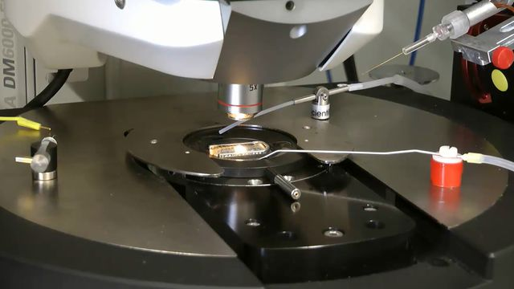
Experiment
Isolate hippocampal slides
Gardoni et al. (2001)
Slice electrophysiology
http://www.leica-microsystems.com/typo3temp/_processed_/csm_Electrophysiology_on_brain_slices_6bf3400f8f.jpg

Slide 8
Experiment
3 Groups
siRNA
Control group
(APP Gene Active, No Glutamate Present)
Second Experimental group
(APP Gene Silenced, Incubated with Glutamate )
First Experimental Group
(APP Gene Silenced, No Glutamate Present)

Slide 9
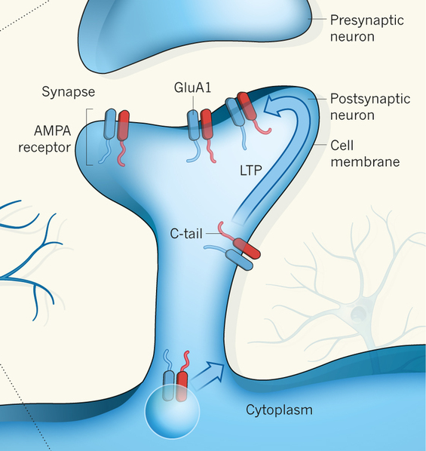
Experiment
EPSPs of AMPA receptors
http://www.nature.com/nature/journal/v493/n7433/images/493482a-f1.2.jpg

Slide 10
Questions?

Slide 11
References
APP. (2016, April 26). Retrieved April 30, 2016, from https://ghr.nlm.nih.gov/gene/APP
Gardoni et al. (2001). Hippocampal Synaptic Plasticity Involves Competition between Ca²⁺/Calmodulin-Dependent Protein Kinase II and Postsynaptic Density 95 for Binding to the NR2A Subunit of the NMDA Receptor. The Journal of Neuroscience 21(5):1501-1509. (http://www.jneurosci.org/content/21/5/1501.long)
Laßek et al. (2014). Amyloid precursor protein knockout diminishes synaptic vesicle proteins at the presynaptic active zone in mouse brain. Current Alzheimer Research 10:971-980. (http://www.ncbi.nlm.nih.gov/pubmed/25387333)
Liang et al. (2010). Neuronal gene expression in non-demented individuals with intermediate Alzheimer’s Disease neuropathology. Neurobiological Aging:549-566. (http://www.ncbi.nlm.nih.gov/pubmed/18572275)
Light Microscope vs Electron Microscope. (n.d.). Retrieved May 01, 2016, from http://www.ivyroses.com/Biology/Techniques/light-microscope-vs-electron-microscope.php
Perez M, Cuadros R, Benitez M, Jimenez J (2004). Interaction of Alzheimer’s disease amyloid β peptide fragment 25–35 with tau protein, and with a tau peptide containing the microtubule binding domain. Journal of Alzheimer’s Disease 6:461-467. (http://content.iospress.com/download/journal-of-alzheimers-disease/jad00350?id=journal-of-alzheimers-disease%2Fjad00350)
Purves, D., & Williams, S. M. (2001). Neuroscience. 2nd edition. Sinauer Associates. Retrieved April 30, 2016, from http://www.ncbi.nlm.nih.gov/books/NBK10802/
Strack S, Choi S, Lovinger D, Colbran R (1997). Translocation of Autophosphorylated Calcium/Calmodulin-dependent Protein Kinase II to the Postsynaptic Density. The Journal of Biological Chemistry 272(21):13467-13470. (http://www.jbc.org/content/272/21/13467.full.pdf+html)
Zito K and Scheuss V (2009). NMDA Receptor Function and Physiological Modulation. Encyclopedia of Neuroscience:1157-1164. (http://brain.phgy.queensu.ca/pare/assets/Neurobiology2.pdf)

