Slide 1
Do enzyme-inhibiting drugs show increased reliance
on certain chemical properties for binding to
their respective enzymes?

Slide 2
Chemical properties that affect binding of
enzyme-inhibiting drugs to enzymes
Research proposal by Dan Nacu

Slide 3
Why is this significant?
Drug Development
Computers

Slide 4
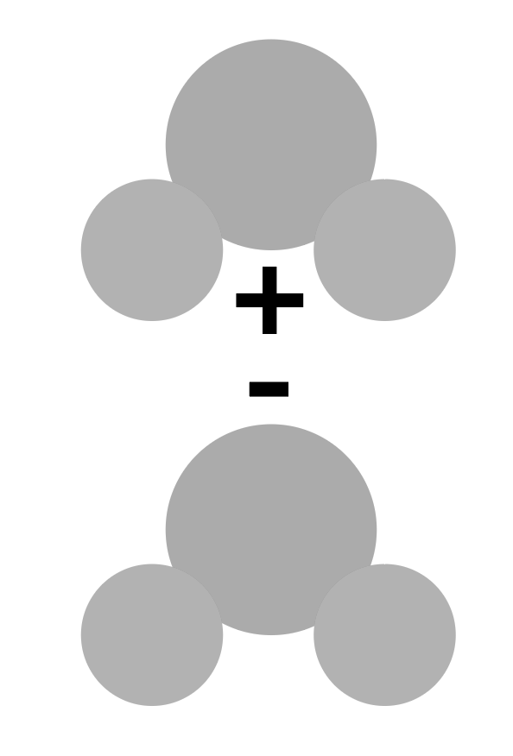
How can it be done?
Simulation Models
Shape Complementarity
Chemical Properties

Slide 5
How can it be done?
Chemical Properties
Solvent Accessible Surface Area
Hydrophobicity
Electrostatics
Van Der Waal’s Forces
Residue Pair potential
Desolvation Energies
Atomic Contact Energies
Complementary Determining Regions
etc…
A lot of options…

Slide 6
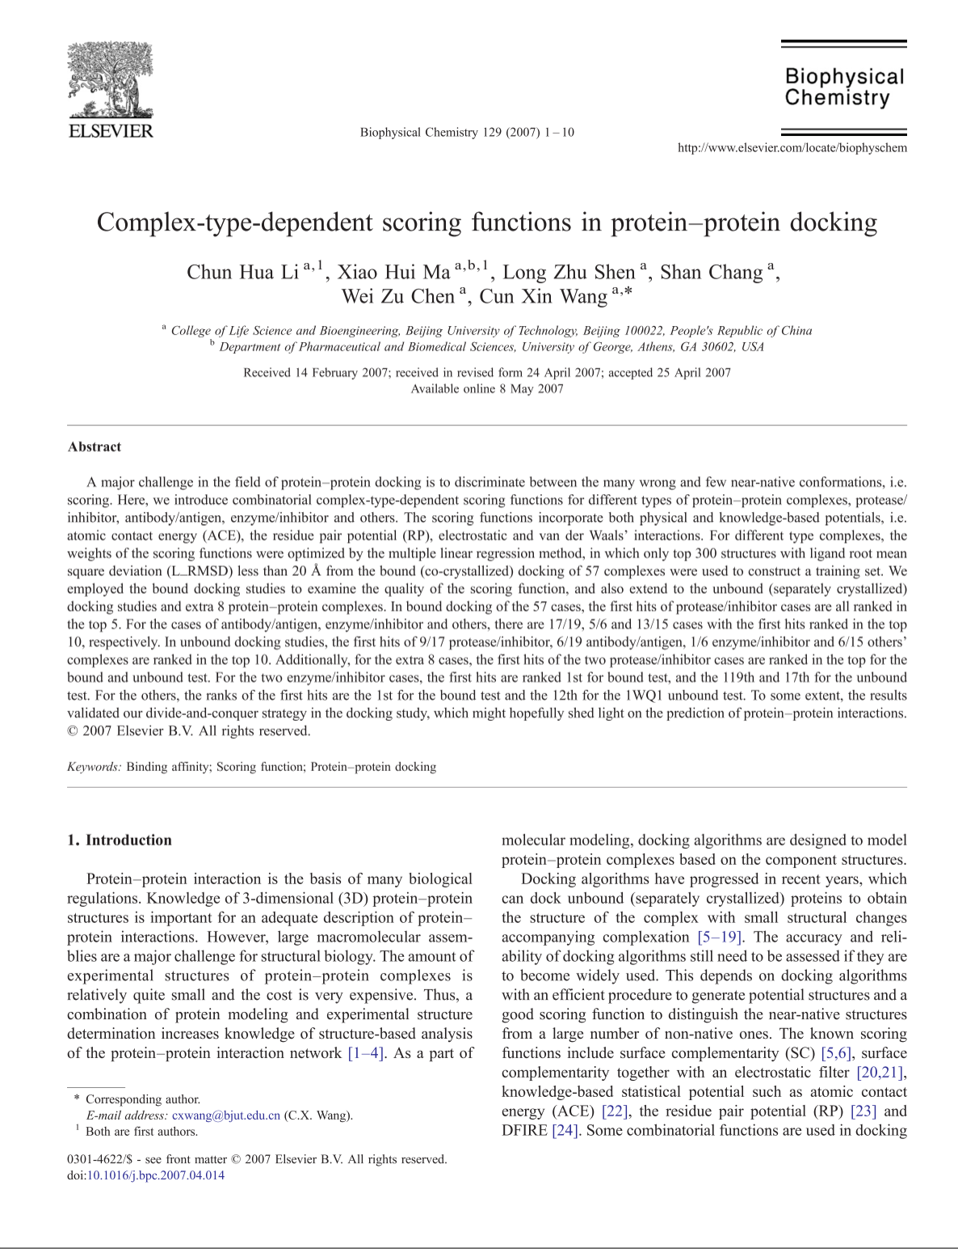
Its been done before…in a different way.
Li et al, 2007
Their Equation
Their Results

Slide 7
How will this be different?
Introducing HINT
Hydropathic INTeractions
The HINT Equation

Slide 8
What can be done?
By weighing each variable in HINT, the most important chemical property for enzyme/inhibitor complexes can be found.
Remember The Question
Do enzyme-inhibiting drugs show increased reliance
on certain chemical properties for binding to
their respective enzymes?

Slide 9
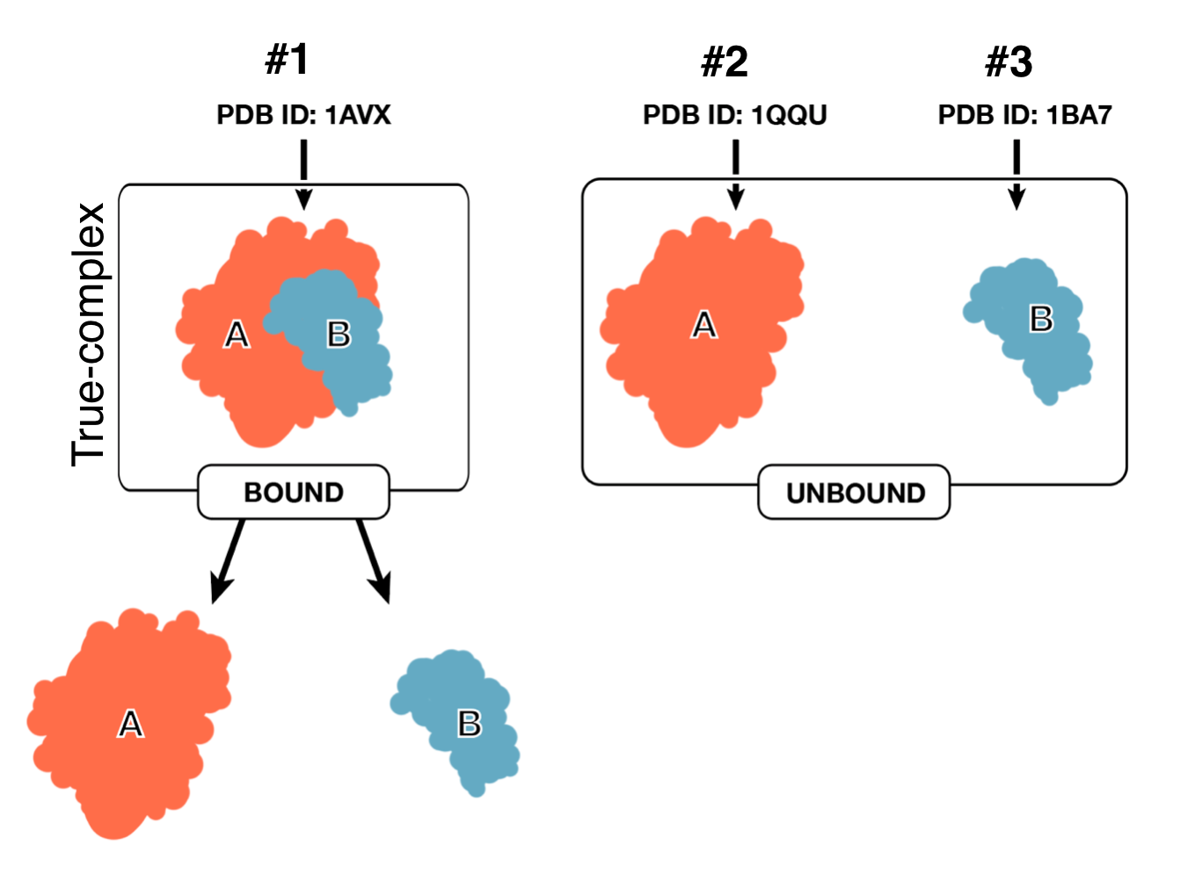
What’s the experiment?
Start with 46 enzyme inhibitor complexes
from the Benchmark 5.

Slide 10
What’s the experiment?
Bound
Unbound
FTDock
Huge list of possible complexes

Slide 11
What’s the experiment?
Huge list of possible complexes
L_RMSD Testing
Ligand_Root-Mean-Square-Deviation
Top 20 Structures

Slide 12
What’s the experiment?
Top 20 Structures
For 46 complexes =
920 simulated structures.
For both bound and unbound, 1,840 total
Lets look at just one

Slide 13
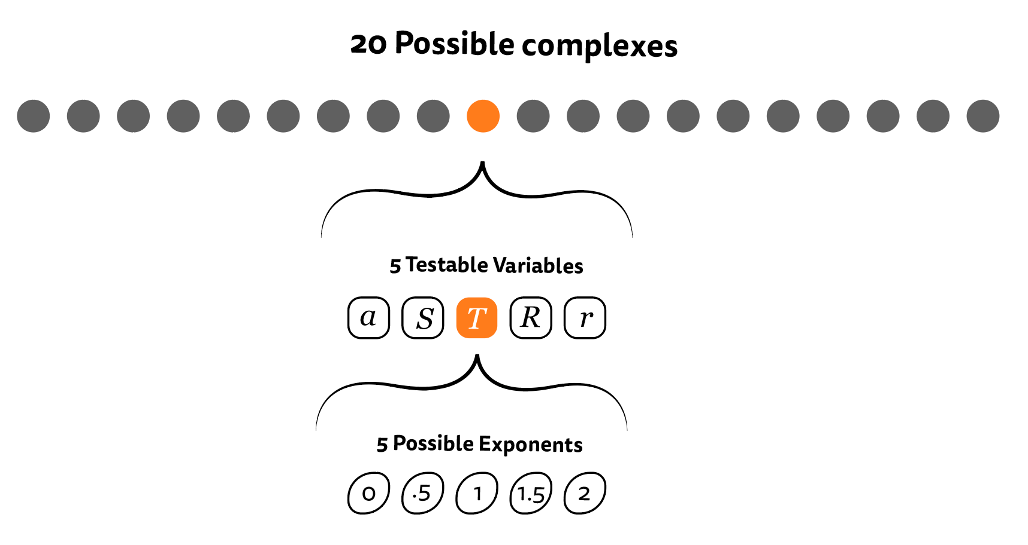
What’s the experiment?

Slide 14
What’s the experiment?
In the end…
23,000 HINT Scores for Bound
23,000 HINT Scores for Unbound
46,000 scores
46•20•5•5 = 23,000

Slide 15
What’s the experiment?
Highest 50 HINT Scores for each complex
L_RMSD Testing
Ligand_Root-Mean-Square-Deviation
Find best match for each complex
Results!
Notes:
Mention <5Å

Slide 16
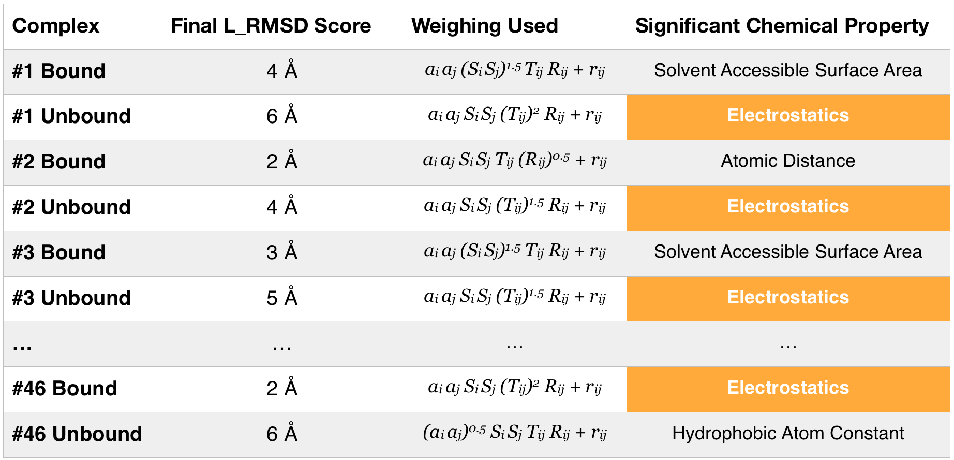
Possible Results

Slide 17
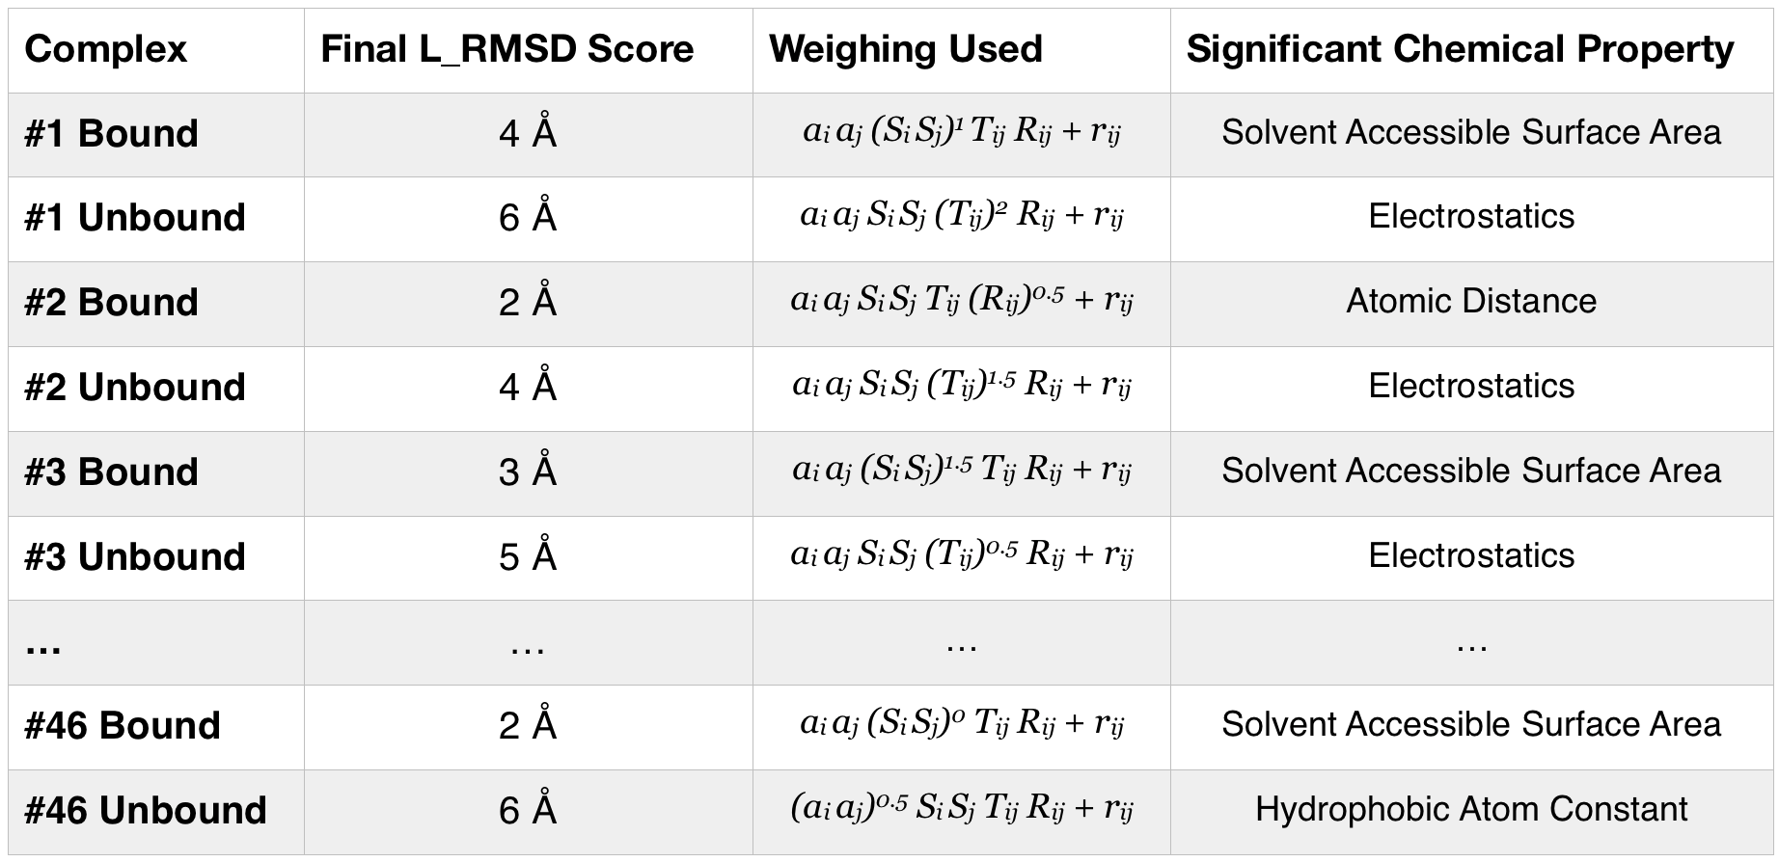
Possible Results

Slide 18
In the future…
Different models (besides HINT)
Different complexes (besides enzyme/inhibitor)

Slide 19
Questions?

