Slide 1
Importance of SPH2 in RAS/MAPK signalling pathway in NF1 nondystrophic scoliosis
Presenter: Miral Mahmood
Mentor: Ning Zhang

Slide 2
Importance of SPH2 in RAS/MAPK signalling pathway in NF1 nondystrophic scoliosis

Slide 3
Introduction: What is Neurofibromatosis?

Slide 4
Key Components for our experiment:
Osteochondroprogenitor cells
Chondrocytes
SHP2
RAS/MAPK signalling

Slide 5
Osteochondroprogenitor cells:
Blood cells
Muscle cells
BONE CELLS

Slide 7
Chondrocytes (cells found in cartilage connective tissue)
What is cartilage?
Our focus is on fibro-cartileage.
Why? Found in knees and also in the spine in between the vertebrae

Slide 8
Why chondrocytes and SHP2? Significance? Importance?
SHP2 has been shown to play an important role in regulating chondrocyte function (Bowen et)
SHP2 regulates chondrogenesis by influencing multiple RTK and cytokine receptor signalling pathways and the expression of Sox9 and Runx2 (Raghevendra et al)
Sox9 and Runx2 are transcriptional regulators essential for articular cartilage fromation (Lefebrvre) eet al

Slide 9
What we don't know:
We still don’t understand what cells come into play or the pathway involved with nondystrophic scoliosis.
however we do know that NF1 MSC cells can be differentiated into chondrocytes as previous studies have demonstrated(Wu et al).
So now we can hypothesize and continue or experiment by applying similar methods to Kim et al since we have all the key components available: SHP2 in chondrocytes and a RAS/MAPK signaling pathway.

Slide 10
What we do know (based on previous experiments):
However we do know that NF1 MSC cells can be differentiated into chondrocytes as previous studies have demonstrated(Wu et al).
We do know that SPH2 disruption has a negative effect of chondrocyte funtion
So now we can hypothesize and continue or experiment by applying similar methods to Kim et al since we have all the key components available: SHP2 in chondrocytes and a RAS/MAPK signaling pathway.

Slide 11
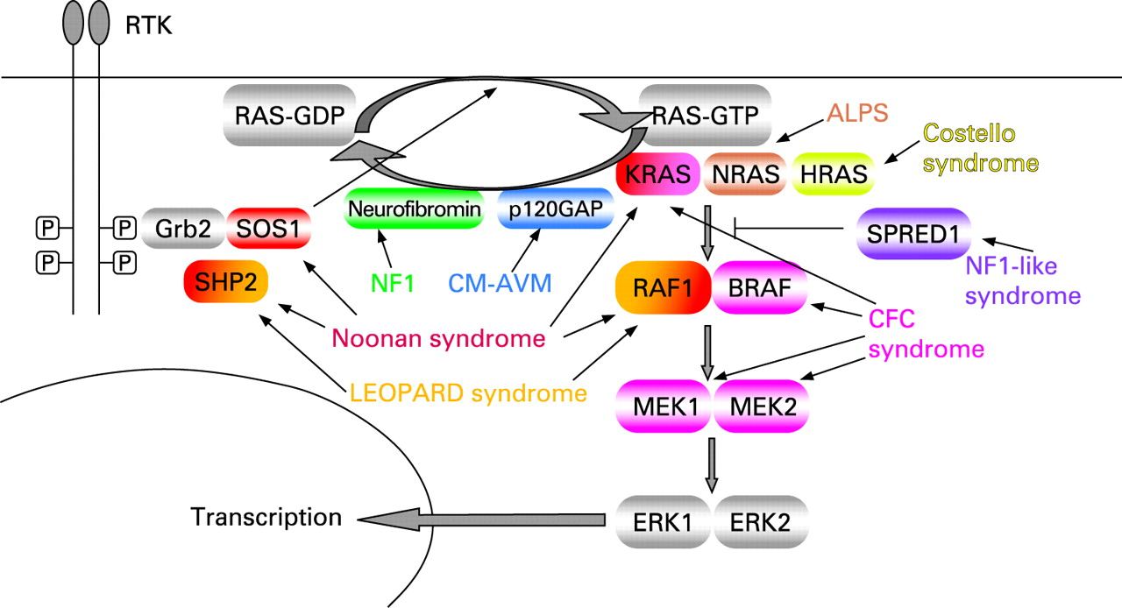
RAS/MAPk Pathway: What does shp2 have to do with this? RAS / RAF / MEK / ERK

Slide 12
Procedure
3. in chondrocytes via tamoxifen administration to control the cell-type and the time of SHP2 defi ciency. To delete conditionally the SHP2 genespecifi cally in chondrocytes, we used a transgenic mouse line expressing Cre recombinase under the control of the type II collagen promoter ( i.e., Col2a1CreERt2 mice, provided by Chen et al3 ), which is inducible by tamoxifen administration.
4. To induce a gene disruption in vivo, we injected tamoxifen into mice via intraperitoneal injection at a concentration of 1 mg per mouse per injection following a previous report. 3 Because the Cre recombinase activity that induces the SHP2 gene deletion is controlled under the type II collagen promoter after tamoxifen administration, only the cells expressing type II collagen ( i.e., chondrocytes) will develop the SHP2 gene disruption.
Genetically engineered mice with inducible deletion of SHP2 in chondrocytes were generated. The SHP2 function in chondrocytes was inactivated during a juvenile growth stage from the mouse age of 4 weeks. Radiographical, micro-computed tomographic, and histological assessments were used to analyze spinal changes
We bred genetically engineered mice with an inducible SHP2 gene deletion

Slide 13
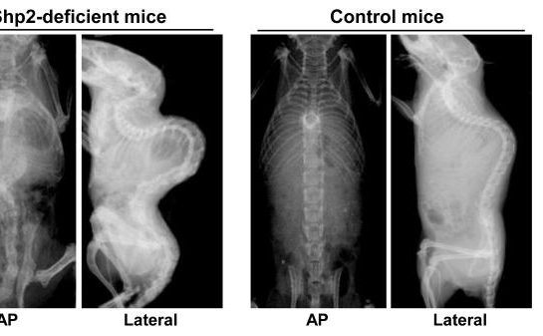
Results
when SHP2 deficiency was induced during the juvenile stage, a progressive kyphoscoliotic deformity (thoracic lordosis and thoracolumbar kyphoscoliosis) developed within 2 weeks of the initiation of SHP2 defi ciency.

Slide 14
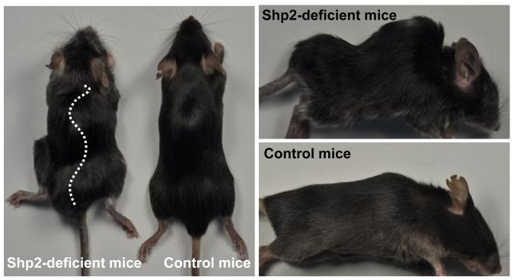
what you expect to happen...

Slide 15
Conclusion
We have determined from the experiment above that SHP2 is a positive regulator of RAS-MAPK signaling.This mouse model is an important tool to study how the SHP2 deficiency affects RAS-MAPK signaling in NF1 specific nondystrophic scoliosis and how it worsens when the RAS-MAPK signaling is not regulated.

Slide 16
REFERENCES:
Germaine L Defendi, Luis O Rohena. Genetics of Neurofibromatosis Type 1 and Type 2. Web.
Stevenson DA1, Schwarz EL, Carey JC, Viskochil DH, Hanson H, Bauer S, Weng HY, Greene T, Reinker K, Swensen J, Chan RJ, Yang FC, Senbanjo L, Yang Z,Mao R, Pasquali M, Bone resorption in syndromes of the Ras/MAPK pathway.
Chen H1, Qiu Y, Chen L, Li L, Chen J, Zhang C, Wang B, Yu Y, Zhu Z, Zhu F, Qian B, Ma W. The expression of neurofibromin in human osteoblasts and chondrocytes.
Kim HK1, Aruwajoye O, Sucato D, Richards BS, Feng GS, Chen D, King PD, Kamiya N. Induction of SHP2 deficiency in chondrocytes causes severe scoliosis and kyphosis in mice.
J.M. Friedman, Epidemiology of neurofibromatosis type 1
Durrani, Abubakar A. MD*; Crawford, Alvin H. MD*; Chouhdry, Sambhu N. MD*; Saifuddin, Asif F.Modulation of Spinal Deformities in Patients With Neurofibromatosis Type 1

Slide 17
QUESTIONS?

