Slide 1
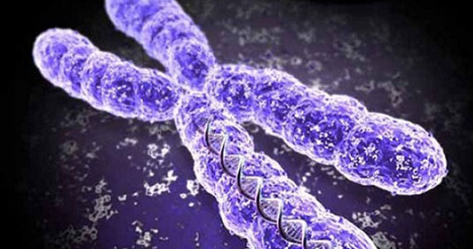
BPTF role in PI3K-AKT pathway in breast cancer
Michael Livingston

Slide 2
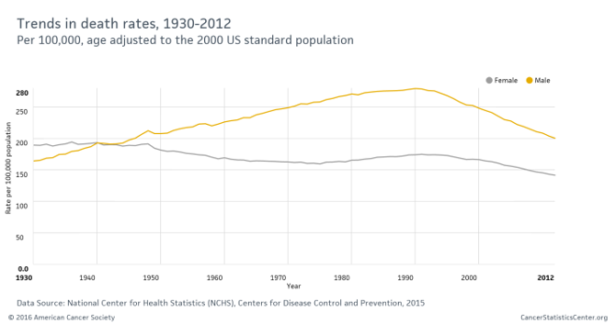

Slide 3
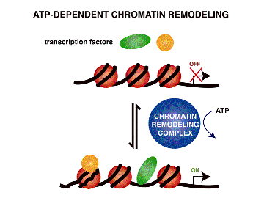
What is Cancer?
Normal cells acquiring tumor promoting traits
uncontrolled cell growth
avoiding detection by the immune system
overriding DNA damage checkpoints
Dysregulated Gene Expression
Nucleosome Remodeling complexes
ATP-dependent

Slide 4
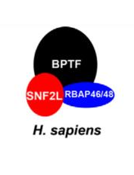
Nucleosome Remodeling Factor (NURF)
Largest subunit: Bromodomain PHD finger transcription factor (BPTF)
Functional role in tumor progression is incompletely understood
Notes:
Part of the ISWI family

Slide 5
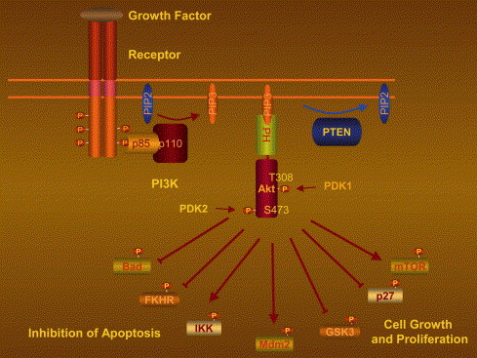
PI3K-AKT Pathway
Regulates many normal cellular processes
proliferation, survival, and growth.
Processes that are critical for tumor growth

Slide 6
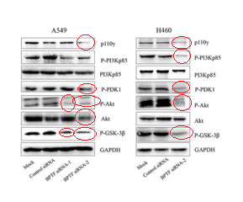
Previous Studies
Dai et al (2015) examined the effects of BPTF on lung cancer cell lines
Reported that BPTF regulates PI3K-AKT signaling pathway in lung cancer (Fig).

Slide 7
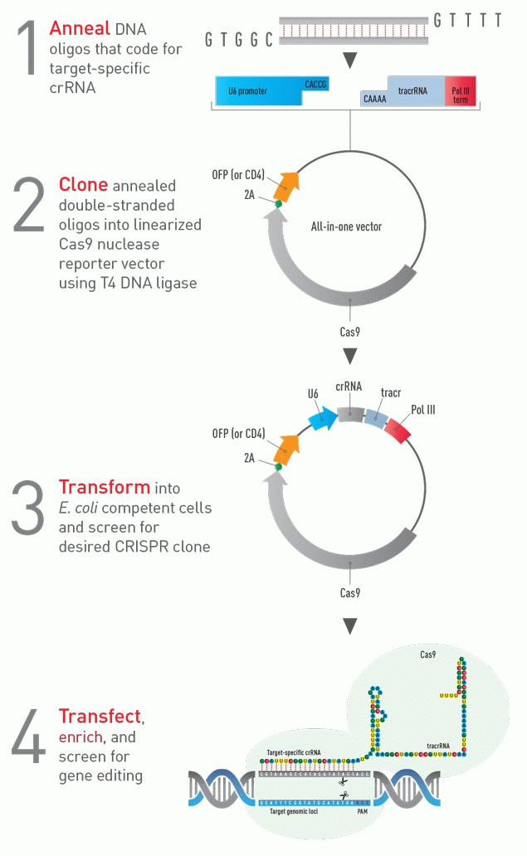
Experiment Overview
CRISPR/Cas9 knockout BPTF gene & Overexpress BPTF
Transfect cell lines
Western Blot

Slide 8
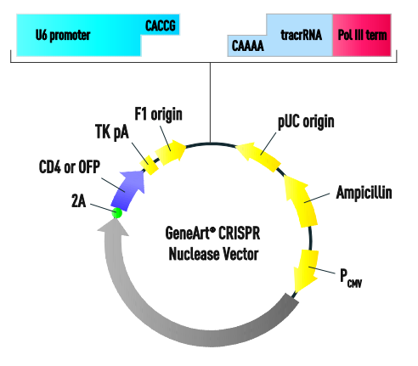
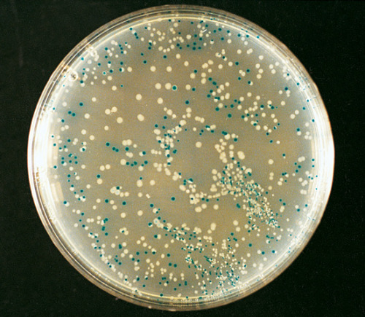
CRISPR/Cas9 - gRNA
Used to knockout BPTF gene
Target sequence:
“AGAGGAGGACATGGTCTCCGAGG”
Screen E.coli
-Recombinants are white
-Non-recombinants are blue
Electroporate vector into E.coli

Slide 9
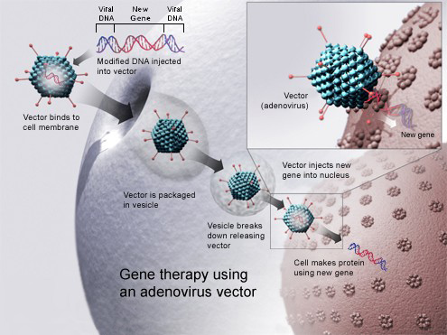
Transfect Cell Lines
Packaged adenovirus transfection
Both overexpression (facilitated by CMVp) & knockout

Slide 10
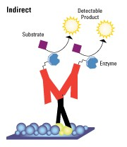
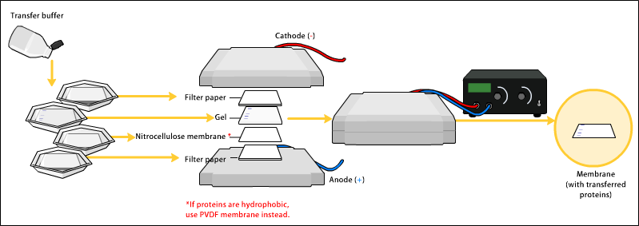
Western Blot
Secondary
Detection
Will knockdown of BPTF decrease expression of proteins related to PI3K-AKT pathway in breast cancer cell lines?

Slide 11
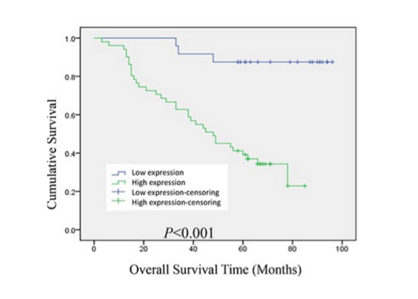
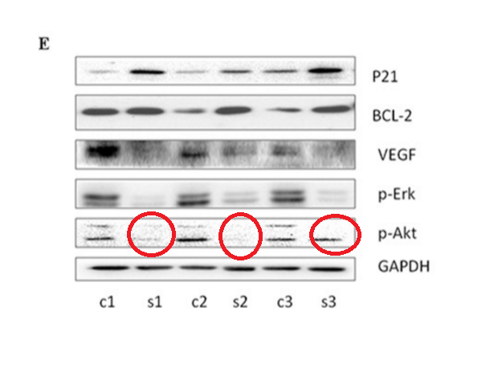
Western blot of p-AKT and other cancerous pathways
BPTF predicted a poor prognosis in lung adenocarcinoma
c= control
s= shRNA BPTF

Slide 12
Questions or Comments

Slide 13
References
Tessa G. Montague; Jose M. Cruz; James A. Gagnon; George M. Church; Eivind Valen. (2014). CHOPCHOP: a CRISPR/Cas9 and TALEN web tool for genome editing. Nucleic Acids Res. 42. W401-W407
"GeneArt CRISPR Products and Services." Thermo Fisher Scientific. N.p., n.d. Web. 30 Apr. 2016.
Luo, Ji, Brendan D. Manning, and Lewis C. Cantley. "Targeting the PI3K-Akt pathway in human cancer: rationale and promise." Cancer cell 4.4 (2003): 257-262.
Vos, Pieter, et al. "AFLP: a new technique for DNA fingerprinting." Nucleic acids research 23.21 (1995): 4407-4414.
Liu, B., Yip, R. K., & Zhou, Z. (2012). Chromatin Remodeling, DNA Damage Repair and Aging. Current Genomics, 13(7), 533–547. http://doi.org/10.2174/138920212803251373
Raab, J. R., Resnick, S., & Magnuson, T. (2015). Genome-Wide Transcriptional Regulation Mediated by Biochemically Distinct SWI/SNF Complexes. PLoS Genet, 11(12), e1005748.
-Kim, K. H., Kim, W., Howard, T. P., Vazquez, F., Tsherniak, A., Wu, J. N., ... & Orkin, S. H. (2015). SWI/SNF-mutant cancers depend on catalytic and non-catalytic activity of EZH2. Nature medicine, 21(12), 1491-1496.
https://upload.wikimedia.org/wikipedia/commons/3/3d/Gene_therapy.jpg

