Slide 1
Down-Regulation of miRNAs by Mutated FOXP2
Ellen Korcovelos
May 11, 2016
BNFO 300

Slide 2
Issue at hand
Dementia
Neurodegeneration
Memory Loss
Speech Deficiencies
Alzheimer’s Disease
Mild Cognitive Impairment
Frontotemporal Dementia
Primary Progressive Aphasia
Vascular Dementia
Notes:
Currently, dementia prevalence is projected to double every 10 years by the year 2040. Dementia, characterized by cognitive decline, is most often associated with neurodegeneration, memory loss, and speech deficiencies. Two disorders that encompass these symptoms are Alzheimer’s disease and primary progressive aphasia.

Slide 3
miRNAs and dementia
Mature miRNA
RISC
mRNA
miRNA
Notes:
So here you can see a cell, this is the nucleus and this is the cytoplasm. The DNA within the nucleus encodes for both messenger RNA and micro RNA. MicroRNA is sent out of the nucleus where is it processed into mature miRNA. Likewise, the messenger RNA is sent into the cytoplasm where it would eventually meet up with the ribosome complex and begin translation. This, however, doesn’t happen. Instead, the mature miRNA is incorporated into a complex called the RNA induced silencing complex RISC. RISC targets sites on the messenger RNA and initiates degradation.

Slide 4
miRNAs and dementia
Mature miRNA
RISC
mRNA
miRNA
mRNA decay gene expression
Notes:
This mRNA degradation thus leads to a silencing affect on the gene and lowers expression.

Slide 5
miRNAs and dementia
APP
BACE1
Mature miRNA
FOXP2
RISC
mRNA
miRNA
Notes:
Different genes that are involved in AD and PPA have been studied regarding this process, like BACE1, APP, and FOXP2. BACE1 and APP are genes that are often associated with the amyloid beta pathway, which is the most commonly associated pathway with Alzheimer’s disease. FOXP2, however, is a gene associated with Language acquisition, production, and impairment. FOXP2 has not been thoroughly studied as a contributor to dementia, which is why I will be looking at it more closely.

Slide 6
miRNAs and dementia
Aβ42
APP
Aβ42
Aβ42
Mature miRNA
RISC
mRNA
miRNA
Notes:
Previous studies have focused on the amyloid beta cascade. Here, the amyloid precursor protein gene encodes for a protein that can normally is 40 polypeptides in length. When mutated though, the chain is made up of 42 polypeptides, and this chain has been directly linked to AD. Ab42 has been found to not only have less expression as a result of certain miRNAs because of the silencing complez I spoke about, but it was also found to down-regulate miRNAs themselves when mutated.

Slide 7
miRNAs and dementia
FOXP2
?
APP
FOXP2
Aβ42
Mature miRNA
RISC
mRNA
miRNA
Notes:
For this reason, I wanted to see if the FOXP2 gene, when mutated, would also regulate miRNA expression.

Slide 8
My experiment
Cell Preparation
Extracting the miRNA
Analyzing Expression
Murine frontotemporal cells
½ unaltered FOXP2 ½ point mutation affected FOXP2
Buffer lyses tissue
DNA removed by centrifugation
RNA binding membrane
TaqMan Low-Density Microarray
Rt-PCR
?
Notes:
My experiment was comprised of three separate steps.

Slide 9
My experiment
Cell Preparation
Extracting the miRNA
Analyzing Expression
Murine frontotemporal cells
½ unaltered FOXP2 ½ point mutation affected FOXP2
Buffer lyses tissue
DNA removed by centrifugation
RNA binding membrane
TaqMan Low-Density Microarray
Rt-PCR
?
Notes:
During the first step, cell preparation, I will use mouse frontotemporal cells as the base. The frontotemporal region of the brain is the one most associated with language impairment. Half of my samples will contain the unaltered FOXP2 gene, while the other half will contain the point mutation affected FOXP2 gene.

Slide 10
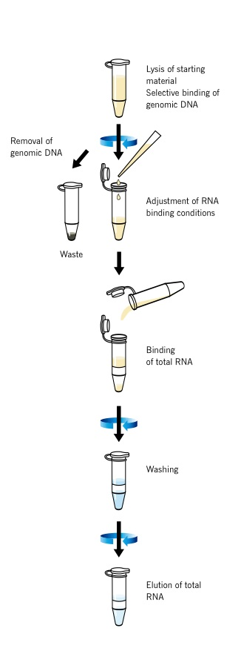
My experiment
Cell Preparation
Extracting the miRNA
Analyzing Expression
Murine frontotemporal cells
½ unaltered FOXP2 ½ point mutation affected FOXP2
Buffer lyses tissue
DNA removed by centrifugation
RNA binding membrane
TaqMan Low-Density Microarray
Rt-PCR
?
Notes:
These cultures will then be added to a buffer which will serve to lyse the DNA from the RNA. As you can see in this image, an RNA binding membrane is then added to the solution and is centrifuged. RNA binds and settles to the bottom, while the DNA is washed away. This leaves just the RNA.

Slide 11
My experiment
Cell Preparation
Extracting the miRNA
Analyzing Expression
Murine frontotemporal cells
½ unaltered FOXP2 ½ point mutation affected FOXP2
Buffer lyses tissue
DNA removed by centrifugation
RNA binding membrane
TaqMan Low-Density Microarray
Rt-PCR
?
Notes:
The isolated RNA is then analyzed for expression using a process called taqman low-density microarrays. What this process essentially does is add a probe into the RNA by means of reverse transcription. Then as taq polymerase synthesizes new RNA from my base RNA, it will eventually reach these probes. It simply cleaves the probes and continues on with transcription. Once light is shone onto these separated probes, the green portion, known as the reporter, fluoresces, and these fluorescent grids can be analyzed using the taqman software. The software is able to tell us whether the miRNA was down-regulated if less fluorescence is present between the two samples.

Slide 12
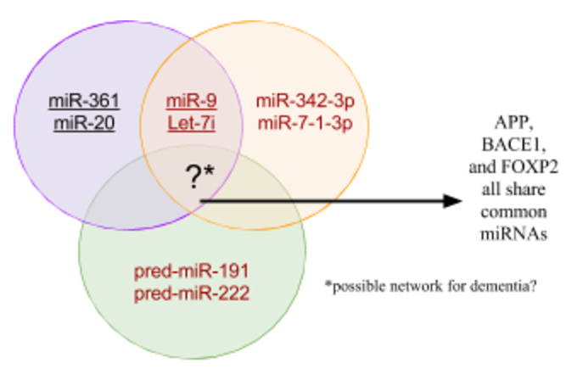
Possible Results
Notes:
Ideally, my experiment would result in less fluorescence of miRNA that has been affected by the point mutation in FOXP2. From this, I would be able to add to this green circle that represents FOXP2. The purple and orange represent the amyloid beta genes reference earlier, and have found specific miRNAs that both affect (red) and are affected (black) by these genes. Moreover, should I find a commonality between these genes and the FOXP2 gene, I might be able to conclude that there is an umbrella network of miRNAs for dementia.

Slide 13
Thank you.

