Slide 1
Inhibition of the p53 tumor suppressor by MDM2 and the role miRNA plays in p53 gene expression and regulation
Bryce Kirby

Slide 2
The tumor suppressor p53
Specialized protein in cells
Keeps genomic stability

Slide 3
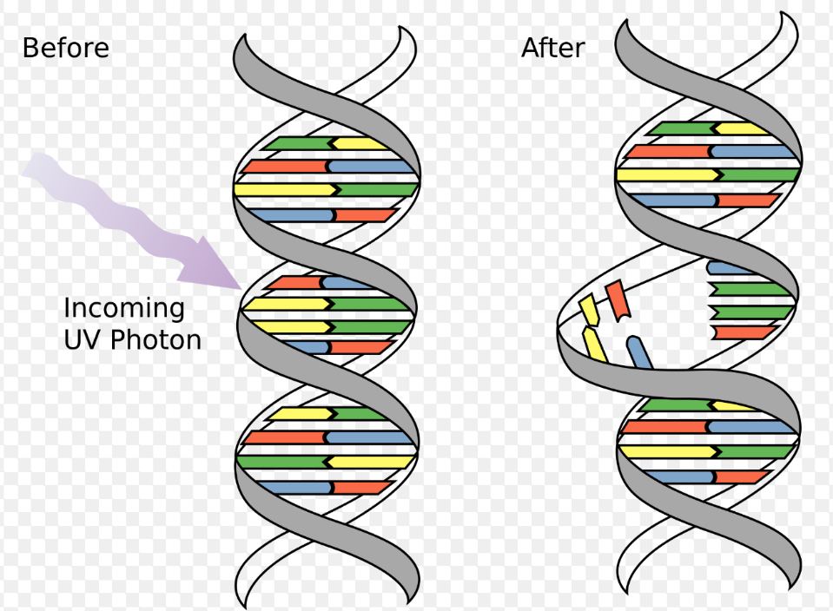
p53 mutations
Highly susceptible to genetic mutation
Two key types:
Germline
Acquired →
loss-of-function
gain-of-function

Slide 4
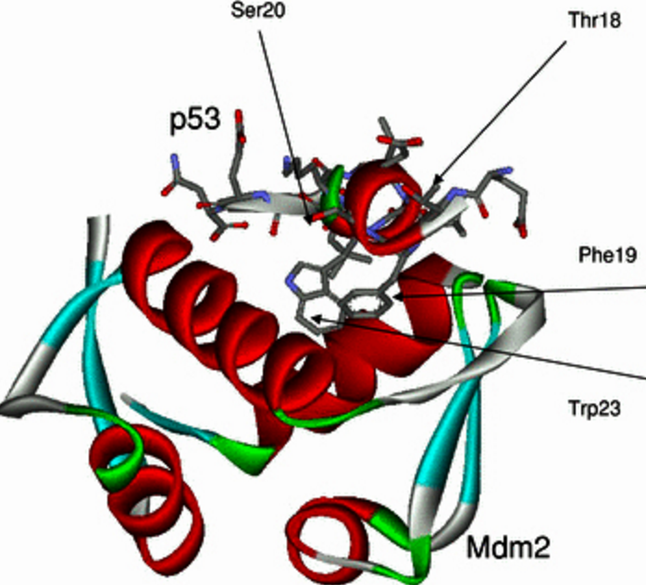
What is MDM2 ?
Oncoprotein
E3 ubiquitin-ligase
Inhibits transcriptional activity of p53
Leads to cancer progression

Slide 5
MDM2 regulation
Negative regulator
Binds to p53
Degrades p53 by adding ubiquitin proteins

Slide 6
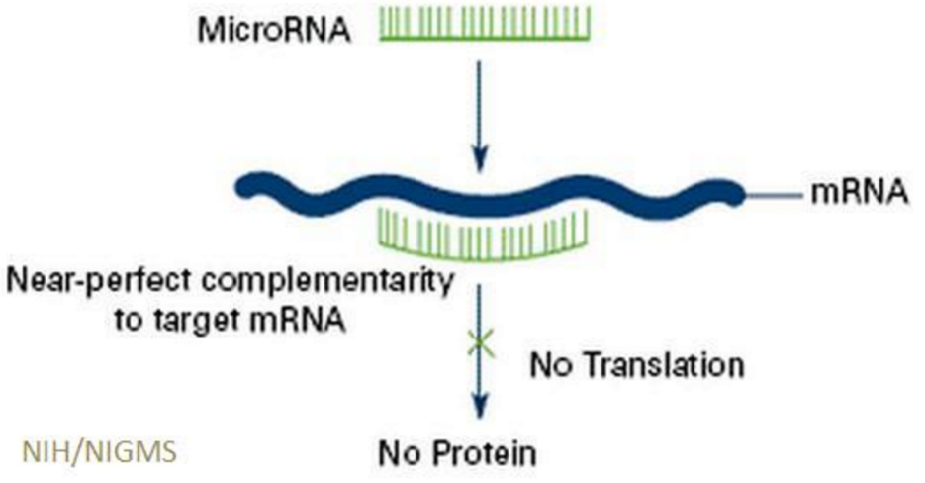
miRNAs
Small non-coding RNAs
Used to deactivate MDM2 transcription
By binding to 3’ UTR
Regulate cancer development

Slide 7
Key questions
Does p53 loss of function cause certain types of cancers ?
Colorectal
Does miRNA-1827 suppress levels of MDM2 ?

Slide 8
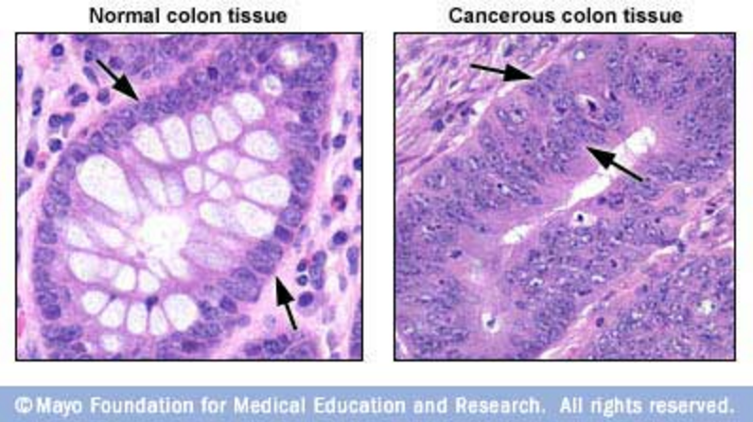
Experiment
miRNA-1827 (Zheng, 2016)
Used to target MDM2
Colorectal cancer cells
HCT116 p53 (WT,M,C)
RKO p53

Slide 9
Methods
Measured interaction of miRNA-1827 & MDM2
miRNAs tagged with biotin
Pull down assays(Western blot and Taqman PCR)

Slide 10
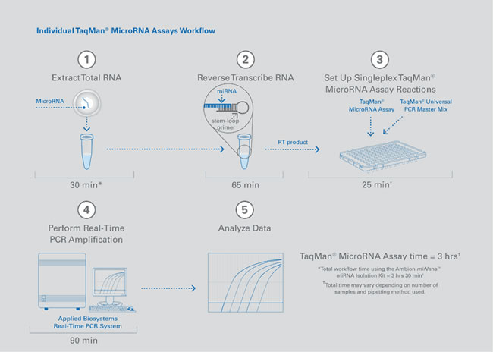
Western Blotting technique
←
Taqman Real-Time PCR technique →

Slide 11
miRNA-1827 regulates MDM2
Fig 2 (Zheng, 2016)
Western Blot (left)
Levels of MDM2 down regulated
P53 levels up regulated
Enrichment fold (right)

Slide 12
Discussion
miRNA-1827 does down regulate MDM2 transcription level
P53 protein function returned to normal
miRNA type and function vary in different cells
miRNA-34 (HeLa cells)

Slide 13
Questions?
#RoastMe

Slide 14
References
References
Bartel, Frank, Helge Taubert, and Linda C. Harris. "Alternative and Aberrant Splicing of MDM2 MRNA in Human Cancer." Cancer Cell 2.1 (2002): 9-15. Web.
Brighenti M. MicroRNA and MET in lung cancer. Ann Transl Med 2015; 3(5):68. doi: 10.3978
Dar, Altaf A., Shahana Majid, David De Semir, Vladimir Bezrookove, Mehdi Nosrati, and Mohammed Kashani-Sabet. "Abstract 3065: The Role of MiR-18b in MDM2-p53 Pathway Signaling and Melanoma Progression." Cancer Research Cancer Res 73.8 Supplement (2013): 3065. Web.
Fornari, F., M. Milazzo, M. Galassi, E. Callegari, A. Veronese, H. Miyaaki, S. Sabbioni, V. Mantovani, E. Marasco, P. Chieco, M. Negrini, L. Bolondi, and L. Gramantieri. "P53/mdm2 Feedback Loop Sustains MiR-221 Expression and Dictates the Response to Anticancer Treatments in Hepatocellular Carcinoma." Molecular Cancer Research 12.2 (2013): 203-16. Web.
Fortunato, O., M. Boeri, M. Moro, C. Verri, M. Mensah, D. Conte, L. Caleca, L. Roz, U. Pastorino, and G. Sozzi. "Mir-660 Is Downregulated in Lung Cancer Patients and Its Replacement Inhibits Lung Tumorigenesis by Targeting MDM2-p53 Interaction." Cell Death Dis Cell Death and Disease 5.12 (2014): 1-9. Web.
Frum, R., Grossman, S., 2014. Mechanisms of mutant p53 stabilization in cancer. Subcell Biochem. (85): 187-97. http://www.ncbi.nlm.nih.gov/pubmed/25201195
Freed-Pastor, W. A., and C. Prives. "Mutant P53: One Name, Many Proteins."Genes & Development 26.12 (2012): 1268-286. Web.
Grossman, S., Vaughan, C., et al. 2012. Gain-of-Function Activity of Mutant p53 in Lung Cancer through Up-Regulation of Receptor Protein Tyrosine Kinase Axl. Genes Cancer 3(7-8): 491–502. http://gan.sagepub.com/content/3/7-8/491.short
Huang, Kai, Yuxin Tang, Leye He, and Yingbo Dai. "MicroRNA-340 Inhibits Prostate Cancer Cell Proliferation and Metastasis by Targeting the MDM2-p53 Pathway." Oncology Reports Oncol Rep 35.2 (2015): 887-95. Web.
Jansson, M. D., N. D. Damas, M. Lees, A. Jacobsen, and A. H. Lund. "MiR-339-5p Regulates the P53 Tumor-suppressor Pathway by Targeting MDM2." Oncogene 34.15 (2014): 1908-918. Web.
Li, Liang, and Binquan Wang. "Overexpression of MicroRNA-30b Improves Adenovirus-Mediated P53 Cancer Gene Therapy for Laryngeal Carcinoma." IJMS International Journal of Molecular Sciences 15.11 (2014): 19729-9740. Web.
Mei, Qian, Xiang Li, Mingzhou Guo, Xiaobing Fu, and Weidong Han. "The MiRNA Network: Micro-regulator of Cell Signaling in Cancer." Expert Review of Anticancer Therapy 14.12 (2014): 1515-527. Web.
Oren, M., and V. Rotter. "Mutant P53 Gain-of-Function in Cancer." Cold Spring Harbor Perspectives in Biology 2.2 (2009). Web.
Ren, Z-J, X-Y Nong, Y-R Lv, H-H Sun, P-P An, F. Wang, X. Li, M. Liu, and H. Tang. "Mir-509-5p Joins the Mdm2/p53 Feedback Loop and Regulates Cancer Cell Growth." Cell Death Dis Cell Death and Disease 5.8 (2014). Web.
Wang, Y., J.-W. Huang, M. Castella, D. G. Huntsman, and T. Taniguchi. "P53 Is Positively Regulated by MiR-542-3p." Cancer Research 74.12 (2014): 3218-227. Web.
Zhang, Cen, Juan Liu, Xiaolong Wang, Rui Wu, Meihua Lin, Saurabh V. Laddha, Qifeng Yang, Chang S. Chan, and Zhaohui Feng. "MicroRNA-339-5p Inhibits Colorectal Tumorigenesis through Regulation of the MDM2/p53 Signaling." Oncotarget 5.19 (2014): 9106-117. Web.
Zheng, Cen, et. al. "MicroRNA-1827 Represses MDM2 to Positively Regulate Tumor Suppressor P53 and Suppress Tumorigenesis." Oncotarget 7.8 (2016): 1-14. Web.
Zhou, Chun-Hong, Xiao-Peng Zhang, Feng Liu, and Wei Wang. "Involvement of MiR-605 and MiR-34a in the DNA Damage Response Promotes Apoptosis Induction." Biophysical Journal 106.8 (2014): 1792-800. Web.
Li, D., N. D. Marchenko, R. Schulz, V. Fischer, T. Velasco-Hernandez, F. Talos, and U. M. Moll. "Functional Inactivation of Endogenous MDM2 and CHIP by HSP90 Causes Aberrant Stabilization of Mutant P53 in Human Cancer Cells." Molecular Cancer Research 9.5 (2011): 577-88. Web.

