Slide 1
How do Acetamiprid and Imidacloprid bind to the alpha subunit of Apis mellifera?
Robert Kalish

Slide 2
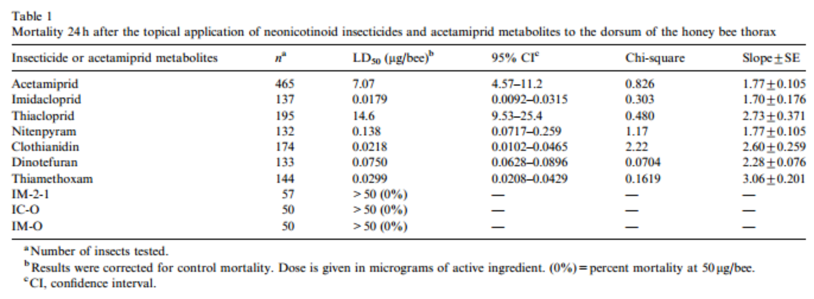
Imidacloprid and Acetamiprid
Iwasa, Takao, Naoki Motoyama, John T. Ambrose, and R.michael Roe. "Mechanism for the Differential Toxicity of Neonicotinoid Insecticides in the Honey Bee, Apis Mellifera." Crop Protection 23.5 (2004): 371-78.Elsevier. Web. http://www.farmlandbirds.net/sites/default/files/Iwasa2004.pdf

Slide 3
Chemical Structures

Slide 4
Binding to the Nitro Group
Figure 2. The structure of the agonist binding domain of AChBP from the mollusk Lymnaea stagnalis when bonded with Imidacloprid. The figure was generated based on the PDB file 2ZJU in RSCB-Ligand Explorer. Q55 and C187 of AChBP, which are colored green, correspond to Q79 and G189, respectively, of the chicken α7 subunit (Shimomura et al., 2002).

Slide 5
Binding to Imidazole Ring
Figure 3. The structure of the agonist binding domain of AChBP from the mollusk Lymnaea stagnalis when bound to Imidacloprid. The figure was generated based on the PDB file 2ZJU in RSCB-Ligand Explorer. Y192 and Y185 (of YXCC) are major structures in determining loop C binding site, W143 is a catalyst for Loop B binding.

Slide 6
Binding Sites observed

Slide 7
Primers
Apis Mellifera nAChR subunit a7 (genbank: NM_001011621) in the pMT3 vector will be used as a template.
Mutant | Forward Strand (C) | Reverse Strand (B)
N212E | 5’-TATTACGAGTGCTGCCCAGAACCG-3’ | 3’-CGGTTCTGGGCAGCACTCGTAATA-5’
Y211S | 5’-TATAGCAATTGCTGCCCAGAACCG-3’ | 3’-CGGTTCTGGGCAGCAATTGCTATA-5’
K77Q | 5’-ATCTCTGGTTACAATTGGAATGG-3’ | 3’-CCATTCCAATTGTAACCAGAGAT-5’
Edge Primers | 5’-ATGAGACGTTGGACTCTCATGGC-3’ (A) | 3’-TATTTCCTTTGTATTCCTTTTCTC-5’ (D)
12 copies of each wild-type and mutant receptor must be made so that they can undergo 3 trials of exposure to each of the 4 agonists.

Slide 8
Voltage Clamp ElectroPhysiology

