Slide 1
PTK7 protein domains involvement in PCP regulation of axonogenesis of copa neurons in Zebrafish.
Spring 2016 BNFO 300
Damien Islek:

Slide 2
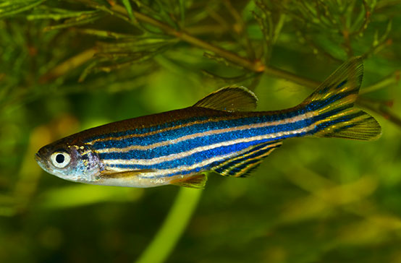
Zebrafish: Model Organism
Great organism to study scientific inquiry.
Neuron development of zebrafish can give us insight into neuron development in humans.
Axonogenesis in zebrafish uses same mechanism as in humans.

Slide 3
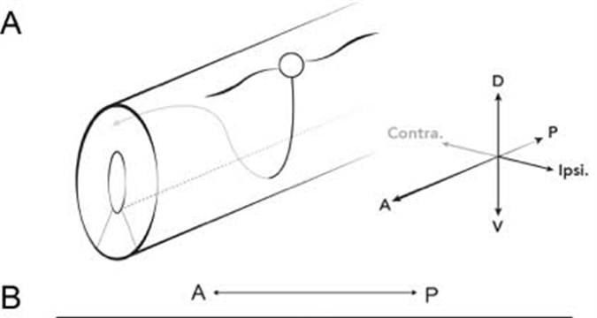
Zebrafish primary commissural ascending neurons (CoPA): Axonogenesis
  Copa neuron in zebrafish
    These Neurons during development project axon ventrally which crosses the midline and grows dorsally; where it then turns anterior and ascends the spinal cord towards the CNS (Hjorth & Key 2002; Chitnis & Kuwada 1990)
  Axonogenesis is mediated by Planar Cell Polarity and Wnt ligand in zebrafish. Direction of axon growth correlates to Wnt concentration in tissue (Hayes et al 2013).

Slide 4
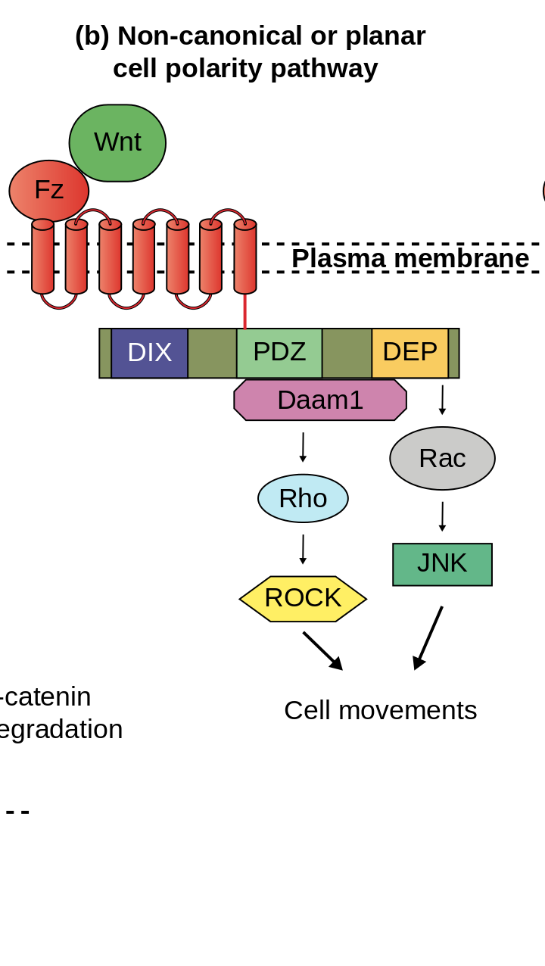
Planar Cell Polarity Pathway: Core Proteins
PCP coordinates the uniform orientation of cell structures and cell movements within the plane of tissue (Zallen 2007).
PCP Core Genes: (Vladar et al 2009)
  Frizzled (Fz)
  Dishevelled (Dsh)
  Van Gogh (Vangl)
  Diego (Dgo)
  Flamingo (Fmi)
  Prickle (Pk)

Slide 5
Planar Cell Polarity Pathway: Core Proteins
Main action in this pathway is Wnt binding to Frizzled (Kohn and Moon, 2005; Jenny and Mlodzik 2006)
Wnt will bind to Fz extracellularly, which will change Fz affinity to Dsh and cause it to interact intracellularly.
Dsh goes on to activate JNK and other proteins in order to affect cell movement through actin filament rearrangement.
PCP requires Fz activation, and therefore membrane localization of Dsh

Slide 6
PTK7 Is a novel regulator in the PCP pathway
It is not known which of these domains, if any at all, are involved in regulating the PCP pathway in vertebrates.
In order to gain insight on which domains of the ptk7 protein are required in this pathway, Hayes et al tested the deletion and substitution of PTK7 domains ability to rescue Wnt8 overexpression defects.
ptk7ΔICD & ptk7EgfrTM were both able to rescue the defects to the same extent as full length PTK7
Ptk7ΔECD was not able to rescue the defects. This indicates that the extracellular domain is important for this pathway

Slide 7
PTK7 Rescue Experiment:
Start with TBX16 ptk7 mutant zebrafish (functional PTK7 deficient zebrafish).
  All Copa neurons in this zebrafish express GFP (Green Fluorescent Protein)
Microinject constructed plasmid and mRNA of Tol2 transposon protein at one cell stage of embryonic development.
Observe direction of Copa neuron axon migration during development.

Slide 8
Plasmids:
Full Length PTK7
Deleted
Intracellular
Domain
Deleted
Extracellular
Domain
Substituted
Trans-membrane
Domain
Ptk7 cDNA-M Cherry
Tol2
HSP-70
pA
Tol2
Ptk7ΔICD-
M Cherry
Tol2
HSP-70
pA
Tol2
Tol2
HSP-70
Ptk7ΔECD –
M Cherry
pA
Tol2
Tol2
HSP-70
Ptk7EgfrTM –
M Cherry
pA
Tol2

Slide 9
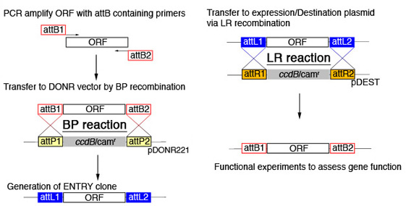
Plasmid Construction:
BP Reaction is done by BP Clonase
LR Reaction is done by LR Clonase
The desired genetic information goes into entry vector (DONR) and then destination vector (pDEST)
Tol2-HSP70-PTK7-pA-Tol2
“ “
“ “
“ “

Slide 10
Experimental Groups:
PTK7 Full Length
Ptk7ΔICD
Ptk7EgfrTM
Ptk7ΔECD

Slide 11
What do we see?
Once zebrafish from all groups in the experiment are matured, you can go and observe the copa neurons which are stained red and green (GFP & M Cherry).
A mosaic model of cells which express the plasmid DNA will be seen in the transgenic zebrafish
  You hope that a few copa neurons are in this mosaic
Copa neurons which express plasmid DNA will express GFP, M Cherry.

Slide 12
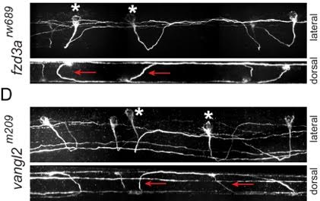
What are we looking for?
To determine which domain is important for PCP pathway function, you look at direction of Copa neuron axon growth.
In mutant PCP zebrafish axons go 50/50 Anterior/Posterior
If Rescue is successfully you will see, theoretically, 100% of all Red and Green copa neurons with axons which turn anterior.
If this function can be rescued without a certain domain, then it must not be required for regulation of this pathway
A
P

Slide 13
Prediction:
Ptk7 mutant
Ptk7 mutant
+
hsp70: ptk7^{FL}-mCherry

Slide 14
What do we learn?
We can learn which domains of ptk7 are required for PCP regulation of axonogenesis in vertebrates.

Slide 15
Questions and Comments

