Slide 1
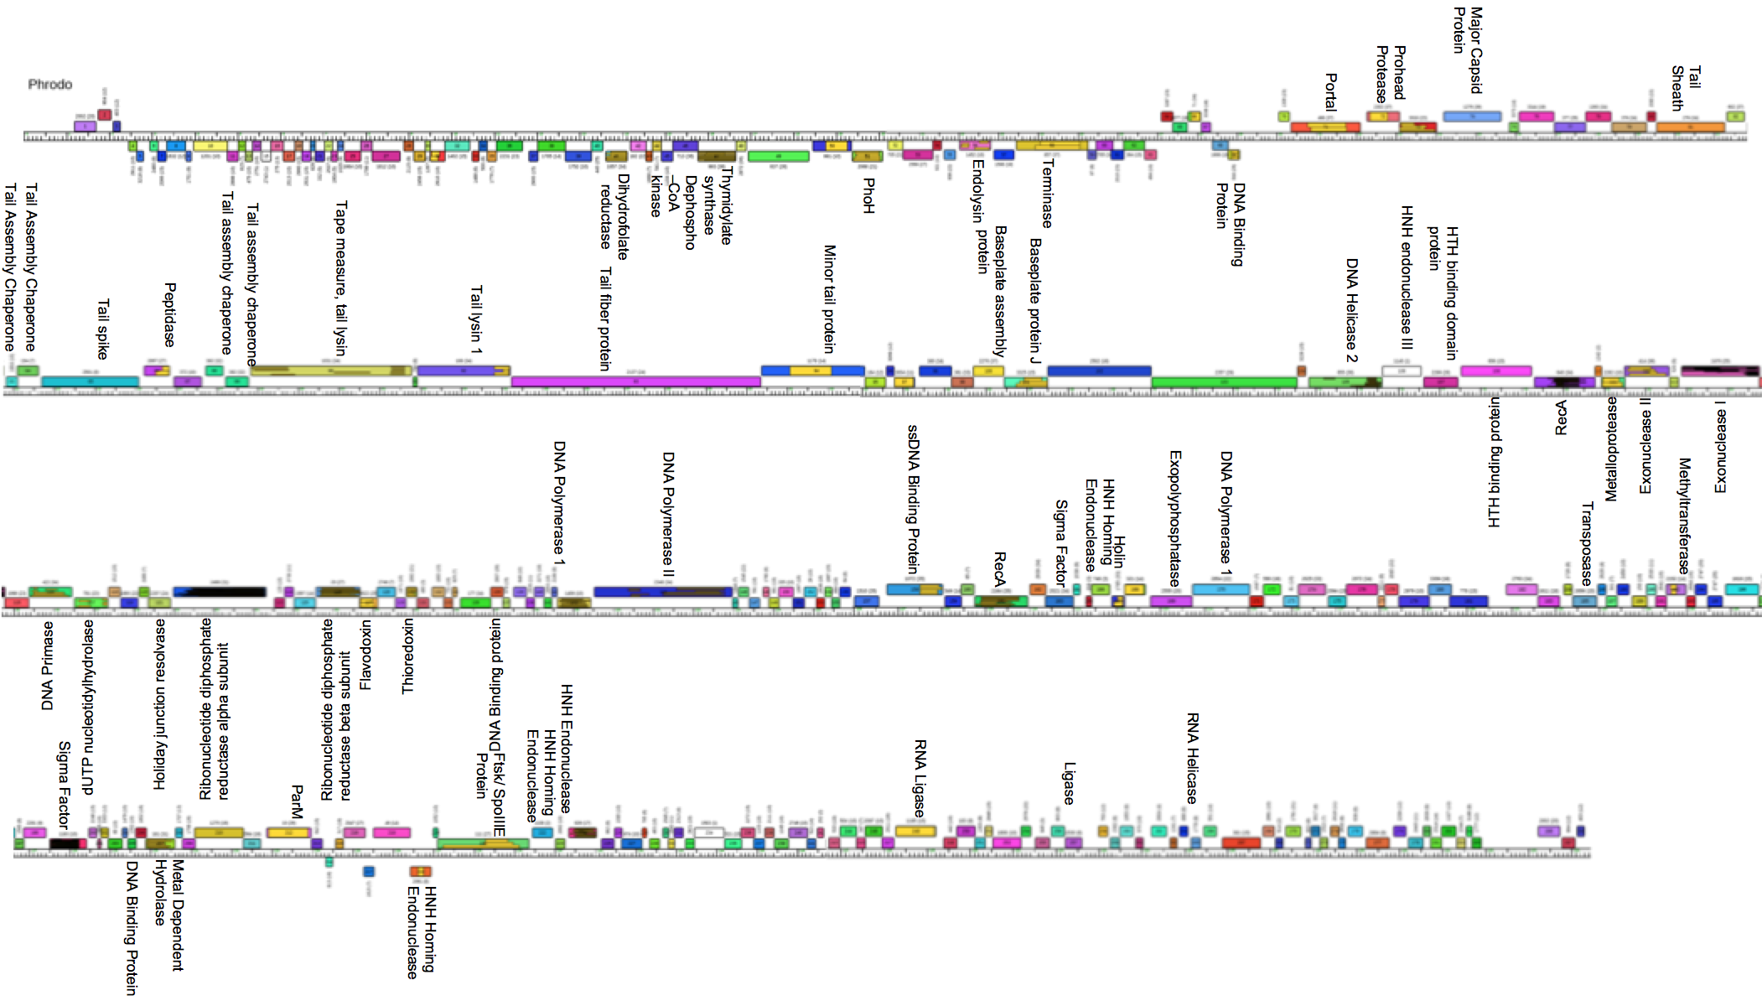
IDENTIFICATION OF HIGHLY CONSERVED BACILLUS ORFS OF UNKNOWN FUNCTION

Slide 2
What is a bacteriophage (Phage)
A bacterial virus
We will use phage Phrodo for this study
Phrodo is a myoviridae with a double stranded DNA genome and a contractile tail
We chose Phrodo because its DNA and genetic information is readily available and a vast majority of our genes of interest are found within it’s genome

Slide 3
What are bacillus bacteria?
Why do we care?
Rod shaped sporulating gram-positive bacteria
Bacillus genus consists of the ATC family (B. anthracis, B. thuringiensis, B. cereus)
This study will use B. thuringiensis since Phrodo was found and isolated from this strain
Bacillus bacteria are naturally resistant to antibiotics
Provides an excellent model for studying viruses and their host
Phage Therapy as an alternative to antibiotics

Slide 4
Model Studies for studying phage protein function
Identified 26 uncharacterized proteins from phage Pseudomonas aeruginosa PAO1 to overexpress from the early infection stage
Used shuttle vector system, pUC18-mini-Tn7T-Lac, which is E. coli and P. aeruginosa compatible, and vector pTNS2
Results in a single ORF integrated into the host genome
6 of them (protein 7, 8, 14, 15, 18, and 30) were found to have a phenotypic impact on host bacteria
Repeated in both E. coli MG1655 and P. aeruginosa PA14 to verify the accuracy of results in P. aeruginosa PAO1
Moved on to Yeast two-hybrid assays of the 6 proteins

Slide 5
We propose to investigate the function of unknown proteins by establishing overexpression assays with an entry and gateway expression vector system to screen for phenotypes so that we can identify proteins for further functional analysis.

Slide 6
Preliminary Data

Slide 7
Dot Plot
Dot plot analysis is used to organize sequences with 50% or more similarity into clusters
Organized 83 bacillus genomes into 13 cluster
This image shows the 7 myoviridae clusters
Phrodo is found in cluster E

Slide 8
SplitsTree
Tree with the top 55 most highly conserved genes
Tree with the top 55 most highly conserved genes absent

Slide 9
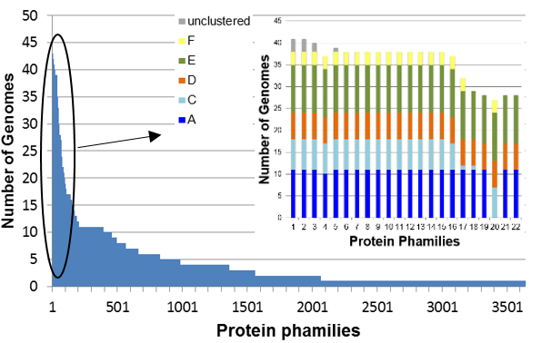
Highly conserved unknown genes
Image shows which cluster each of the top 22 highly conserved proteins of unknown function belongs to
Cluster E contains the most unknown proteins

Slide 10
Control and Unknown ORFs to overexpress

Slide 11
Methods
PCR, BP clonase, E. coli transformation, mini prep, lr clonase, bacillus transformation, overexpression with IPTG

Slide 12
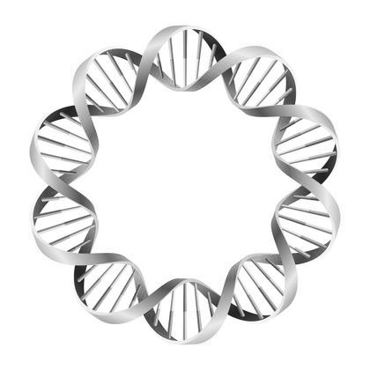
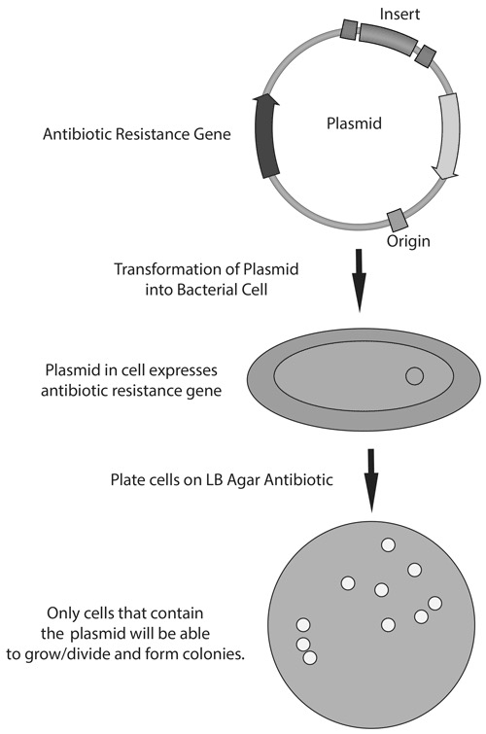
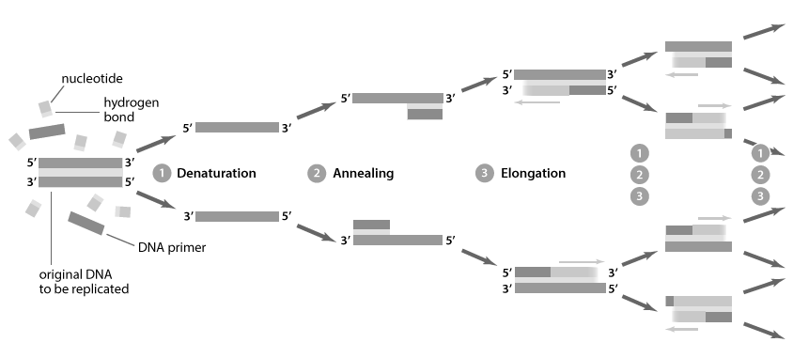
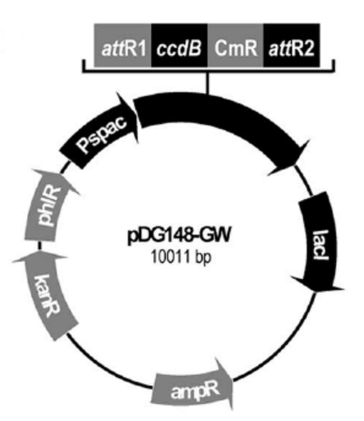
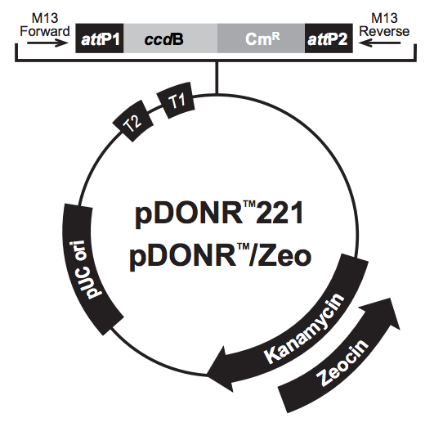
SUMMER 2016 RESEARCH PLAN
OVEREXPRESSION ASSAY OF HIGHLY CONSERVED ORFS OF UNKNOWN FUNCTION
Determining ORF candidates for PCR using preliminary data
Overexpress genes from PCR in Bacillus bacteria
Design primers to isolate target genes
Perform PCR to amplify desired gene sequences
Isolate genes from entry vector by mini prep and perform LR clonase reaction to combine gene with expression vector pDG148
Transform vector into chemically competent Bacillus cells and observe phenotypic results
Combine PCR product with entry vector pDONR/ Zeo by BP clonase reaction and transform into competent E. coli cells
Week 1-6 | Week 7-12

Slide 13
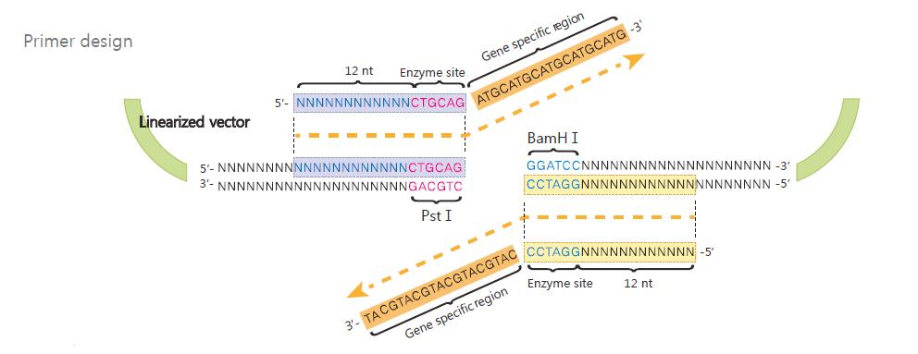
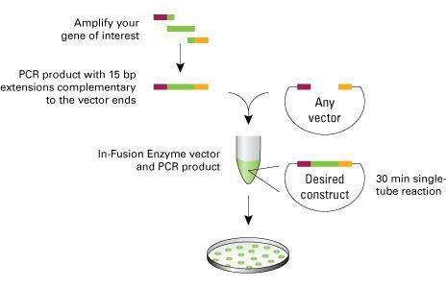
Primer design and two-step PCR
Requirements for primer design include a section of the beginning and end of each gene (20-40bp in length) running 5’-3’ with a GC content of ~50% and a melting point of ~55ºC
Bacillus phages have a naturally low GC content
12 nucleotide attB1/2 sites are attached to each end of the primers during step one
12 nucleotide attB1/2 adapter primer sites are added during step two
PCR is cloned into E. coli using BP clonase reaction

Slide 14
BP and LR clonase reactions
Mimics phage host reactions
Naturally phage DNA has attP sites and host has attB sites and the resulting attL and attR sites are a product of these sites being combined
In BP clonase the PCR ORF has attP sites and empty plasmid has the attB sites
Result from LR clonase is attL1 and attL2 sites flanking the ORF

Slide 15
Discussion

Slide 16
Entry and Expression Vectors
pDONR / ZEO contains T2 and T1 promoters for inducing ORF translation with IPTG
pDONR / ZEO entry vector for E. coli
pDG148 GW contains the Pspac promoter for inducing translation of Bacillus ORFs
Compatible with both E. coli and Bacillus

Slide 17
Expected Overexpression Results
Gp 7: Could not properly divide after one correct division, cells are elongated with two nuclei
Gp 8: Cells begin division correctly but stop mid division, attached daughter cells that burst several hours later
Gp 14/18: have a long filamentous phenotype
Gp 15/30: affect cells by inhibiting their growth

