Slide 1
Impact of raft association of NF155 on the inflammatory response of microglial cells

Slide 2
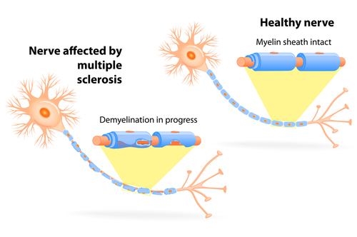
Background
MS is a neurodegenerative disease that effects more than 2.3 million people worldwide. Which is characterized by the loss of myelin on the axons of the CNS
Bionews Texas

Slide 3
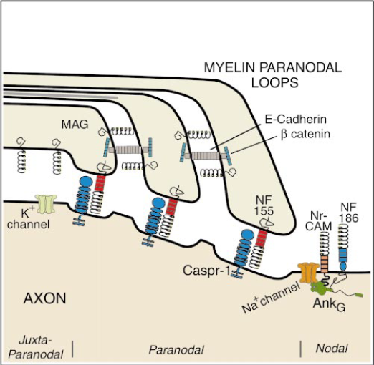
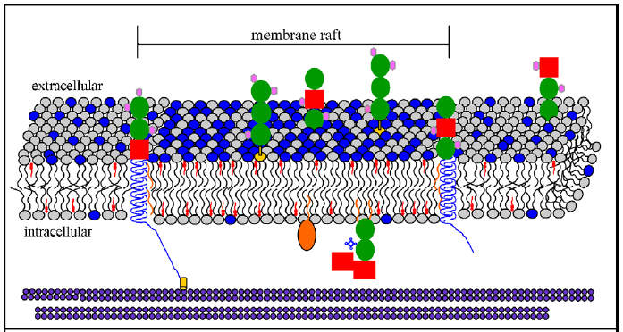
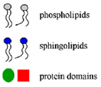
Background
Coogan et al
Adapted from Dupree et al

Slide 4
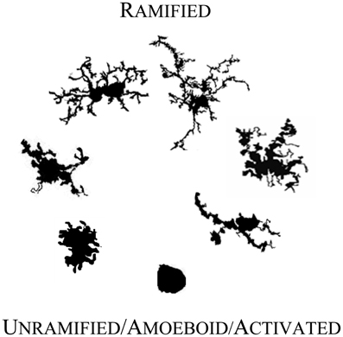
Background
Karperien et al

Slide 5
Prior Research
Maier et al 2007

Slide 6
Experiment – Liposomes
Treatments
Protein Free, non-raft liposome
NF155 and control protein, non-raft liposome
NF155, raft liposome
NF155 and control protein, raft liposome
Adapted from Patil & Jadhav

Slide 7
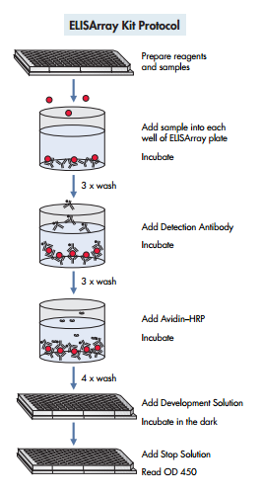
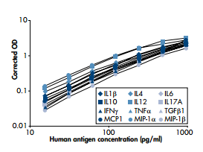
Experiment – Cell Culturing & ELISA
QIAGEN

Slide 8
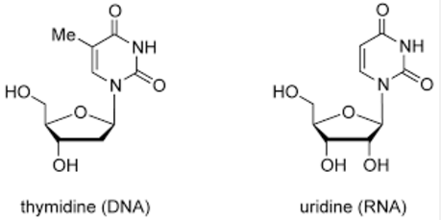
Experiment – Cell proliferation Assay & Immunocytochemistry
Br
Adapted from Leinco
Adapted from atdbio

Slide 9
Results
EMBL

