Slide 1
The effect of suppressing HIF1A on the expression of HIF2A
Project Author: Shray Amin
Project Mentor: Keith Baker

Slide 2
What is already known?
The oxygen-regulated subunits HIF-1 and 2 are expressed in inverse relationship to oxygen tensions in every cell line investigated to date

Slide 3
Background Information
A transcription factor is a protein that binds to specific DNA sequences, thereby controlling the rate of transcription of genetic information from DNA to messenger RNA
transcription factors that creates a response to hypoxia

Slide 4
Why it matters?
Hypoxia Inducible Factors are known to known to transcribe of more than 60 genes, which affect biological processes such as angiogenesis and erythropoiesis, which assist in promoting and increasing oxygen delivery to hypoxic regions and regenerating lost or damaged tissue in mammals that have a repair response. Additionally, the overexpression of HIFs are linked to cancer.
A better understanding of the interplay between HIF 1 and 2 alpha can offer valuable incite into research in regenerative treatments and cancer.

Slide 5
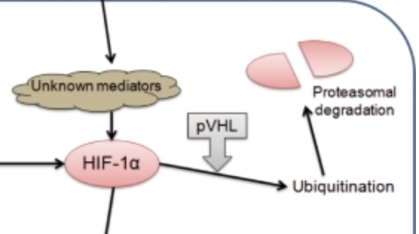
Project Goal
To determine the consequential effects on HIF2a via the suppression of HIF1a
HIF-2a ?

Slide 6
The Experiment
The template for the experiment will follow Rosenber et al, (2002).
In Short, rat kidneys subject to Hypoxic conditions, half of which will be treated with HAF, will under go immunohistochemistry to measure the two different HIFs

Slide 7
The Experiment Continued…
Half of the rat kidneys will be subject HAF, which is known Hypoxia Associated Factor. It will be added in the form of a plasmid modeled after Koh et al. (2008).
pOTB7
HAFHAF ubiquitinates HIF1A, but not HIF2A, targeting it for destruction regardless of oxygen tension, making it an ideal protein to use for the removal of HIF1a, leaving only the HIF2a

Slide 8
Imminohistochemistry?
the process of detecting antigens in cells of a tissue section by exploiting the principle of antibodies binding specifically to antigens in biological tissues

Slide 9
Potential Outcome
During the first 24 hours while under conditions of acute, transactivation of target genes occurs primarily by virtue of HIF1A, whereas following longer periods HIF2A begins to exert more of an influence (Koh et al., 2011, Koh and Powis, 2012). Thus, a potential result of suppression HIF1a could be that there is no temporal delay for the incidence of HIF2a.

