Slide 1
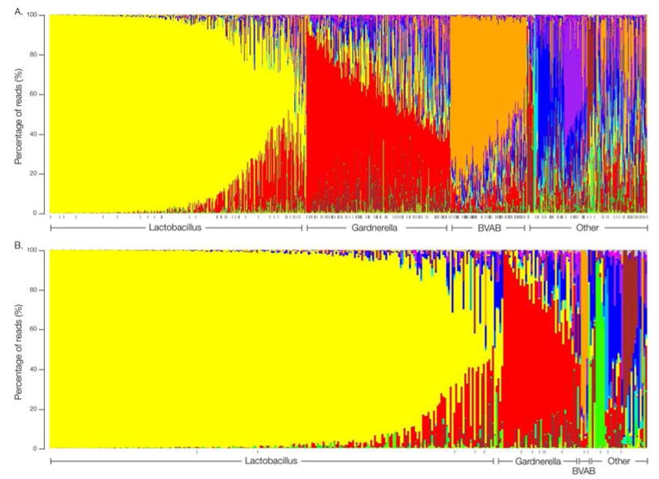
The Vaginal Microbiome

Slide 2
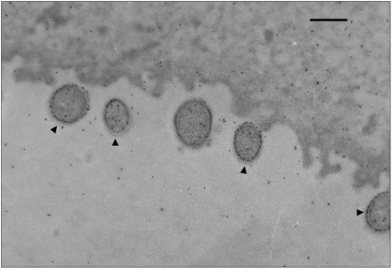
Lactobacillus iners

Slide 3
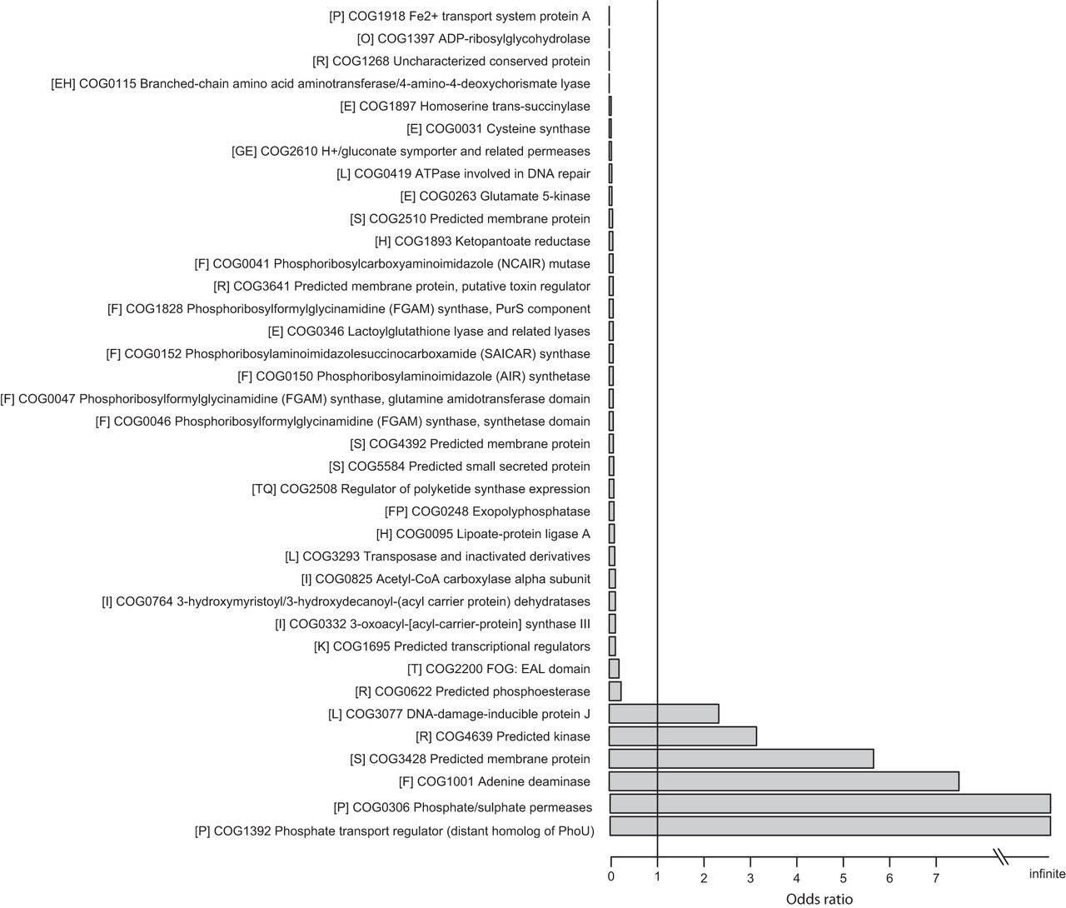
Mendes-Soares et al
Genes over and under-represented in vaginal Lactobacillus species relative to other Lactobacilli strains

Slide 4
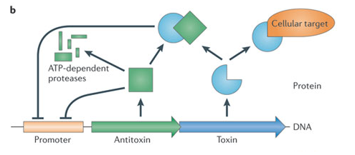
ReIEB toxin-antitoxin system
Yamaguchi & Inouye. Regulation of growth and death in Escherichia coli by toxin-antitoxin systems. Nature Reviews Microbiology 9, 779-790 (November 2011).

Slide 5
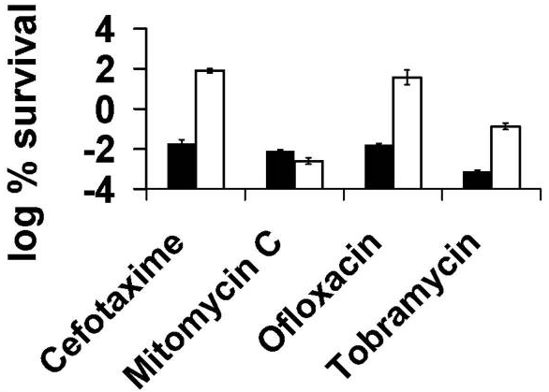
Specialized Persister Cells & the Mechanism of Multidrug Tolerance in Escherichia coli
Induced expression of the ReIE toxin
Subjected E. coli cells to antibiotics
Spotted cells on an agar plate which induced expression of ReIB antitoxin
Counted numbers of surviving persister cell colonies
Number of surviving persister cells was 10 to 10,000 times higher when toxin was expressed before adding antibiotics (aside from Mitomycin C)

Slide 6
Does the toxin-antitoxin protein family present in Lactobacillus iners play a part in its ability to survive the conditions associated with bacterial vaginosis?

Slide 7
The Experiment
Create an artificial microbiome
Knock out the toxin and antitoxin genes
Use an expression vector to insert toxin gene into the genome where it can be forcibly expressed using a promotor
Add Lactobacillus iners to microbiome and induce expression of toxin
Use 16s rRNA analysis to analyze relative abundance of bacteria in microbiome comparing wild-type, absence of antitoxin strain, absence of toxin-antitoxin strain

Slide 8
Possible Outcomes:
The toxin gene in Lactobacillus iners allows for increased survivability of the bacteria when in conditions associated with bacterial vaginosis
The toxin-antitoxin protein family has a detrimental effect on the survivability
There is no difference

Slide 9
Possible treatment for bacterial vaginosis?

