Slide 1
Measuring myelin protein expression with a MeCP2 knockdown in oligodendrocytes
Rachel Siefring
Mentor: Dr. Carmen Sato-Bigbee

Slide 2
The human population

Slide 3
People with disabilities

Slide 4
People with autism

Slide 5
ASD and Rett Syndrome
Autism Spectrum Disorders
Rett Syndrome

Slide 6
Cause of Rett Syndrome
Caused by a mutation
in methyl-CpG-binding
Protein (MeCP2)
CH₃
CH₃
Figure 2 of Cortes-Mendoza, 2013
Notes:
Really need to break this slide down and work on it…

Slide 7
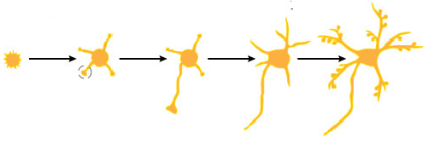
What does MeCP2 do?
MeCP2
Regulates transcription of
Brain-derived growth factor (BDNF)
Axonal maturation
Neuronal development

Slide 8
What does MeCP2 do?
MeCP2
Regulates transcription of
Brain-derived growth factor (BDNF)
Axonal maturation
Neuronal development

Slide 9
What does MeCP2 do?
MeCP2
Regulates transcription of
Myelination
Brain-derived growth factor (BDNF)
Oligodendrocytes
Axonal maturation
Neuronal development

Slide 10
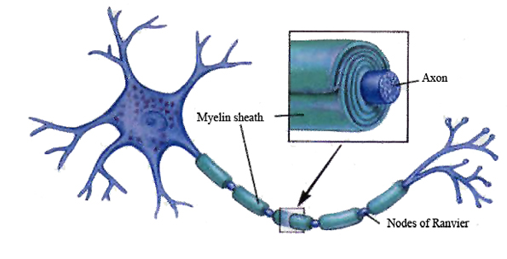
What does MeCP2 do?
MeCP2
Myelination

Slide 11
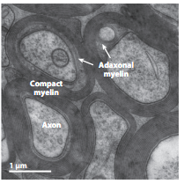
What does MeCP2 do?
MeCP2
Myelination
Axon
Figure 1B from Nave and Werner (2014)

Slide 12
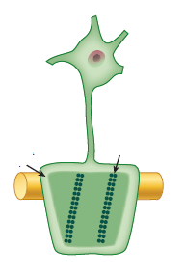
What does MeCP2 do?
MeCP2
Oligodendrocyte
Myelination
Oligodendrocytes
Myelin

Slide 13
What does MeCP2 do?
MeCP2
Myelination
How is the myelination process different in a child with Rett syndrome?
Oligodendrocytes

Slide 14
Stages of oligodendrocyte development
Progenitor cell
Pre-oligodendrocyte
Mature oligodendrocyte
Slide provided by Dr. Sato-Bigbee

Slide 15
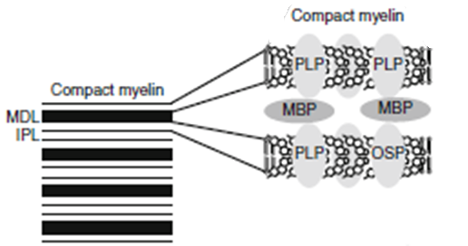
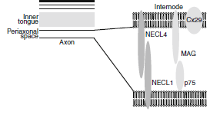
Myelin Proteins
Figure 1 from Jahn, et al
Myelin Basic Protein (MBP)
Myelin-associated glycoprotein (MAG)
Notes:
I need an immunocytochemistry shot of these two proteins in action…

Slide 16
Myelin Basic Protein (MBP)
MBP
MBP
Modified Figure 1D from Aggarwal et al (2013)

Slide 17
Myelin-associated glycoprotein (MAG)
Acts as a linker between the axon and the myelin sheath

Slide 18
Is there a difference in MBP and MAG expression levels
when there is a MeCP2 knockdown??

Slide 19
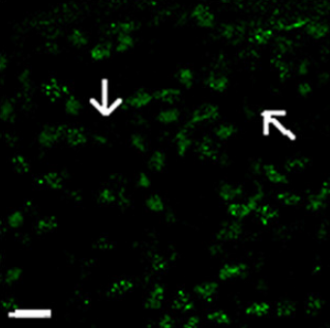
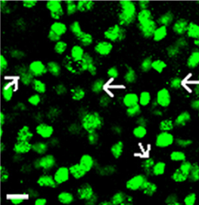
Isolating oligodendroctyes
2 experimental groups
Sprague-Dawley rats
Regular MeCP2
MeCP2 knockdown
Cerebral hemispheres
and cerebellum
From Figure 1A from Nguyen et al (2013)
Notes:
I need two different immunocytochemistry pics, one with a MeCP2 knockout and another with ordinary MeCP2

Slide 20
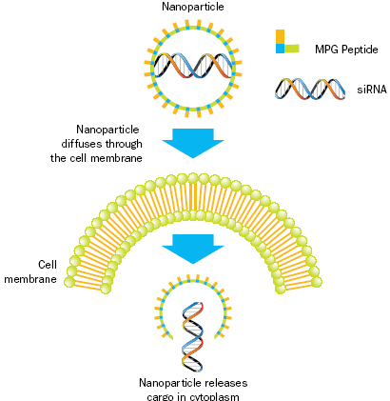
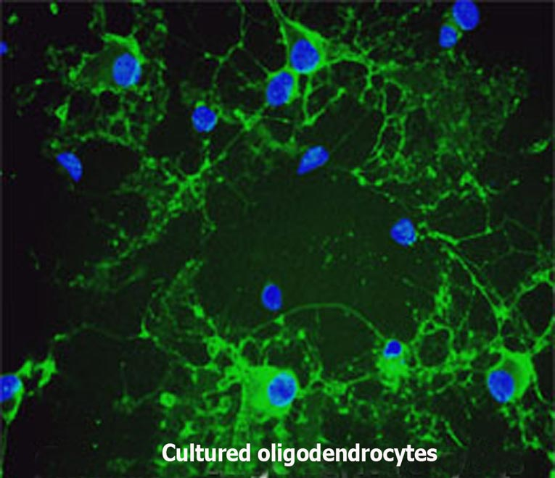
Knockdown method: siRNA

Slide 21
siRNA synthesis
Send MeCP2 sequence
to Sigma Aldrich
Use DEQOR to generate 21 nucleotide transcripts
Synthesized siRNA
300-600 nt mRNA transcript
Notes:
This slide will describe the process of transfection into the cells.

Slide 22
Applying siRNA to oligodendrocytes
siRNA
GeneJammer
reagent
See if knockdown worked
via Western Blot

Slide 23
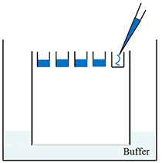
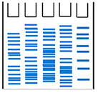
Western Blot: SDS-PAGE
Make cell lysates for each culture
Load samples into the SDS-PAGE
Separated lysate proteins
Notes:
Add a few more slides related to this technique. Try to add real Western blots containing MBP and MAG WBs.

Slide 24
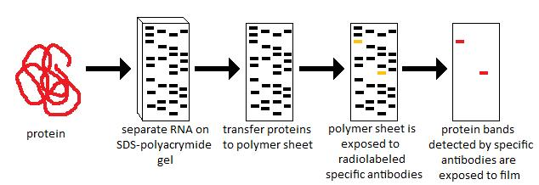
Western Blot
Polymer sheet is exposed to antibodies
http://en.wikibooks.org/wiki/Structural_Biochemistry/Proteins/Western_Blotting

Slide 25
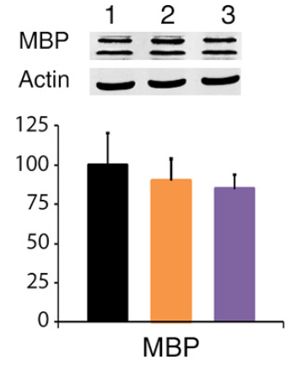
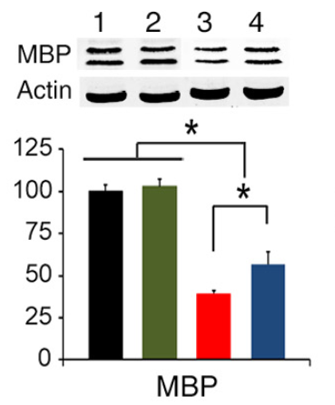
Western Blot
Figures 7A and 7B from Nguyen (2013)
Notes:
Quantitative western blot: measuring the amount of fluorescence that exudes from it in order to get a quantitative measure…
Loss of MeCP2 in oligodendrocyte lineage…looking almost exclusively at oligodendrocytes
B. Loss of MeCP2 in an entire mouse…whole-brain extracts.

Slide 26
Possible resulting scenarios
Methods don’t work
Oligodendrocyte isolation fails
siRNA

Slide 27
Possible resulting scenarios
Methods don’t work
No difference in myelin protein expression
Oligodendrocyte isolation fails
MeCP2 doesn’t effect oligodendrocytes in culture
siRNA
Notes:
Nguyen (2013) didn’t see a big difference in protein expression levels when they compared the different types of mice.

Slide 28
Possible resulting scenarios
Methods don’t work
No difference in myelin protein expression
Large differences in myelin protein expression
Oligodendrocyte isolation fails
MeCP2 doesn’t effect oligodendrocytes in culture
MeCP2 does effect oligodendrocytes in culture
siRNA
Overexpression
Underexpression

Slide 29
Concluding remarks
Do myelination and oligodendrocytes play a role in the Rett syndrome phenotype?
Does MeCP2 specifically affect MBP and MAG?
Based on this experiment, should this research even be pursued?
Does MeCP2 directly affect the myelination process?

Slide 30
References:
Bhat, S., et al. (2014). Autism: cause factors, early diagnosis, and therapies. Reviews in the Neurosciences. De Gruyter. 25(6): 841-850.
Amir, R. et al. (1999). Rett syndrome is caused by mutations in X-linked MECP2, encoding methyl-CpG-binding protein 2. Nature Genetics, 23: 185-188.
Kleijer, K., Schmeisser, M., Krueger, D., Boeckers, T., Scheiffele, P., Bourgeron, T., Brose, N., and J. Burbach. 2014. Neurobiology of autism gene products: towards pathogenesis and drug targets. Psychopharmacology. 231: 1037-1062.
Chahrour, M., et al. (2008). MeCP2, a key contributor to neurological disease, activates and represses transcription. Science, 320: 1224-1229.
Ebert, D. & M. Greenberg. (2013). Activity-dependent neuronal signalling and autism spectrum disorder. Nature, 493: 327-337.
Vora, P., et al. (2010). A novel transcriptional regulator of myelin gene expression: implications for neurodevelopmental disorders. Lippincott Williams & Wilkins, 0959-4965: 917-921.
Zeidán-Chuliá, F., et al. (2014). The glial perspective of autism spectrum disorders. Neuroscience and Biobehavioral Reviews, 38: 160-172.

Slide 31
References, cont.
8. Karpova, N. (2014). Role of BDNF epigenetics in activity-dependent neuronal plasticity. Neuropharmacology, 76: 709-718.
9. Cortes-Mendoza, J., et al. (2013). Shaping synaptic plasticity: the role of activity-mediated epigenetic regulation on gene transcription. International Journal of Developmental Neuroscience. 31: 359-369.
10. Sato-Bigbee, C., et al. (1999). Different neuroligands and signal transduction pathways stimulate CREB phosphorylation at specific developmental stages along oligodendrocyte differentiation. Journal of Neurochemistry, 72: 139-147.
11. Saini, H., et al. (2005). Novel role of sphinogosine kinase 1 as a mediator of neurotrophin-3 action in oligodendrocyte progenitors. Journal of Neurochemistry, 95: 1298-1310.
Shan, G. (2010). RNA interference as a gene knockdown technique. The International Journal of Biochemistry and Cell Biology, 42: 1243-1251.
Nguyen, M., et al. (2013). Oligodendrocyte lineage cells contribute unique features to Rett Syndrome neuropathology. Neurobiology of Disease, 33(48): 18764-18774.
Bradl, M. and H. Lassmann. (2010). Oligodendrocytes: biology and pathology. Acta Neuropathol, 119: 37-53.
Jahn, O., Tenzer, S., and H. Werner. (2009). Myelin proteomics: molecular anatomy of the insulating sheath. Mol Neurobiol, 40: 55-72.

