Slide 1
Using Mutagenesis to Determine the Significance of a Two-Component Regulatory Response Gene in Bacteria Streptococcus sanguinis
Navpreet Saini

Slide 2
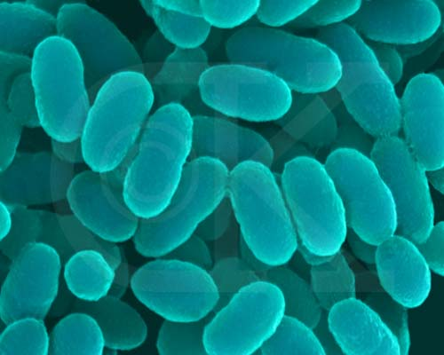
Streptococcus Sanguinis
Gram Positive Bacteria (Caufield et al.
2000)
Normally Harmless in Human Mouth
Forms Plaques
Gains a Pathway to the Heart
through bloodstream
Causes Cardiac Diseases (Endocarditis)
ComputationalBioenergy.org

Slide 3
Tolerance Level of S. sanguinis
Bacteria is resistant to antibiotics
Why so resistant?
Full Genome Determined in 2007
Determined to have over 100 transcriptional regulators (Ping et al. 2007)

Slide 4
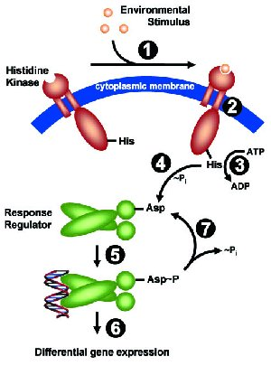
Two Component Response Regulatory System
Mechanism that aids in adaptation to
environment
Occurs through signal transduction
Allows bacteria to become tolerant to
environment (Marx, Patrick et al. 2010)
There are 14 regulatory systems in S.
sanguinis (Ping et al. 2007)
“Signal Transduction”, Faculty of Biology. Ludwing-Maximilians University

Slide 5
Which genes are actually significant
There are 14 regulatory genes – which one is expressed under certain conditions?
Observe multiple genes of the bacteria under penicillin
Is the gene essential to the bacteria in the condition?
Use of mutagenesis with Transposons

Slide 6
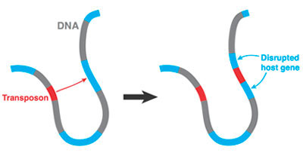
Transposons
DNA sequence that is added to the bacteria; affects gene function (Twetman et al.)
Add transposon to certain gene to disrupt function
Binding site for regulatory gene is disrupted,
the essential gene will not be upregulated
or downregulated
UCSF.edu

Slide 7
Analysis with Microplate Reader
Place mutant strains into reader to see if gene regulator is damaged (in low concentrations or high concentrations)
Light source transmits light to gene; amount of light emitted back = concentration of gene regulator
Subject each mutant to antibiotic
Gene regulator is low concentration but bacteria formation is not declining, gene regulator is unnecessary when bacteria is under antibiotic threat.
Low concentration, less population, gene is necessary.

Slide 8
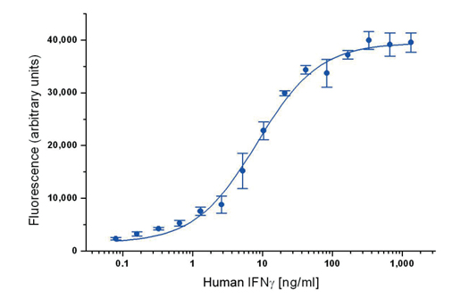
Overview of Experiment
Two Strains: sanguinis and mutans (Transposons)
Use microplate reader to observe target gene
Amount of light transmitted =
concentration of gene regulator
(Adam et al 2014)
Do multiple experiments for the bacteria
Affect strains with penicillin
Sample Graph of plate reader on Human interferon (Ab D serotec)

Slide 9
Significant Score of Gene
Number determines fitness of gene under certain conditions.
Use of T value and P value
P Value range from 0 to 1
Closer to 1, more significant (essential) gene is to bacteria
Determining if the gene is essential allows future experiments in having a shorter task.

Slide 10
References
Seaton, K et al. (2014). “Regulation of competence and gene expression in Streptococcus mutans by the RcrR transcriptional regulator.” Molecular Oral Microbiology 10.1: 1-13. NCBI. Web.
Ping, Xu et al. (2007). “Genome of the opportunistic pathogen Streptococcus sanguinis.” Journal of Bacteriology 189.8:3166-3175. NCBI.
Marx, Patrick et al. (2010). “Identification of genes for small non-coding RNAs that belong to the regulation of the two-component regulatory system CiaRH in Streptococcus.” BMC Genomics 11:661. NCBI.
Lee, Chih and Chun-His Huang. (2012). “Searching for transcription factor binding sites in vector spaces.” BMC Bioinformatics 13: 215. NCBI.
Todeschini, Anne-Laure, Adrein Geroges, and Reiner Veitia. (2014). “Transcription factors: specific DNA binding and specific gene regulation.” Trends in Genetics 30.6: 211-219. ScienceDirect.
Caufield, Page et al. (2000). “Natural History of Streptococcus sanguinis in the oral cavity of Infants: Evidence for a Discrete Window of Infectivity.” Infection and Immunity 68.7: 4018-4023. NCBI.
“Signal Transduction”. Faculty of Biology. Ludwing-Maximilians University, Munich.
Adam Deutschabauer et al. “Towards an Informative Mutant Phenotype for Every Bacterial Gene.” Journal of Bacteriology 196.20 (2014): 3642-3655. Web.
“An Introduction to ELISA.” Ab D serotec
Twetman, Svante et al. (2014). “A mariner transposon vector adapted for mutagenesis in oral streptococci.” MicrobiologyOpen 3.3: 333-400. NCBI.

