Slide 1
CpmA and Phage 80α scaffolding proteins interaction in Staphylococcus aureus

Slide 2
What is a SaPI
super antigen
pathogenicity islands
promote massive activation of immune cells
release of inflammatory mediators
result in hypotension, shock, organ failure and death
distinct genetic elements on the chromosomes of a large number of bacterial pathogens.

Slide 3
SaPI infecting a Host Cell

Slide 4
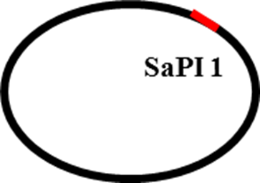
Phage 80α Infecting S.aureus

Slide 5
Replication

Slide 6
Cell lyses

Slide 7
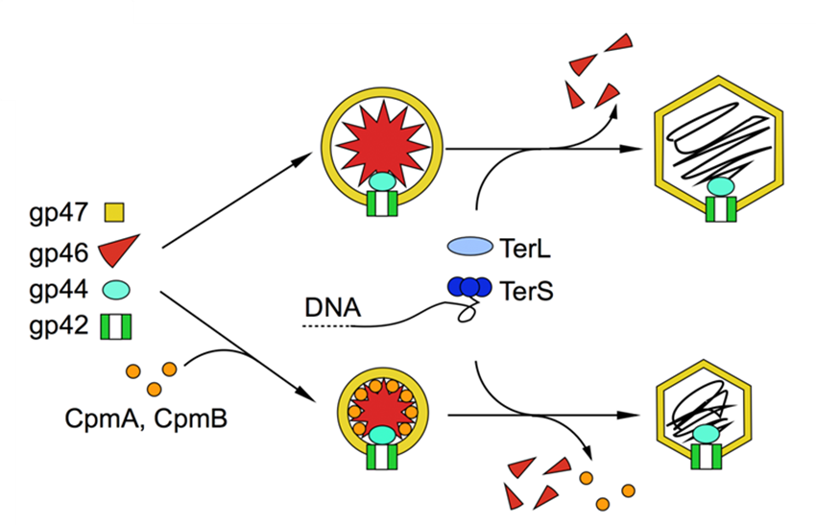
How CpmA Could Redirect Capsid formatiom
80α capsid
MAJOR CAPSID
SCAFFOLDING
MINOR CAPSID
PORTAL
SaPI1 capsid

Slide 8
Plasmid Modification

Slide 9
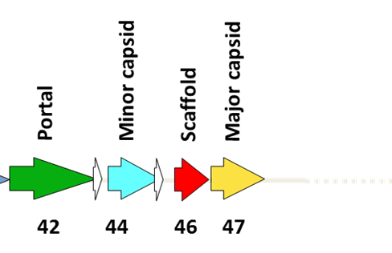
Plasmid Modification
ATG-CAT-CAT-CAT-CAT-CAT-CAT
Histidine x6
CpmA

Slide 10
Plasmid Insertion

Slide 11
Insertion into Staphylococcus

Slide 12
Bead Beater

Slide 13
Nickel Column
CpmA and proteins that are bound to CpmA
Nickel beads

Slide 14
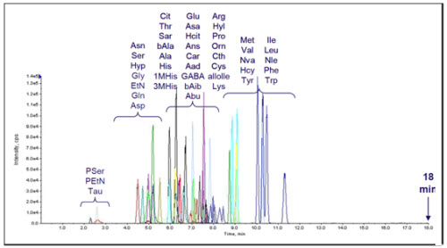
Mass Spectrometry

