Slide 1
Differentiation of LCH-Like Cells
Megan Mair

Slide 2
Langerhans Cell Histiocytosis

Slide 3
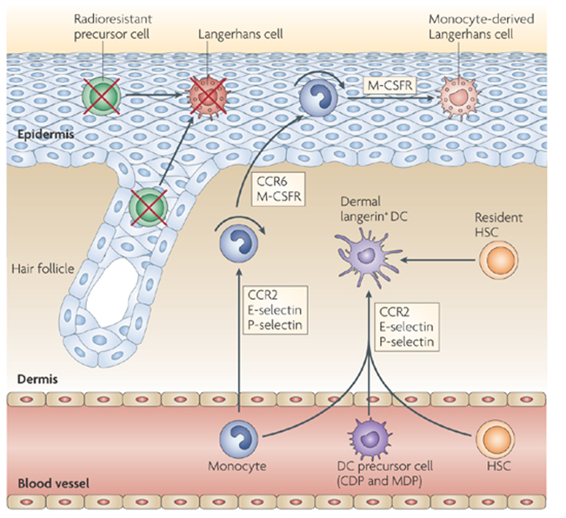
Langerhans Cells
- Dendritic cells primarily found in skin and mucosa tissue
- Origin of abnormal LCs found in LCH tumors unknown

Slide 4
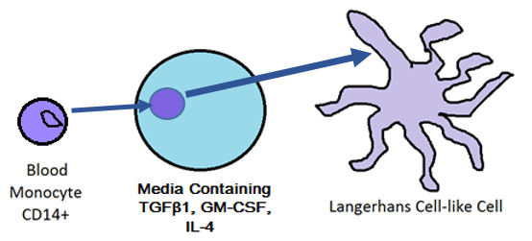
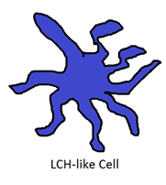
Potential origin of Langerhans Cell: CD14+ Monocyte
Isolation
Growth
Development
Geissmann et al.: proposed origin of LC-like cells in vitro

Slide 5
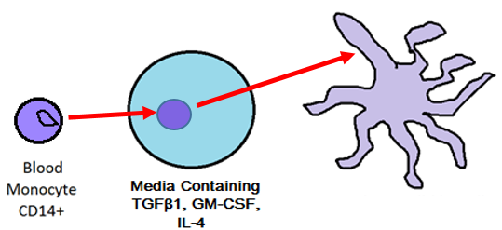
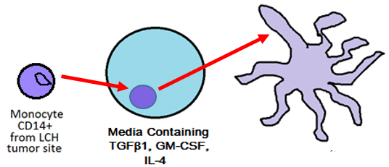
Proposed origin of LCH cells: same differentiation pathway?
Isolate monocyte CD14+ from blood sample Isolate monocyte CD14+ from tumor site
Test for LCH-like behavior

Slide 6
LCH-like behavior: overproduction of cytokines
Interleukin-1α (IL-1α) | Interferon-γ (IFN-γ) | GM-CSF (Granulocyte-macrophage colony-stimulating growth factor)
Interact with T-cells found at the tumor site, stimulating their additional proliferation (Egeler et al., 1999) | Prevent the full maturation of LCH cells (Geissmann et al., 2001) | Drive LCH cell growth and over replication at tumor sites (Emile et al., 1995)
Measure levels of RNAs encoding these three cytokines
more RNA = more LCH-like

Slide 7
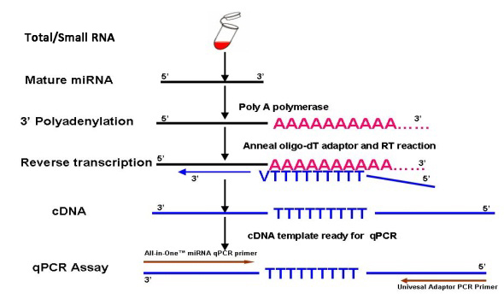
PCR: Amplify RNA Levels
IL-1α, IFN-γ, GM-CSF
Procedures described by Enk & Katz
Isolate RNA
centrifugation/cesium chloride gradient
stabilize RNA
Reverse transcribe RNA into cDNA
Moloney murine leukemia reverse transcriptase

Slide 8
PCR: Amplify RNA Levels
Target cDNA sequences for IL-1α, IFN-γ, GM-CSF
cDNA content
cDNA content for IL-1α
complementary primer for IL-1α
cDNA content

Slide 9
2) Liquid hybridization: Read RNA Levels
Tag IL-1α, IFN-γ, GM-CSF with probe
Sequence of PCR product
Complementary probe
P-32
Measure radioactivity

Slide 10
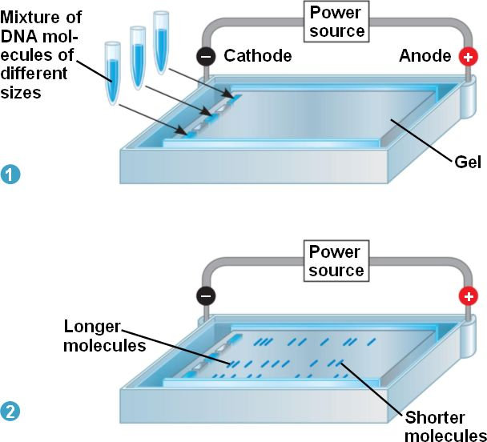
2) Liquid hybridization: Read RNA Levels
Identify IL-1α, IFN-γ, GM-CSF
Identify amplified products
based on relative length of bp content

Slide 11
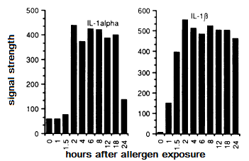
2) Liquid hybridization: Read RNA Levels
Measure levels of IL-1α, IFN-γ, GM-CSF
Densitometric Scanning
measures levels of radioactive phosphorus-32, resulting in computer-generated graphs
Procedures described by Enk & Katz

Slide 12
Potential Outcomes
LCH-like cells cannot be differentiated from CD14+ monocytes
LCH-like cells can be differentiated from CD14+ monocytes
DNA sequencing of blood and tumor monocyte to identify differences and potential causes of the disease
Repeat experiment with other proposed LC-from-monocyte origins
LCH cells have non-myeloid environmental origins

Slide 13
References
Badalian-very G, Vergilio JA, Degar BA, Rodriguez-galindo C, Rollins BJ. Recent advances in the understanding of Langerhans cell histiocytosis. Br J Haematol. 2012;156(2):163-72.
Badalian-Very, Gayane et al. “Recurrent BRAF Mutations in Langerhans Cell Histiocytosis.” Blood 116.11
Enk, A.H., Katz, S.I.(1992).Early molecular events in the induction phase of contact sensitivity. Proc. Natl. Acad. Sci. USA,89, 1398-1402.
Fearon ER, Vogelstein B. A genetic model for colorectal tumorigenesis. Cell. 1990;61(5):759-67.
Hayworth, Douglas. Overview of ELISA. 2014. Web. http://www.piercenet.com/method/overview-elisa
Hoesel B, Schmid JA. The complexity of NF-κB signaling in inflammation and cancer. Mol Cancer. 2013;12:86.
Madonna G, Ullman CD, Gentilcore G, Palmieri G, Ascierto PA. NF-κB as potential target in the treatment of melanoma. J Transl Med. 2012;10:53.
Valladeau, Jenny; Dezutter-Dambuyant, Colette; Saeland, Sem (2003). "Langerin/CD207 Sheds Light on Formation of Birbeck Granules and Their Possible Function in Langerhans Cells". Immunologic Research 28 (2): 93–107.

