Slide 1
Smad7 Knockout leads to increased Collagen 1 gene levels in kidney cells
Farrah Hermes
Mentor: Dr. John Ryan

Slide 2
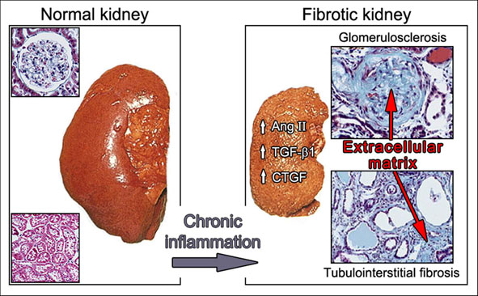
Renal Fibrosis
http://www.pzf.de/allg/research/schaefer.php

Slide 3
Collagen 1 Gene
Found in the extracellular matrix

Slide 4
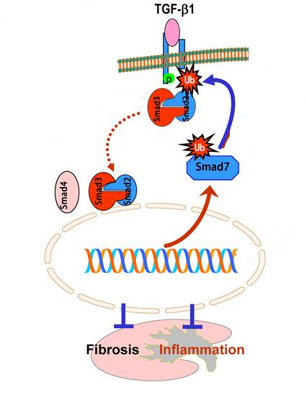
Pathway

Slide 5
Pathway
Nucleus
TGF-b1
Smad3
Production of Collagen 1
P

Slide 6
Pathway
Nucleus
TGF-b1
Collagen 1
Smad3
Smad7

Slide 7
Is there a lack of the Smad7 protein when fibrosis occurs?
Does Smad7 play an important role in the regulation of Collagen 1?

Slide 8
Will a lack of Smad7 in kidney cells lead to an over production of the Collagen 1 protein?

Slide 9
Western Blot
Purify collagen protein from kidneys
Place onto Membrane
Fluorescently label with antibody specific to Collagen 1
Run on SDS Page
Measure by densitometry data

Slide 10
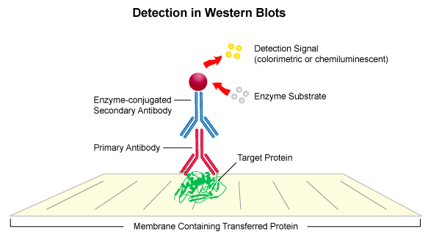
http://www.leinco.com/general_wb

Slide 11
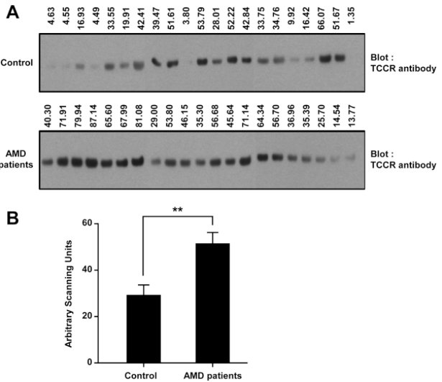
http://www.molvis.org/molvis/v18/a27/sung-fig3.html

Slide 12
References
Ai, J., He, J., Guo, Q., et al. (2014). GQ5 Hinders renal fibrosis in obstructive nephropathy by selectively inhibiting TGF-b-induced smad3 phosphorylation. Journal of the American Society of Nephrology, 26 : 1-12. Chou, Y. Pan, S., Yang, C., and Lin, S. (2014). Stem Cells and Kidney Regeneration. Journal of the Formosan Medical Association, 113(4),: 201-220. Derynck, R. and Zhang, Y. (2003). Smad-dependent and Smad-independent pathways in TGF-beta family signaling. Nature, 425: 577-584. http://www.nature.com/nature/journal/v425/n6958/full/nature02006.html Ghosh, A., Quaggin, S., and Vaughan, D. (2013). Molecular Basis of Organ Fibrosis: Potential Therapeutic Approaches. Experimental Biology and Medicine, 238(5): 461-481. http://ebm.sagepub.com/content/238/5/461.full.pdf+html Lan, H. (2011). Diverse Roles of TGF-β/Smads in Renal Fibrosis and Inflammation. Internatioanl Journal of Biological Sciences, 7(7):1056-1067.
Li, R., Rosendahl, A., Brodin, G., et al. (2006). Deletion of exon 1 of Smad7 in Mice Results in Altered B Cell Responses. Journal of Immunology, 176(11): 6777-6784. http://www.jimmunol.org/content/176/11/6777.long
Liu, Y. Renal fibrosis: New insights into the pathogenesis and therapeutics. Kidney International. 69:213-217.
Ma, X., Che, N., Gu, Z. et al. (2013). Allogenic Mesenchymal Stem Cell Transplantation Amerliorates Nephritis in Lupus Mice Via Inhibition of B-Cell Activation. Cell Transplantation, 22:2279, 2290.
Nowling, T. and Gilkeson, G. (2011). Mechanisms of Tissue Injury in Lupus Nephritis. Arthritis Research and Therapy, 13(6): 250. http://www.ncbi.nlm.nih.gov/pmc/articles/PMC3334648/
Singh, S, et al., Lupus Nephritis. (2009).The American Journal of the Medical Sciences, 337(6): 451-460.
Sugimoto, H., LeBleu, V., et al. (2012). Activin- like kinase 3 is important for kidney regeneration and reversal of fibrosis. Nature Medicine, 18: 394-404. http://www.nature.com/nm/journal/v18/n3/full/nm.2629.html
Wise, A. and Ricardo, S. (2012). Mesenchymal Stem Cells in Kidney Inflammation and Repair. Nephrology, 17:1-10. http://onlinelibrary.wiley.com/store/10.1111/j.1440-1797.2011.01501.x/asset/j.1440-1797.2011.01501.x.pdf;jsessionid=EA0EC9ACE4795F7D0334147BECBD857E.f04t02?v=1&t=i3535hr9&s=caceb6a1e31402ffc0a70eef9062bd678b17f05c
Zhou, H., Hasni, S., Perez, P., et al. (2013). miR-150 Promotes Renal Fibrosis in Lupus Nephritis by Downregualting SOCS1. Journal of the American Society of Nephrology, 24(7): 1073-1087 http://www.ncbi.nlm.nih.gov/pmc/articles/PMC3699828/

