Slide 1
Blood vessel leakiness – how is it controlled?
Akhil Garg

Slide 2
Blood vessels and diffusion
Inflammation
Metastasis
Viral hemorrhagic infections
uic.edu

Slide 3
Blood vessels and diffusion
Understanding the pathways that cause leakiness could lead to a drug that can treat those diseases
uic.edu

Slide 4
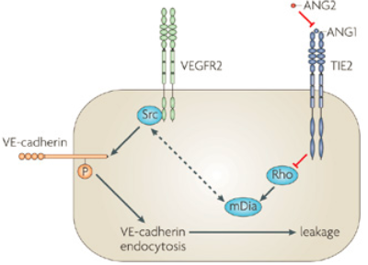
Tie-2: Controlling Endothelial Cells
Adapted from
Helmutt, Nature Reviews Molecular Cell Biology 10, 165-177

Slide 5
Tie-2 effects
Angiopoietins activate or deactivate Tie-2
Activation:
vessel diameter increases
transferring white blood cells across the cell wall
De-activation:
reduction of cell-cell adhesion proteins

Slide 6
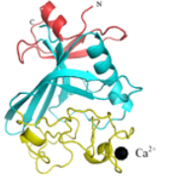
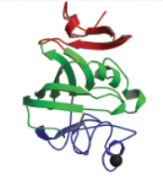
4 angiopoietins
Ang-2
Ang-3 and Ang-4
Ang-1
?
http://www.people.vcu.edu/~wabarton/structures.html
Lungs only?

Slide 7
Ang-3
Ang-4

Slide 8
Ang-3
Ang-4
What is the relative binding of each angiopoietin to Tie-2?

Slide 9
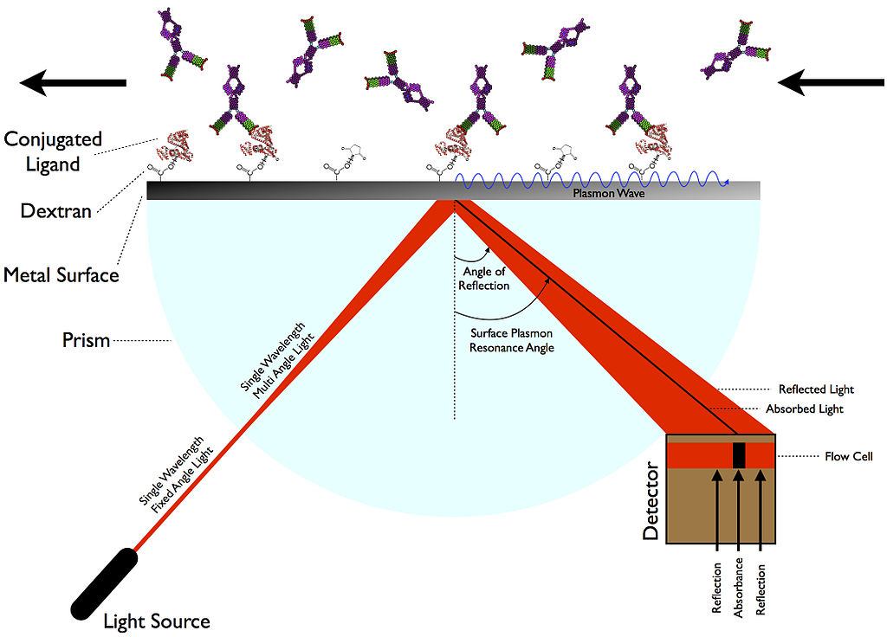
Surface plasmon resonance (SPR)
wide angle light fired at metal surface
single absorption angle due to electrons absorbing the photons’ energy
Adapted from etheses.whiterose.ac.uk

Slide 10
Central Idea of SPR
Vary what is on the surface, and then measure the change in SPR angle.
Adapted from etheses.whiterose.ac.uk

Slide 11
SPR Experiment
Metal surface constant: Tie-2
Metal surface variable: Ang-1, Ang-2, Ang-3, Ang-4
Angiopoietin
Tie-2
etheses.whiterose.ac.uk

Slide 12
SPR Measurement
More change in angle = more binding
Angiopoietin
Tie-2
etheses.whiterose.ac.uk

Slide 13
SPR procedure
Bind Tie-2 to dextran
(and add ethanolamine)
Add angiopoietin solution
Add Angiopoietin-free buffer
Measure SPR reference angle
Angiopoietin
Tie-2

Slide 14
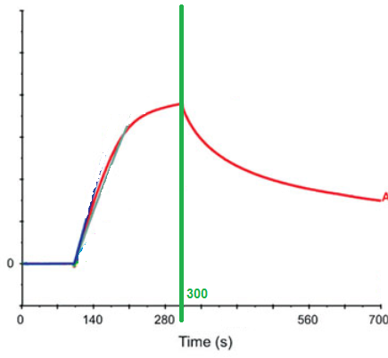
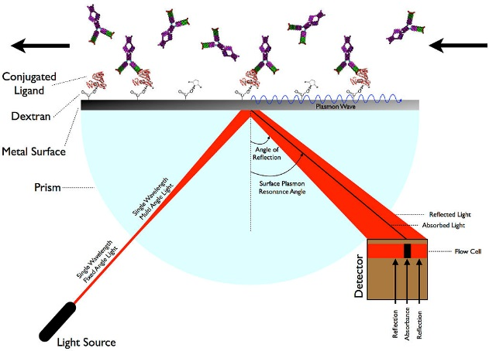
Example SPR curves
Change in absorption angle
binding constants
Adapted from Himanen (2004), Nature Neuroscience 7: 501-509

Slide 15
Ang-3
Ang-4
What is the relative binding of each angiopoietin to Tie-2?

Slide 16
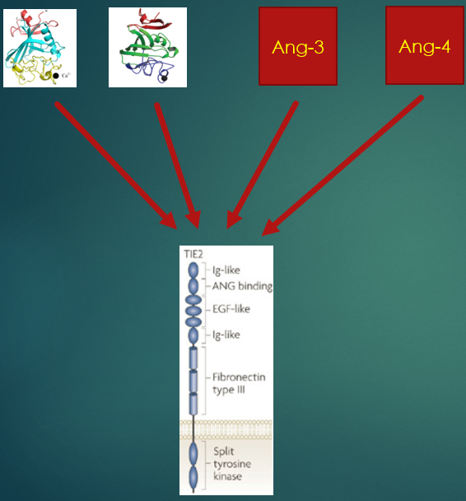
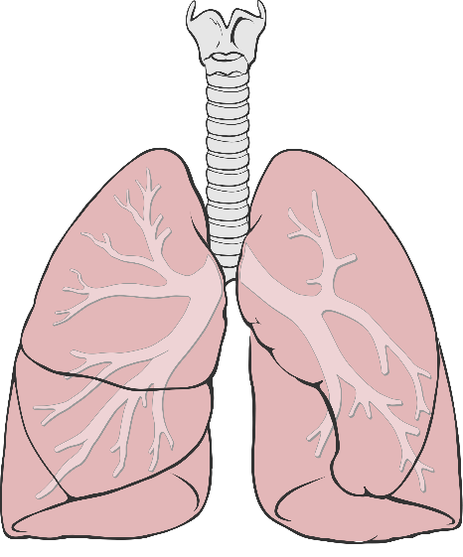
What is the relative binding of each angiopoietin to Tie-2?
What is the cellular effect of Ang-4?
laughingmantis.com
What is the in vivo effect of Ang-4?
Wikimedia

