Slide 1
Potential relations between two drosophila proteins
Jordan Davis
Mentor: Dr. Mike grotwiel bnfo 300

Slide 2
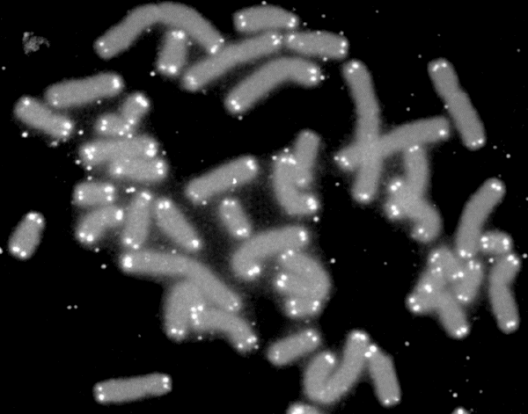
Location: Telomeres
Telomeres Are capped at the end of each chromatid
Prevents chromosome end-to-end fusion
Fruit fly telomeres are capped by protein complex terminin
U.S. Department of Energy Human Genome Program. SierraSciSPA
Raffa, Grazia D., et al. "Organization and evolution of Drosophila terminin: similarities and differences between Drosophila and human telomeres."Frontiers in oncology 3 (2013).
Raffa, Grazia D., et al. "ORGANIZATION AND MAINTENANCE OF DROSOPHILA TELOMERES: THE ROLES OF TERMININ AND NON-TERMININ PROTEINS." ЦИТОЛОГИЯ 55.3 (2013): 204-208.

Slide 3
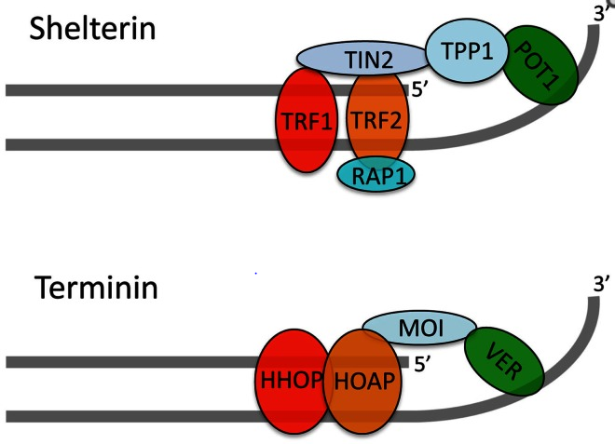
Terminin function at risk?
Woc protein is located near telomere ends
Terminin complex is located near telomere ends
Verrocchio protein is vital for protection of telomeres
Ver may be dependent on woc protein for function
Raffa, Grazia D., et al. "Organization and evolution of Drosophila terminin: similarities and differences between Drosophila and human telomeres."Frontiers in oncology 3 (2013).
Muller H. J. (1938). The remaking of chromosomes. Collect. Net 8, 182–195
Gao, Guanjun, et al. "HipHop interacts with HOAP and HP1 to protect Drosophila telomeres in a sequence‐independent manner." The EMBO journal29.4 (2010): 819-829.

Slide 4
Question
Is the terminin complex at risk with a mutation in woc?

Slide 5
Experimental Question
Will Verrocchio be expressed with a gene knockout of woc?

Slide 6
Methodology: Gene knockout
Why gene knockout?
To compare terminin in wild type flies to woc mutated flies
Dr. Graham Beards – Own work
Phage display process described further in Wolfe et al. (1999)
Wolfe, Scot A., et al. "Analysis of zinc fingers optimized< i> via</i> phage display: evaluating the utility of a recognition code." Journal of molecular biology 285.5 (1999): 1917-1934.
Raffa, Grazia D., et al. "Terminin: a protein complex that mediates epigenetic maintenance of Drosophila telomeres." Nucleus 2.5 (2011): 383-391.

Slide 7
Methodology: Gene knockout
Why gene knockout?
To compare terminin in wild type flies to woc mutated flies
What will be analyzed?
Ver’s ability to be expressed at telomere ends
Sequence information provided by flybase.org

Slide 8
Methodology: Gene knockout
Why gene knockout?
To compare terminin in wild type flies to woc mutated flies
What will be analyzed?
Ver’s ability to be expressed at telomere ends
Why does it matter??
Woc protein is also found in humans
Woc protein has no known function in humans
Woc may be of ver at telomere protecting proteinsvital for localization

Slide 9
Analysis
Western blot analysis for two samples
One wild type
One with/ woc mutation
Testing expression of protein verrocchio within drosophila samples

Slide 10
What next ?
Hopefully woc and ver show some sign of a relation between the two
Test individual function of woc
Move to human homolog?

Slide 11
References
Biessmann, Harald, Steven B. Carter, and James M. Mason. "Chromosome ends in Drosophila without telomeric DNA sequences." Proceedings of the National Academy of Sciences 87.5 (1990): 1758-1761.
Cenci, Giovanni, et al. "The Drosophila HOAP protein is required for telomere capping." Nature cell biology 5.1 (2002): 82-84.
Frydrychová, Radmila, et al. "Phylogenetic distribution of TTAGG telomeric repeats in insects." Genome 47.1 (2004): 163-178.
Gao, Guanjun, et al. "HipHop interacts with HOAP and HP1 to protect Drosophila telomeres in a sequence‐independent manner." The EMBO journal29.4 (2010): 819-829.
Font-Burgada J., Rossell D., Auer H., Azorin F. (2008).Drosophila HP1c isoform interacts with the zinc-finger proteins WOC and Relative-of-WOC to regulate gene expression. Genes Dev. 22, 3007–302310.1101/gad.481408
Muller H. J. (1938). The remaking of chromosomes. Collect. Net 8, 182–195
Nielsen, Lena, and J. E. Edström. "Complex telomere-associated repeat units in members of the genus Chironomus evolve from sequences similar to simple telomeric repeats." Molecular and cellular biology 13.3 (1993): 1583-1589.
Raffa, Grazia D., et al. "Organization and evolution of Drosophila terminin: similarities and differences between Drosophila and human telomeres."Frontiers in oncology 3 (2013).
Raffa, Grazia D., et al. "ORGANIZATION AND MAINTENANCE OF DROSOPHILA TELOMERES: THE ROLES OF TERMININ AND NON-TERMININ PROTEINS." ЦИТОЛОГИЯ 55.3 (2013): 204-208.
Raffa, Grazia D., et al. "Terminin: a protein complex that mediates epigenetic maintenance of Drosophila telomeres." Nucleus 2.5 (2011): 383-391.
Raffa, Grazia D., et al. "Verrocchio, a Drosophila OB fold-containing protein, is a component of the terminin telomere-capping complex." Genes & development24.15 (2010): 1596-1601.
Roth, Charles W., et al. "Chromosome end elongation by recombination in the mosquito Anopheles gambiae." Molecular and cellular biology 17.9 (1997): 5176-5183.
Sean Gallagher, Deb Chakavarti. Keck Graduate Institute of Applied Life Sciences, UVP, LLC, Proteomic Center, Keck Graduate Institute of Applied Life Sciences.
SimpleScience. "SDS PAGE Principles - Simple Animated Tutorial." YouTube. YouTube, 10 Nov. 2013. Web. 02 Dec. 2014.
Takada, Shinako, et al. "A TRF1: BRF Complex Directs Drosophila RNA Polymerase III Transcription." Cell 101.5 (2000): 459-469.
Wolfe, Scot A., et al. "Analysis of zinc fingers optimized< i> via</i> phage display: evaluating the utility of a recognition code." Journal of molecular biology 285.5 (1999): 1917-1934.

Slide 12
Questions?

