Slide 1
Measuring myelin protein expression with a MeCP2 KO in oligodendrocytes
Rachel Siefring
Mentor: Dr. Carmen Sato-Bigbee

Slide 2
The human population

Slide 3
People with disabilities

Slide 4
People with autism

Slide 5
Rett Syndrome
Rett Syndrome

Slide 6
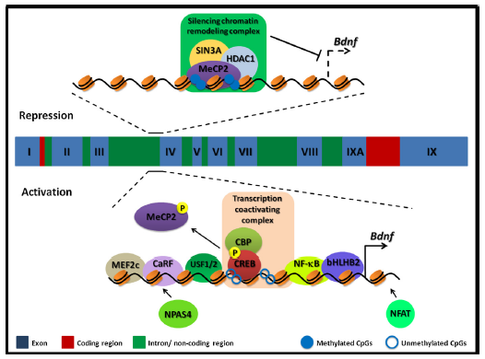
Cause of Rett Syndrome
Caused by a mutation
in methyl-CpG-binding
Protein (MeCP2)
Figure 2 of Cortes-Mendoza, 2013

Slide 7
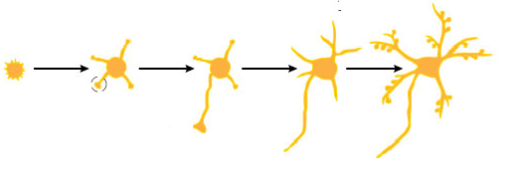
MeCP2 and neurons
MeCP2
Regulates transcription of
Brain-derived growth factor (BDNF)
Axonal maturation
Neuronal development

Slide 8
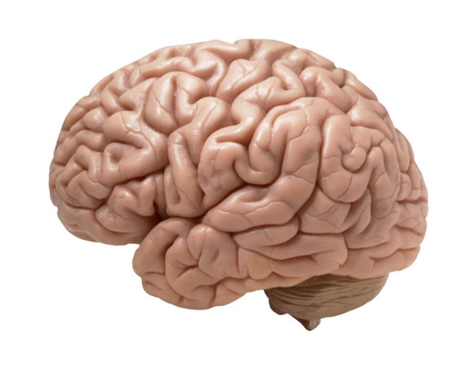
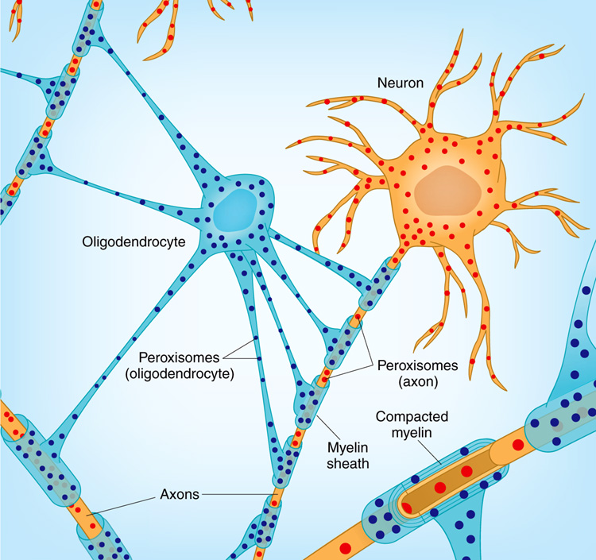
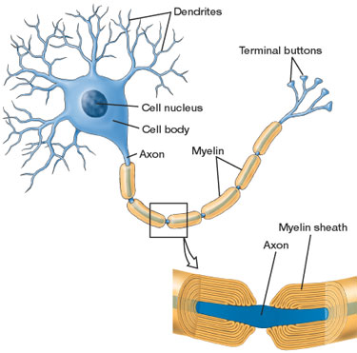
MeCP2 and myelin
MeCP2
Myelination
Oligodendrocytes

Slide 9
MeCP2
MeCP2
Regulates transcription of
Myelination
Brain-derived growth factor (BDNF)
Oligodendrocytes
Axonal maturation
How is the myelination process different in a child with Rett syndrome??
Neuronal development

Slide 10
Stages of oligodendrocyte development
Progenitor cell
Pre-oligodendrocyte
Mature oligodendrocyte
Slide provided by Dr. Sato-Bigbee

Slide 11
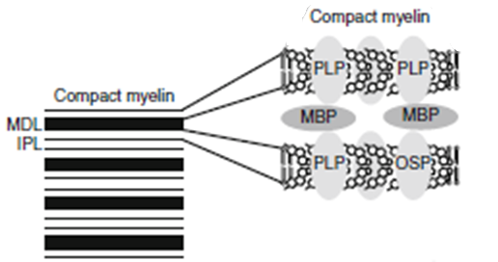
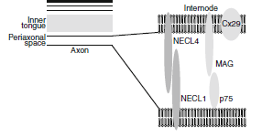
Myelin Proteins
Figure 1 from Jahn, et al
Myelin Basic Protein (MBP)
Myelin-associated glycoprotein
Is there a difference in MBP and MAG expression levels
when there is a MeCP2 knockout??

Slide 12
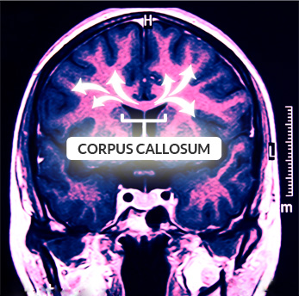
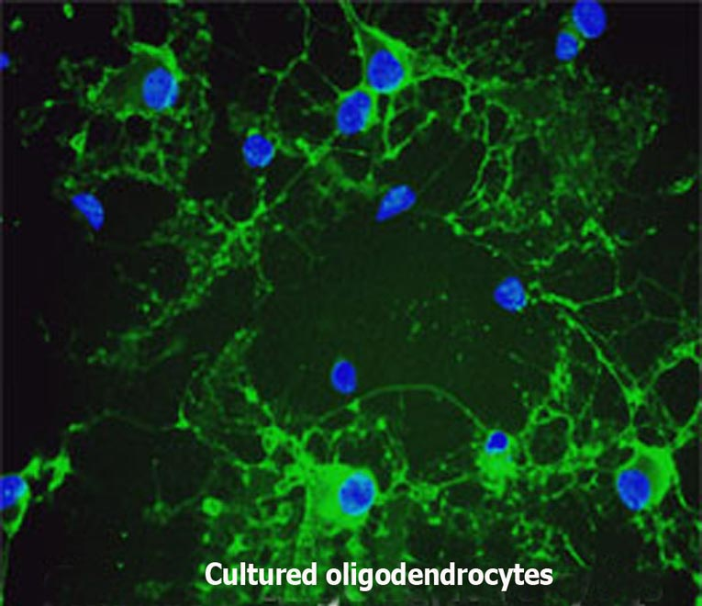
Isolating oligodendroctyes
Sprague-Dawley rats
2 experimental groups
MeCP2 knockout
Regular MeCP2

Slide 13
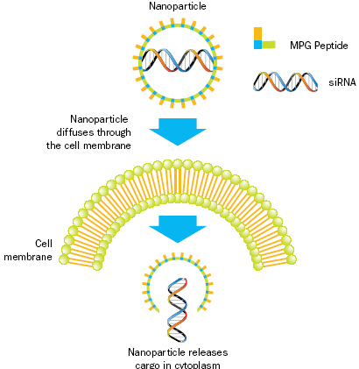
Knockout method: siRNA
MeCP2 knockout

Slide 14
Immunocytochemistry
4 days old
Apply MBP and MAG antibodies
MBP and MAG expression based on antibody binding
11 days old
21 days old

Slide 15
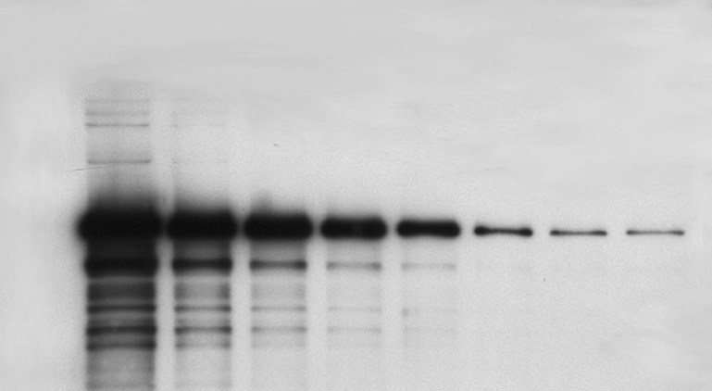
Western Blot
Make cell lysates for each culture
Apply MBP and MAG antibodies
Look at protein expression on Western Blot

Slide 16
Possible resulting scenarios
Methods don’t work
No difference in myelin protein expression
Large differences in myelin protein expression
Oligodendrocyte isolation fails
MeCP2 doesn’t effect oligodendrocytes in culture
MeCP2 does effect oligodendrocytes in culture
siRNA
Overexpression
Underexpression

Slide 17
Concluding remarks
Do myelination and oligodendrocytes play a role in the Rett syndrome phenotype?
Based on this experiment, should this research even be pursued?

Slide 18
References:
Bhat, S., et al. (2014). Autism: cause factors, early diagnosis, and therapies. Reviews in the Neurosciences. De Gruyter. 25(6): 841-850.
Amir, R. et al. (1999). Rett syndrome is caused by mutations in X-linked MECP2, encoding methyl-CpG-binding protein 2. Nature Genetics, 23: 185-188.
Kleijer, K., Schmeisser, M., Krueger, D., Boeckers, T., Scheiffele, P., Bourgeron, T., Brose, N., and J. Burbach. 2014. Neurobiology of autism gene products: towards pathogenesis and drug targets. Psychopharmacology. 231: 1037-1062.
Chahrour, M., et al. (2008). MeCP2, a key contributor to neurological disease, activates and represses transcription. Science, 320: 1224-1229.
Ebert, D. & M. Greenberg. (2013). Activity-dependent neuronal signalling and autism spectrum disorder. Nature, 493: 327-337.
Vora, P., et al. (2010). A novel transcriptional regulator of myelin gene expression: implications for neurodevelopmental disorders. Lippincott Williams & Wilkins, 0959-4965: 917-921.
Zeidán-Chuliá, F., et al. (2014). The glial perspective of autism spectrum disorders. Neuroscience and Biobehavioral Reviews, 38: 160-172.

Slide 19
References, cont.
8. Karpova, N. (2014). Role of BDNF epigenetics in activity-dependent neuronal plasticity. Neuropharmacology, 76: 709-718.
9. Cortes-Mendoza, J., et al. (2013). Shaping synaptic plasticity: the role of activity-mediated epigenetic regulation on gene transcription. International Journal of Developmental Neuroscience. 31: 359-369.
10. Sato-Bigbee, C., et al. (1999). Different neuroligands and signal transduction pathways stimulate CREB phosphorylation at specific developmental stages along oligodendrocyte differentiation. Journal of Neurochemistry, 72: 139-147.
11. Saini, H., et al. (2005). Novel role of sphinogosine kinase 1 as a mediator of neurotrophin-3 action in oligodendrocyte progenitors. Journal of Neurochemistry, 95: 1298-1310.
Shan, G. (2010). RNA interference as a gene knockdown technique. The International Journal of Biochemistry and Cell Biology, 42: 1243-1251.
Nguyen, M., et al. (2013). Oligodendrocyte lineage cells contribute unique features to Rett Syndrome neuropathology. Neurobiology of Disease, 33(48): 18764-18774.
Bradl, M. and H. Lassmann. (2010). Oligodendrocytes: biology and pathology. Acta Neuropathol, 119: 37-53.
Jahn, O., Tenzer, S., and H. Werner. (2009). Myelin proteomics: molecular anatomy of the insulating sheath. Mol Neurobiol, 40: 55-72.

