Slide 1
Determining the significance of a two-component regulatory response gene in bacteria Streptococcus sanguinis
Navpreet Saini

Slide 2
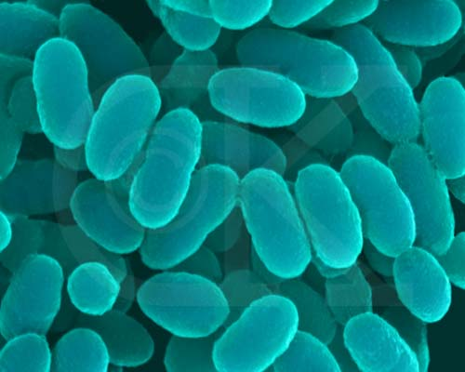
Streptococcus Sanguinis
Gram Positive Bacteria (Caufield et al.
2000)
Normally Harmless in Human Mouth
Forms Plaques
Gains a Pathway to the Heart
through bloodstream
Causes Cardiac Diseases (Endocarditis)
ComputationalBioenergy.org

Slide 3
Tolerance Level of S. sanguinis
Bacteria is resistant to antibiotics
Why so resistant?
Full Genome Determined in 2007
Determined to have over 100 transcriptional regulators (Ping et al. 2007)

Slide 4
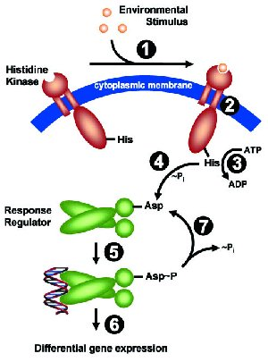
Two Component Response Regulatory System
Mechanism that aids in adaptation to
environment
Occurs through signal transduction
Allows bacteria to become tolerant to
environment (Marx, Patrick et al. 2010)
There are 14 regulatory systems in S.
sanguinis (Ping et al. 2007)
“Signal Transduction”, Faculty of Biology. Ludwing-Maximilians University

Slide 5
Which genes are actually significant
There are 14 regulatory genes – which one is expressed under certain conditions?
Observe multiple genes of the bacteria under penicillin
Is the gene essential to the bacteria in the condition?
Use statistical approach

Slide 6
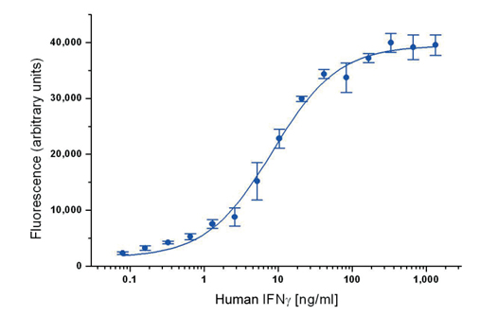
Bacteria combined with Transposable Elements
Two Strains: sanguinis and mutans (TE)
Affect strains with penicillin
Use microplate reader to observe target gene
Amount of light transmitted =
concentration of gene (Adam et al 2014)
Do multiple experiments for the bacteria
Sample Graph of plate reader on Human interferon (Ab D serotec)

Slide 7
Statistical Approach
After determining if a gene is clearly expressed through multiple times, use formula from Adam et al. 2014 to determine significance.
Number determines fitness of gene under certain conditions.
Use of T value and P value

Slide 8
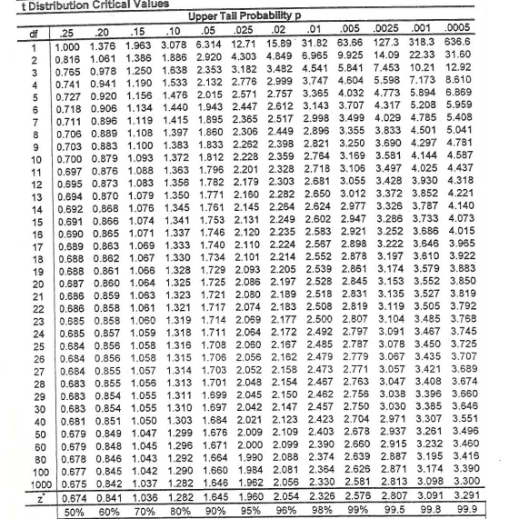
T Value and P Value
The calculation to determine the test statistic for a gene. $μ$ is the average number of “expressed” genes for each experiment, n is the number of experiments, V is the difference in strain fitness, $Ψ$ is the standard deviation of the amount of genes for each experiment⁸. (Adam et al.)

Slide 9
Significant Score of Gene
P Value range from 0 to 1
Closer to 1, more significant (essential) gene is to bacteria
Determining if the gene is essential allows future experiments in having a shorter task.

Slide 10
References
Seaton, K et al. (2014). “Regulation of competence and gene expression in Streptococcus mutans by the RcrR transcriptional regulator.” Molecular Oral Microbiology 10.1: 1-13. NCBI. Web.
Ping, Xu et al. (2007). “Genome of the opportunistic pathogen Streptococcus sanguinis.” Journal of Bacteriology 189.8:3166-3175. NCBI.
Marx, Patrick et al. (2010). “Identification of genes for small non-coding RNAs that belong to the regulation of the two-component regulatory system CiaRH in Streptococcus.” BMC Genomics 11:661. NCBI.
Lee, Chih and Chun-His Huang. (2012). “Searching for transcription factor binding sites in vector spaces.” BMC Bioinformatics 13: 215. NCBI.
Todeschini, Anne-Laure, Adrein Geroges, and Reiner Veitia. (2014). “Transcription factors: specific DNA binding and specific gene regulation.” Trends in Genetics 30.6: 211-219. ScienceDirect.
Caufield, Page et al. (2000). “Natural History of Streptococcus sanguinis in the oral cavity of Infants: Evidence for a Discrete Window of Infectivity.” Infection and Immunity 68.7: 4018-4023. NCBI.
“Signal Transduction”. Faculty of Biology. Ludwing-Maximilians University, Munich.
Adam Deutschabauer et al. “Towards an Informative Mutant Phenotype for Every Bacterial Gene.” Journal of Bacteriology 196.20 (2014): 3642-3655. Web.
“An Introduction to ELISA.” Ab D serotec

