Slide 1
CpmA and Phage 80α scaffolding proteins interaction in Staphylococcus aureus

Slide 2
SaPIs
SaPIs are super antigen carrying pathogenicity islands. They are mobile genetic elements that are discretely integrated within the genome of S. aureus
One example is S. aureus SaPl1. This particular SaPI is responsible for the spread of toxins. The toxins released by SaPI1 can cause toxic shock syndrome, a rare life threatening disease
The SaPIs excise form the host genome using helper phages to replicate. . Helper phages are viruses that assist a separate and unrelated defective virus to reproduce. This process occurs by infecting the same host cell that is already occupied by the , pathogenicity island this in turn provides the proteins the SaPI is missing to complete its’ life cycle

Slide 3
SaPI Integrated in MRSA

Slide 4
The SaPI1 highjacks the Helper Phage and redirect capsid formation. The two proteins that are responsible for this are CpmA and CpmB

Slide 6
Plasmid Modification

Slide 7
Plasmid Insertion

Slide 8
Purify Plasmids

Slide 9
Insertion into Staphylococcus

Slide 10
Bead Beater

Slide 11
Nickel Column

Slide 12
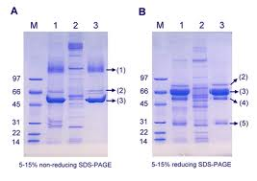
SDS-Polyacryamide Gel Electrophoresis

Slide 13
Mass Spectrometry

