Slide 1
Differentiation of LCH-Like Cells
Megan Mair

Slide 2
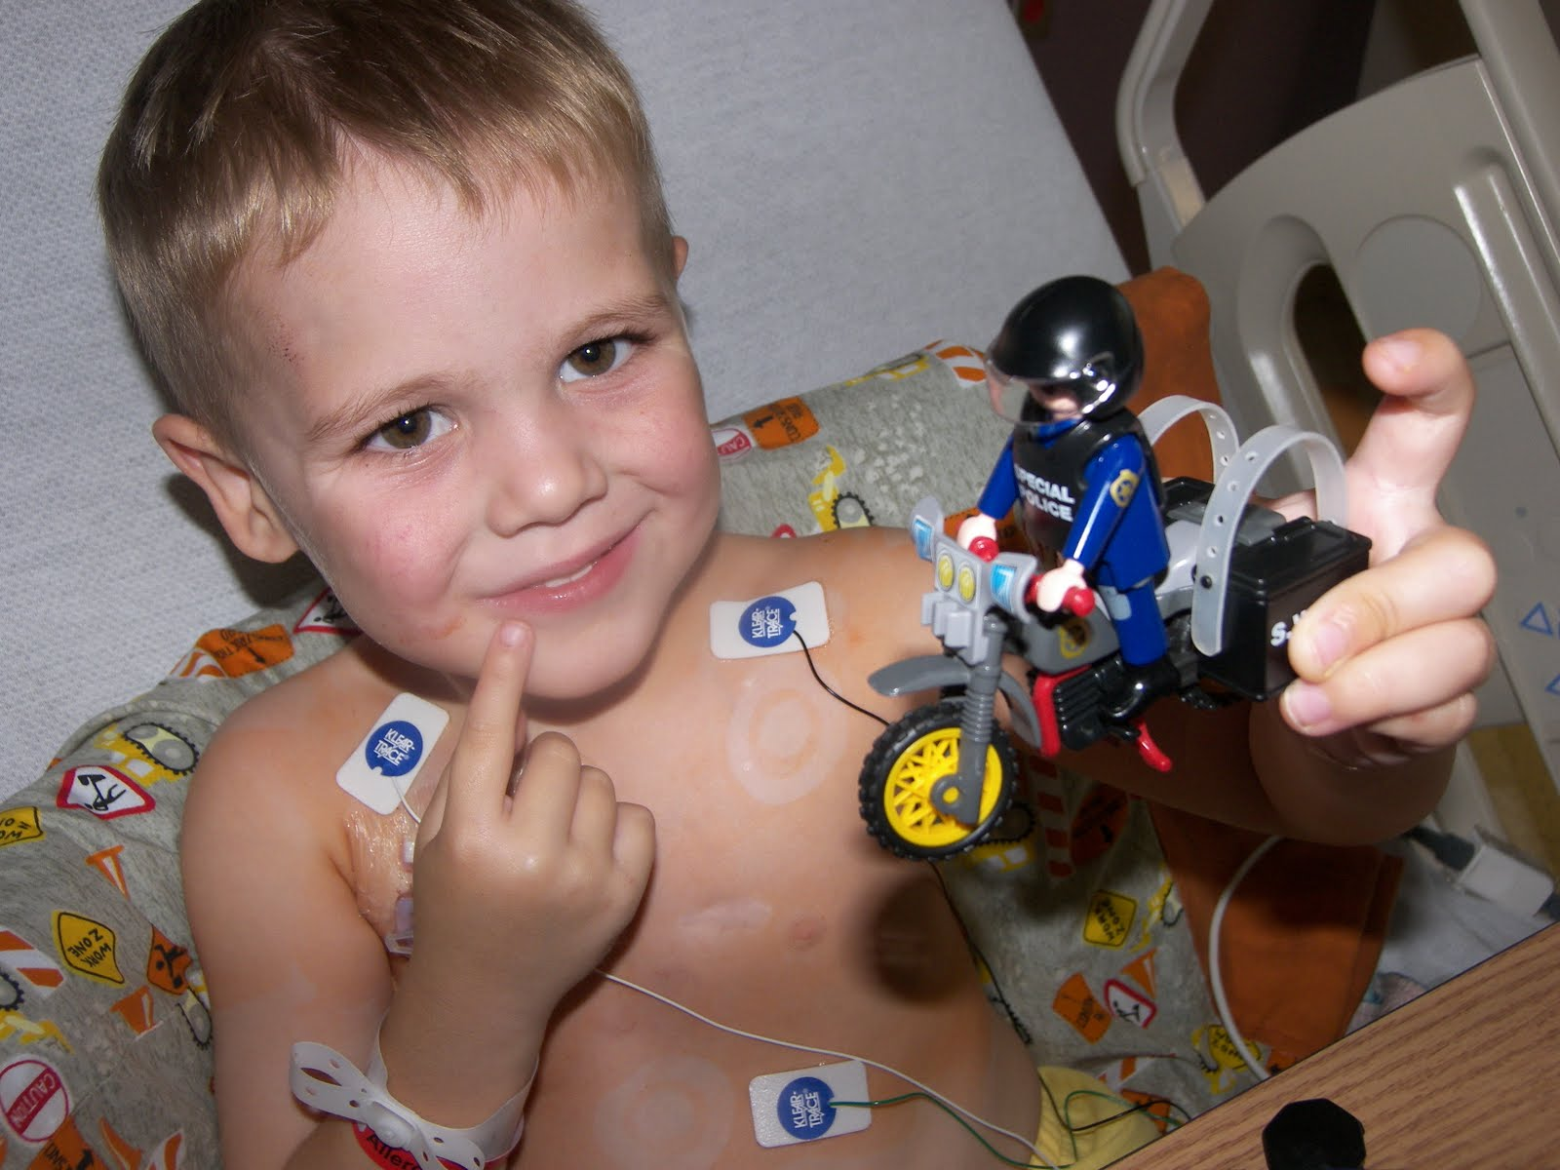
Langerhans Cell Histiocytosis: An Overview
- Sawyer: diagnosed with histiocytosis of the mastoid and skull at age 2
- Langerhans Cell Histiocytosis (LCH): a rare blood disorder characterized by the abnormal development and proliferation of Langerhans Cells within the body, resulting in cellularly diverse tumors
colloquially known as a “relative of cancer”
- Langerhans Cells: self-dividing dendritic cells primarily found on the skin. Origin of the abnormal LCs found in the abnormal locations typical of LCH is unknown.

Slide 3
Disease origin? Breakdown the parts
Disease
LCH Lesions
Cell Behavior
LCH Cells
Cell Origin

Slide 4
Cell origin from monocytes?
LC-like behavior
LC-like cells
Monocyte CD14+ from blood
LCH-like behavior
LCH-like cells
Monocyte CD14+ from LCH lesion
Measures of LCH-like molecular behavior:
“Cytokine storm”: levels of pro-inflammatory cytokines interleukin-1α (IL-1α) and interferon-γ (IFN-γ), as well as anti-inflammatory interleukin-10 (IL-10) and growth factor GM-CSF
Lesion formation: irregularities in cell-regulating NF-κB pathway, measured through presence of P16 and P21
Geissmann et al.: proposed origin of LC-like cells in vitro
Hypothesis: same conditions result in development of LCH-like cells in vitro
Grown in media with TGFβ1, GM-CSF, and IL-4
Collect samples from blood and lesion
site of LCH patient and sample from
blood of healthy non-LCH patient; expose to same growth conditions

Slide 5
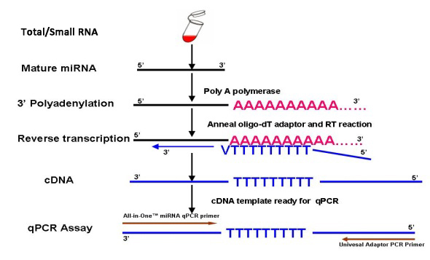
1) Levels of IL-1α, IFN-γ, IL-10, GM-CSF
Polymerase chain reaction to amplify level of producing RNAs
Procedures described by Enk & Katz
1) Purification from other cell products via CsCl gradient. RNA stabilized through polyadenylation
2) Total RNA reverse transcribed using enzyme Moloney murine leukemia reverse transcriptase (BRL)
3) Target cDNA found in PCR cycles via primer sequences. Primer sequences for cytokines IL-1α, IFN-γ, IL-10, as well as GM-CSF are available on GenBank
4) Heating/cooling cycles break apart strands and continue to synthesize cDNA between heat cycles, amplifying initial RNA products

Slide 6
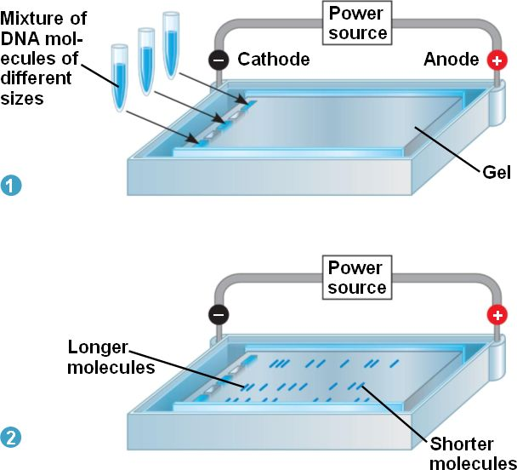
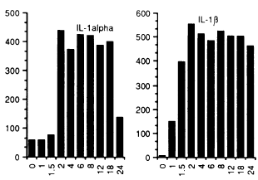
1) Levels of IL-1α, IFN-γ, IL-10, GM-CSF
2) Liquid hybridization techniques
1) Amplified RNA products bind to complementary probes labeled by radioactive isotope Phosphorous-32
2) Each sample loaded onto PAGE gel and electrophoresed
3) Samples dried and analyzed for bp signals, and radiation levels analyzed via densitometric scanner
Radiation levels versus hours after hapten application. Computer-generated graphs measuring radiation levels within each sample. For our proposes, sample type replaces time.

Slide 7
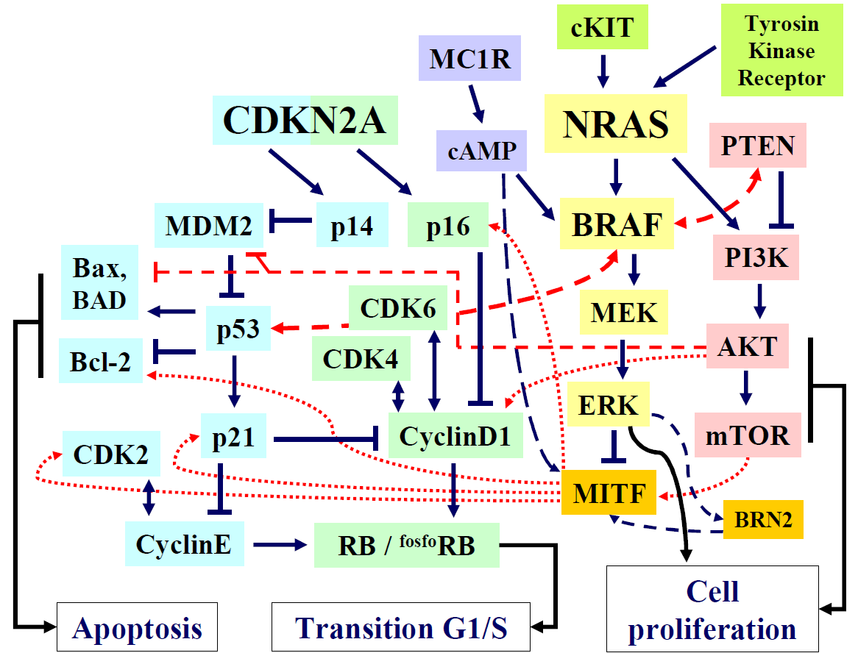
2) Irregular presence of P16 and P21
NF-κB: protein complex responsible regulating DNA transcription within animal cells
Irregularities in signaling pathway result in abnormal cell behavior that can lead to tumor formation
Mutation in BRAF V600E gene found in many cases of both melanoma and LCH (Badalian-Very)

Slide 8
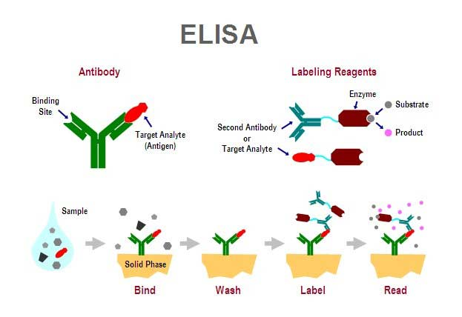
2) Irregular presence of P16 and P21
ELISA kits available for target antigens
Labeling antibody emits dye, indicating presence of target antigen

Slide 9
Potential Outcomes
LCH-like cells can be differentiated from CD14+ monocytes
Genomic differences in monocytes found in lesion site are likely accountable for this altered differentiation pattern from regular LCs
Further suggests monocyte CD14+ is involved in initial production of LCs
LCH-like cells cannot be differentiated from CD14+ monocytes
Further experimentation of other proposed LC differentiation origins via different monocytes can be tested using the same procedures; if no results, it can be assumed there are no differences within the monocyte precursors in LCH cells, indicating non-myeloid environmental causes for the development of the disease
DNA sequencing of blood and lesion site monocytes can identify differences and potential oncogenes; a similar study by Fearon & Vogelstein found genetic differences in cancer and noncancerous colon cells
Regular LCs are the body’s first defense against diseases such as HIV; this knowledge may help in developing preventatives and treatments to other autoimmune disorders

Slide 10
References
Badalian-very G, Vergilio JA, Degar BA, Rodriguez-galindo C, Rollins BJ. Recent advances in the understanding of Langerhans cell histiocytosis. Br J Haematol. 2012;156(2):163-72.
Badalian-Very, Gayane et al. “Recurrent BRAF Mutations in Langerhans Cell Histiocytosis.” Blood 116.11
Enk, A.H., Katz, S.I.(1992).Early molecular events in the induction phase of contact sensitivity. Proc. Natl. Acad. Sci. USA,89, 1398-1402.
Fearon ER, Vogelstein B. A genetic model for colorectal tumorigenesis. Cell. 1990;61(5):759-67.
Hayworth, Douglas. Overview of ELISA. 2014. Web. http://www.piercenet.com/method/overview-elisa
Hoesel B, Schmid JA. The complexity of NF-κB signaling in inflammation and cancer. Mol Cancer. 2013;12:86.
Madonna G, Ullman CD, Gentilcore G, Palmieri G, Ascierto PA. NF-κB as potential target in the treatment of melanoma. J Transl Med. 2012;10:53.
Valladeau, Jenny; Dezutter-Dambuyant, Colette; Saeland, Sem (2003). "Langerin/CD207 Sheds Light on Formation of Birbeck Granules and Their Possible Function in Langerhans Cells". Immunologic Research 28 (2): 93–107.

