Slide 1
Blood vessel leakiness – how is it controlled?
Akhil Garg

Slide 2
Blood vessels and diffusion
bbc.co.uk

Slide 3
Diseases
Inflammation
Sepsis (widespread inflammation)
Metastasis
Viral hemorrhagic infections
uic.edu

Slide 4
What makes vessels leaky?
drugs could target the factors that make vessels leaky

Slide 5
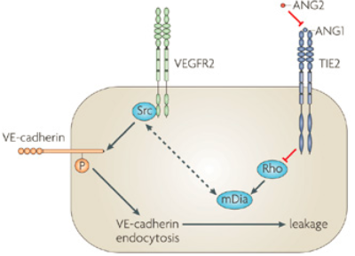
Angiopoietins and Tie
Helmutt, Nature Reviews Molecular Cell Biology 10, 165-177

Slide 6
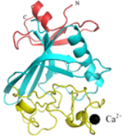
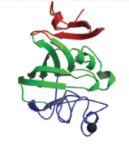
4 angiopoietins
Ang-2
Ang-3 and Ang-4
Ang-1
?
http://www.people.vcu.edu/~wabarton/structures.html
Lungs only?

Slide 7
Ang-3
Ang-4

Slide 8
Ang-3
Ang-4
What is the relative binding of each angiopoietin to Tie-2?

Slide 9
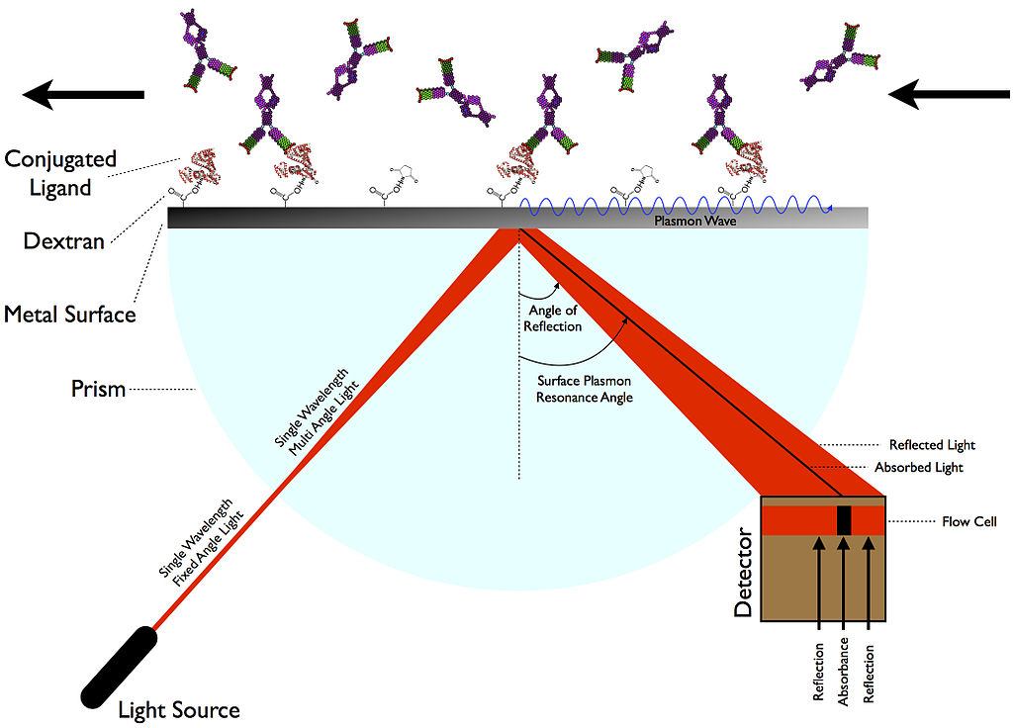
Surface Plasmon Resonance (SPR)
SPR absorption angle depends on metal surface
Metal surface constant: Tie-2
Metal surface variable: Ang-1, Ang-2, Ang-3, Ang-4
etheses.whiterose.ac.uk

Slide 10
SPR Concepts
More binding = more change in SPR absorption angle
Continuous stream of each angiopoietin

Slide 11
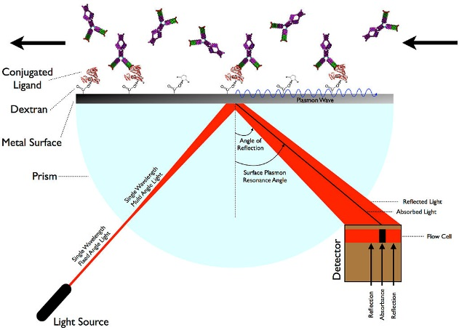
SPR Curves
Himanen (2004), Nature Neuroscience 7: 501-509

Slide 12
Ang-3
Ang-4
What is the relative binding of each angiopoietin to Tie-2?

Slide 13
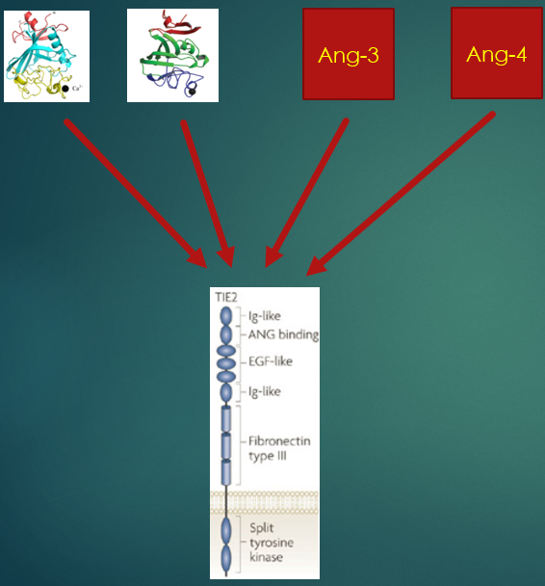
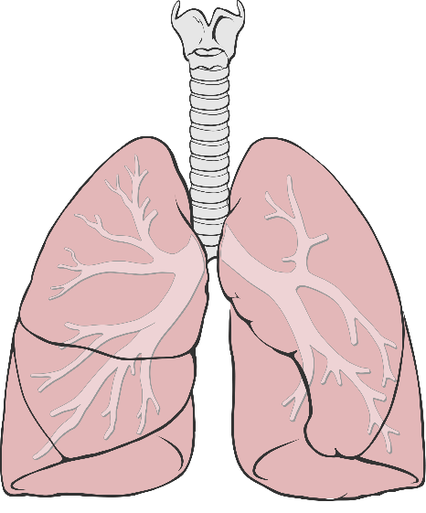
What is the relative binding of each angiopoietin to Tie-2?
What is the cellular effect of Ang-4?
laughingmantis.com
What is the in vivo effect of Ang-4?
Wikimedia

