Slide 1
Investigating the effects of human aldehyde dehydrogenase on vaccinia virus replication in breast cancer stem cells
Mazin Elsarrag
BNFO 300
12/4/2014

Slide 2
Cancer is responsible for nearly 25% of all deaths in the U.S.

Slide 3
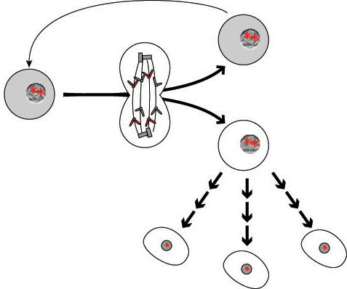
Cancer stem cells give rise to the primary tumor mass
Cancer Stem Cell
DNA mutations
Cancer Progenitor Cell
Cancer Stem Cell

Slide 4
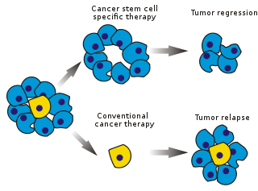
CSCs are highly resistant to current forms of therapy
Drug Resistant
Radiation Resistant
Not removed by surgery
How to remove them?

Slide 5
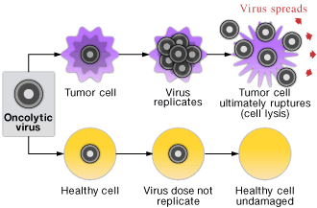
Oncolytic virotherapy is one way to target CSCs

Slide 6
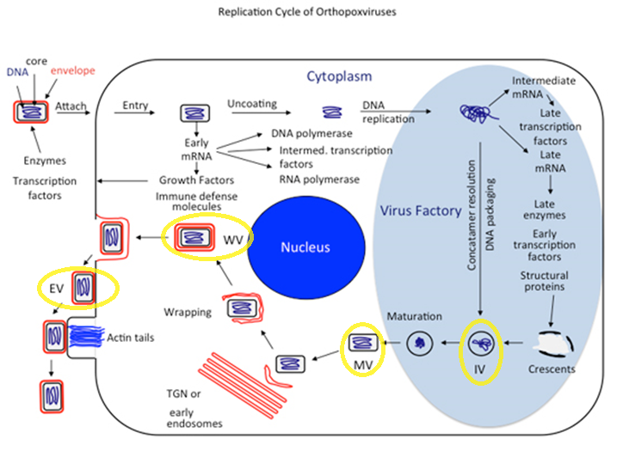
Vaccinia Virus Replication Cycle has 4 stages

Slide 7
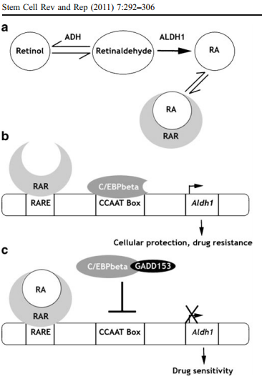
CSCs express Aldehyde Dehydrogenase, which is protective

Slide 8
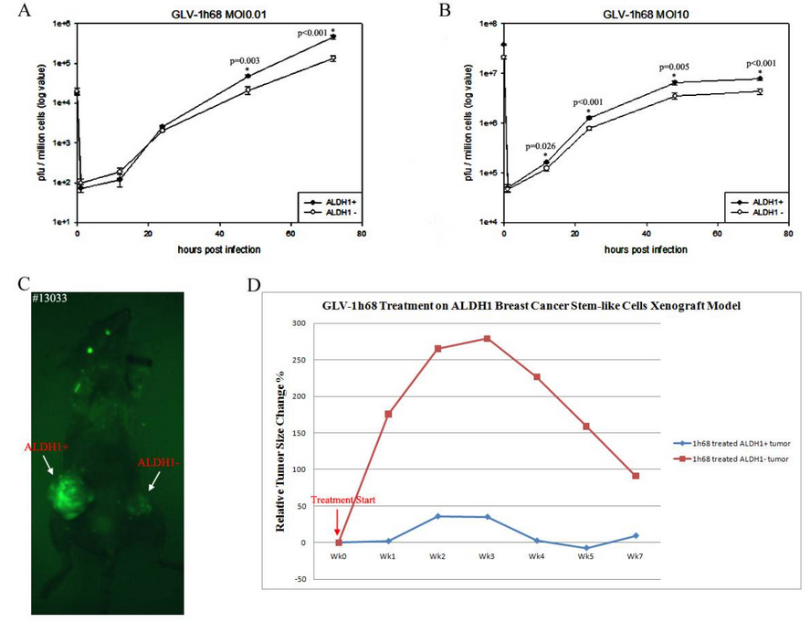
Wang et al showed that Vaccinia virus replicated more efficienty in ALDH+ cells (CSCs)
Why is this the case? How does ALDH influence VACV?

Slide 9
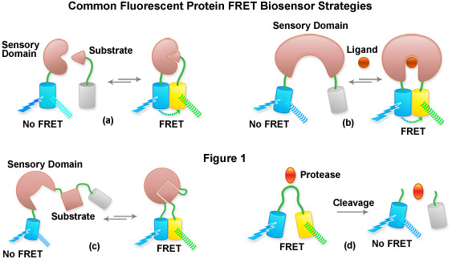
FRET Biosensors to measure the concentration of Retinoic Acid

