Slide 1
Binding affinity between HP1-HOAP interacting protein (HipHop) and telomere maintenance proteins Modigliani & Verrocchio in Drosophila melanogaster through co-immunoprecipitation and Western blot analysis
Jordan Davis bnfo 300

Slide 2
Terminology
HP1-HOAP-interacting protein (HipHop)
Telomere maintenance protein, critical for protection of telomeres and prevention of chromatid fusion
Modigliani (moi)
Is a subunit protein of the terminin complex, but individual role is still unknown
Is exclusively located at the telomeres
Verrocchio (ver)
Is a subunit protein of the terminin complex, but individual role is still unknown
Is exclusively located at the telomeres
Terminin
Protein complex which includes Modigliani, Verrocchio, and HipHop
Potential unknown protein subunits?
Shelterin
Human analog for terminin protein complex
Telomere
DNA nucleotide sequence at each end of chromatid
Telomeres act as caps which protects end of each chromatid from deterioration
Raffa, Grazia D., et al. "Organization and evolution of Drosophila terminin: similarities and differences between Drosophila and human telomeres."Frontiers in oncology 3 (2013).
Raffa, Grazia D., et al. "ORGANIZATION AND MAINTENANCE OF DROSOPHILA TELOMERES: THE ROLES OF TERMININ AND NON-TERMININ PROTEINS." ЦИТОЛОГИЯ 55.3 (2013): 204-208.
Raffa, Grazia D., et al. "Terminin: a protein complex that mediates epigenetic maintenance of Drosophila telomeres." Nucleus 2.5 (2011): 383-391.
Raffa, Grazia D., et al. "Verrocchio, a Drosophila OB fold-containing protein, is a component of the terminin telomere-capping complex." Genes & development24.15 (2010): 1596-1601.

Slide 3
Location: Telomeres
Made of nucleoprotein complexes and are located eukaryotic chromosome ends
Are capped at the end of each chromatid
Used as a buffer to protect DNA sequences
Prevents chromosome end-to-end fusion
Fruit fly telomeres are capped by protein complex terminin
U.S. Department of Energy Human Genome Program. SierraSciSPA
Raffa, Grazia D., et al. "Organization and evolution of Drosophila terminin: similarities and differences between Drosophila and human telomeres."Frontiers in oncology 3 (2013).
Raffa, Grazia D., et al. "ORGANIZATION AND MAINTENANCE OF DROSOPHILA TELOMERES: THE ROLES OF TERMININ AND NON-TERMININ PROTEINS." ЦИТОЛОГИЯ 55.3 (2013): 204-208.

Slide 4
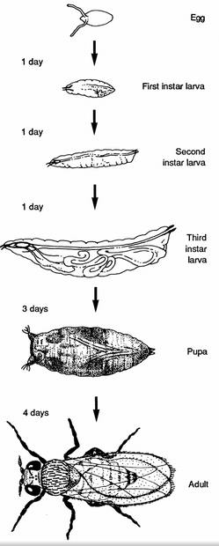
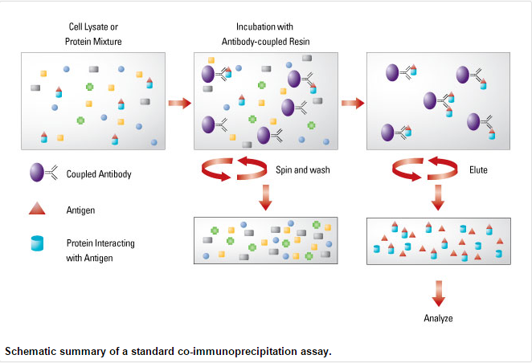
Methodology I: Co-Immunoprecipitation assay
The protein mixture will be obtained from the salivary gland nuclei from drosophila third instar larvae development stage
Retrieve antibody that targets a certain antigen, in this case we will target HP1-HOAP-interacting protein (HipHop)
Antigen (HP1-HOAP (HipHop)) will bind with the coupled antibody
After the spin/wash and elute processes I will analyze the antigens and protein interacting partners to find new components of the terminin complex in a phage display assay
Proteins that should interact with HP1-HOAP protein are
*Verrocchio *Modigliani
*Possible newly found terminin protein subunits yet to be discovered?
www.piercenet.com/method/co-immnoprecipiatation-co-ip
Rubin M. Gerald 1988. Drosophila melanogaster as an Experimental Organism. Science, New Series, Vol. 240. No. 4858 (Jun. 10, 1988), pp. 1453-1459
www.piercenet.com/method/co-immnoprecipiatation-co-ip
Raffa, Grazia D., et al. "Verrocchio, a Drosophila OB fold-containing protein, is a component of the terminin telomere-capping complex." Genes & development24.15 (2010): 1596-1601.

Slide 5
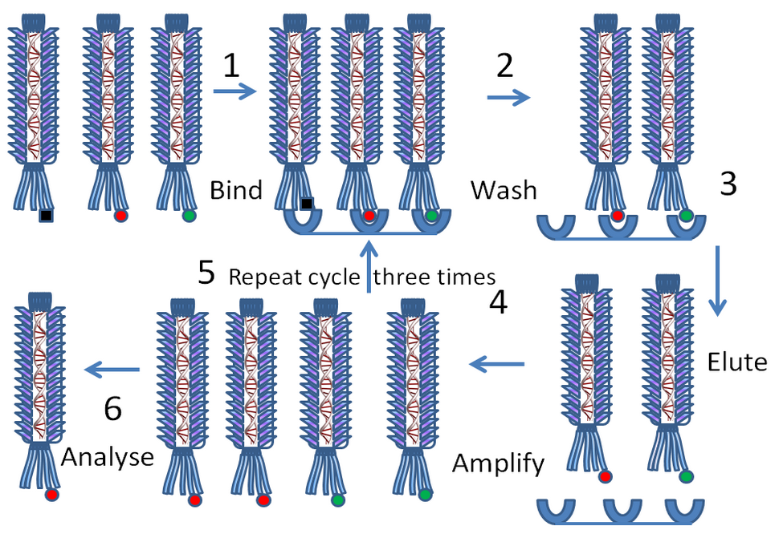
Methodology II: Phage Display assay
After the sample of antigens and interacting proteins are analyzed from the Co-IP sample I will begin the phage display assay.
Phage Display Protocol
Insert HP1-HOAP (HipHop) gene inside a phage coat protein gene
This allows for the phage to display the protein the gene encodes on the outside, while the phage still houses the gene on the inside of the phage
Proteins that are known to bind with HP1-HOAP (HipHop) such as Modigliani and Verrocchio should bind with the desired protein
Unknown proteins that may have been attached with Modigliani and Verrocchio can potentially be subunit proteins of the terminin complex yet to be discovered
After the elute process I will analyze the sample of polypeptides, hopefully finding new polypeptides that may be critical subunits of the terminin complex
Dr. Graham Beards – Own work
Phage display process described further in Wolfe et al. (1999)
Wolfe, Scot A., et al. "Analysis of zinc fingers optimized< i> via</i> phage display: evaluating the utility of a recognition code." Journal of molecular biology 285.5 (1999): 1917-1934.
Raffa, Grazia D., et al. "Terminin: a protein complex that mediates epigenetic maintenance of Drosophila telomeres." Nucleus 2.5 (2011): 383-391.

Slide 6
Expected Outcomes
I would expect to see expression in Modigliani and Verrocchio. These two telomere maintenance proteins are known to be apart of the terminin complex within drosophila.
Measurement: Expression of Modigliani and Verrocchio through a Western blot procedure
Significance: To reassure that the protein sample that was experimented in Co-IP included the only currently discovered proteins in the drosophila terminin complex.
I would also expect to see expression in HipHop through western blot analysis
Significance: Through the Co-Immunoprecipitation and western blot assays I should be reassured that the antigen HipHop and the interacting partners Modigliani and Verrocchio are apart of the protein complex.
The discovery of new protein subunits through the phage display assay that are a part of the terminin complex in drosophila that could very well be extremely critical proteins for telomere protection and maintenance
The cons
The Co-IP method can be used to find specific proteins that are already identified and can shed light on interactions between said proteins within the complex, but it cannot identify new proteins.
This is why I include the phage display assay to present a possibility of discovering new protein subunits involved in the terminin complex
Raffa, Grazia D., et al. "ORGANIZATION AND MAINTENANCE OF DROSOPHILA TELOMERES: THE ROLES OF TERMININ AND NON-TERMININ PROTEINS." ЦИТОЛОГИЯ 55.3 (2013): 204-208.
Raffa, Grazia D., et al. "Terminin: a protein complex that mediates epigenetic maintenance of Drosophila telomeres." Nucleus 2.5 (2011): 383-391.
Raffa, Grazia D., et al. "Verrocchio, a Drosophila OB fold-containing protein, is a component of the terminin telomere-capping complex." Genes & development24.15 (2010): 1596-1601.

Slide 7
Background & Relevance
Drosophila protein complex terminin is an analogue for the telomere protecting protein complex shelterin in humans
Continued analysis of drosophila telomeres opens a gateway for investigations of human telomere biology
Novel components of human telomere protection in shelterin may be discovered by learning interactions between proteins within the terminin complex, the fruit fly analogue for telomere maintenance and protection
Raffa, Grazia D., et al. "Organization and evolution of Drosophila terminin: similarities and differences between Drosophila and human telomeres."Frontiers in oncology 3 (2013).
Muller H. J. (1938). The remaking of chromosomes. Collect. Net 8, 182–195
Gao, Guanjun, et al. "HipHop interacts with HOAP and HP1 to protect Drosophila telomeres in a sequence‐independent manner." The EMBO journal29.4 (2010): 819-829.

Slide 8
References
Biessmann, Harald, Steven B. Carter, and James M. Mason. "Chromosome ends in Drosophila without telomeric DNA sequences." Proceedings of the National Academy of Sciences 87.5 (1990): 1758-1761.
Cenci, Giovanni, et al. "The Drosophila HOAP protein is required for telomere capping." Nature cell biology 5.1 (2002): 82-84.
Frydrychová, Radmila, et al. "Phylogenetic distribution of TTAGG telomeric repeats in insects." Genome 47.1 (2004): 163-178.
Gao, Guanjun, et al. "HipHop interacts with HOAP and HP1 to protect Drosophila telomeres in a sequence‐independent manner." The EMBO journal29.4 (2010): 819-829.
Muller H. J. (1938). The remaking of chromosomes. Collect. Net 8, 182–195
Nielsen, Lena, and J. E. Edström. "Complex telomere-associated repeat units in members of the genus Chironomus evolve from sequences similar to simple telomeric repeats." Molecular and cellular biology 13.3 (1993): 1583-1589.
Raffa, Grazia D., et al. "Organization and evolution of Drosophila terminin: similarities and differences between Drosophila and human telomeres."Frontiers in oncology 3 (2013).
Raffa, Grazia D., et al. "ORGANIZATION AND MAINTENANCE OF DROSOPHILA TELOMERES: THE ROLES OF TERMININ AND NON-TERMININ PROTEINS." ЦИТОЛОГИЯ 55.3 (2013): 204-208.
Raffa, Grazia D., et al. "Terminin: a protein complex that mediates epigenetic maintenance of Drosophila telomeres." Nucleus 2.5 (2011): 383-391.
Raffa, Grazia D., et al. "Verrocchio, a Drosophila OB fold-containing protein, is a component of the terminin telomere-capping complex." Genes & development24.15 (2010): 1596-1601.
Roth, Charles W., et al. "Chromosome end elongation by recombination in the mosquito Anopheles gambiae." Molecular and cellular biology 17.9 (1997): 5176-5183.
Takada, Shinako, et al. "A TRF1: BRF Complex Directs Drosophila RNA Polymerase III Transcription." Cell 101.5 (2000): 459-469.
Wolfe, Scot A., et al. "Analysis of zinc fingers optimized< i> via</i> phage display: evaluating the utility of a recognition code." Journal of molecular biology 285.5 (1999): 1917-1934.

Slide 9
Questions?

